Slide 1
Accessibility in Emerging Industries
Accessibility Partners
CSUN 2014

Slide 2
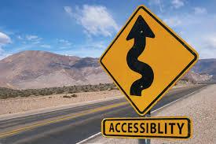
Agenda
How do we construe accessibility now?
Moving beyond accessible IT
New possibilities in new markets
Future legislation
The future of accessibility services

Slide 3
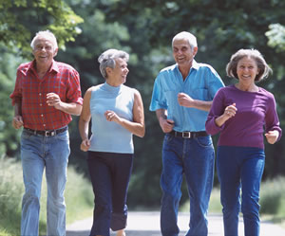
The Numbers
1 in 3 households includes a person with a disability
60 million Americans
76 million baby boomers
$220 billion discretionary income

Slide 4
What does accessibility ‘mean’?
How available a product or device is to as many people as possible
Hard to measure—number cannot be quantified
Must measure comparative benefits:
Product A is more accessible than Product B
Subjective
Focused on people with disabilities and rights of access
Enable use of assistive technology

Slide 5
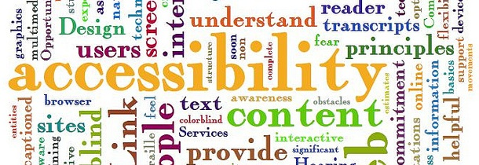
Accessibility as a right
Is accessibility guaranteed?
How do we monitor accessibility
Watchdog agencies like the GSA, DOJ, FCC, etc.
Once accessibility becomes more acknowledged, the possibilities grow
Breaking free of the realm of litigation
Accessibility has potential for innovation, creativity, and inclusivity in all realms.

Slide 6
Breaking out of technology confines
Accessibility transcends technology traditions
Time to insert accessibility in new markets:
Entertainment and travel
Food and beverage
Financial services
Healthcare
Cloud computing
All industries deal with accessibility, whether they realize it or not!

Slide 7
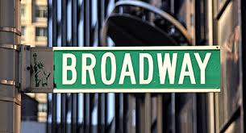
Entertainment: Broadway and Theater
Starting in spring 2014, nine Broadway theaters will become more accessible
Provide 70 wheelchair seats
134 transfer seats
Elimination of 500 accessibility barriers
restrooms, concession counters, waiting areas and box offices

Slide 8
Entertainment: Tickets for Live Events
Missing out on 2.5 million ticket sales per year
Equal to about $110 million in lost revenue
While events are made accessible, tickets sales are not
83% of people with disabilities put off by sites
Some are forced to buy online, with more difficulty

Slide 9
Film Festivals
Local venues eliminate travel
Images, dialogue, and music made more accessible with subtitles
Can be on Internet or have communal experience
Venues meet ADA requirements

Slide 10
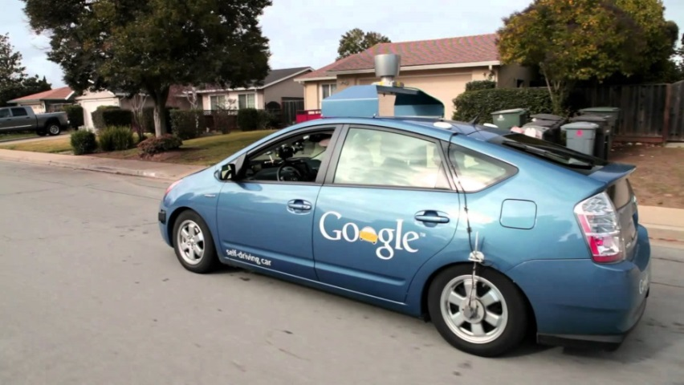
Travel: Self-Driving Cars
New level of freedom with self-driving cars
Extends to those with visual disabilities or inability to obtain a driver’s license
Removes reliance on people and public transportation
Increases ability to travel to work and independence

Slide 11
Food and Beverage: Grocery Delivery
On-demand grocery delivery services are a boon for those with mobility and visual disabilities
Companies like Peapod, Netgrocer and newly Amazon
Eliminates ‘prisoner in own home’ feeling
Increased access to more nutrition with wider selection

Slide 12
Restaurants, Hotels and Mobile Accessibility
Out of ten industries, hotels and B&Bs ranked first for mobile accessibility: 63%
Restaurants have 52% friendly experience
51% of restaurants with iPhone accessibility
Devices change periodically
Lack of web accessibility is a huge mistake

Slide 13
Financial Services: Following India’s Banking Model
Rail accident led to increased banking accessibility for Reserve Bank of India
Toe impressions instead of fingerprints
Banking representatives can visit the customer
Outline procedures for interactions
Guardianship certificates

Slide 14
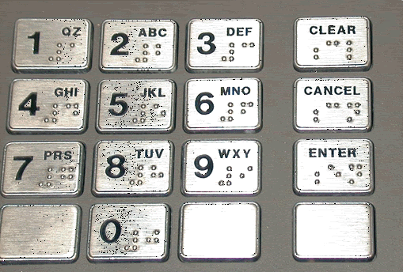
Banking in the United States
Audio input for ATMs with Braille keypads
Options to make deposits
Web apps to track finances
Accessible documents
Dedicated telephone lines
Specialized training for CSRs

Slide 15
Healthcare: the ABLE Act
Cuts to Medicaid, SSI and other federal programs
Families need the ability to save private funds to support health, independence and quality of life
ABLE Act would create tax-advantaged account for disability related expenses
Education, housing, transportation, health-related expenses, AT, and personal support
Up for a vote sometime in 113th Congress

Slide 16
The Convention on the Rights of Persons with Disabilities Treaty
Recognizes rights of people with disabilities by creating legislation to embrace dignity
Based on ADA—increases benefits of those with disabilities in the US and worldwide
Increased travel potential
One billion people worldwide have a disability

Slide 17
CRPD continued
90% of children with a disability worldwide do not attend school
Unemployment and poverty rates are very high
US has not currently signed, but could join 130 other countries to increase accessibility

Slide 18
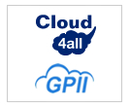
Cloud4All
International project funded by the EU
Objectives:
Simple, instant accessibility for ALL
Anywhere, any device access
Supply and demand better connected
Affordable method to offer diversity needed.

Slide 19
Global Public Inclusive Infrastructure
Those facing accessibility barriers can access the Internet
Disability
Digital Literacy
Aging
Economics
Access to information, communities, and services

Slide 20
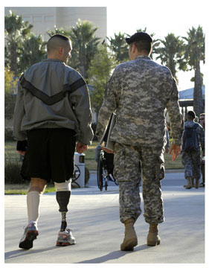
The impetus of accessibility
Increased population of people with disabilities
Aging population
Returning veterans with disabilities

Slide 21
Why accessibility should be considered now!
Helps customers use your services
Regardless of ability or disability
Promotes diversity of customer pace
Competitive differentiator
Better user experience:
Reach mission critical goals
Customers utilize services better

Slide 22
Thank You!
Contact Information:
Dana Marlowe
Accessibility Partners
www.AccessibilityPartners.com
Info@AccessibilityPartners.com 301-717-7177

Slide 23
References
Census Information: http://www.census.gov/people/disability/
ADA: Americans with Disabilities Act
IDEA: Individuals with Disabilities Education Act
CVAA: The 21st Century Communications and Video Accessibility Act
Attitude is Everything Report: http://www.attitudeiseverything.org.uk/news/music-industry-missing-out-on-66m-a-year-through-inaccessible-ticketing
Banking in India: http://m.economictimes.com/news/news-by-industry/banking/finance/banking/banking-guidelines-in-place-to-help-differently-abled-individuals/articleshow/29174125.cms
The ABLE Act: http://www.ndss.org/Advocacy/Legislative-Agenda/Creating-an-Economic-Future-for-Individuals-with-Down-Syndrome/Achieving-a-Better-of-Life-Experience-ABLE-Act/
CRPD: http://www.usicd.org/template/index.cfm
Cloud Computing: http://www.cnbc.com/id/43483060
Safeway: http://lflegal.com/2014/02/safeway-accessibility/
Mobile Accessibility in Hotels and Restaurants: http://www.gaebler.com/News/Small-Business-Marketing/Hotels-and-Restaurants-Lead-Other-Small-Businesses-in-Mobile-Accessibility-900000562.htm
Film Festival Accessibility: http://hellonfriscobay.blogspot.com/2014/03/adam-hartzell-on-caam-fest-and.html

