Slide 1

Keeping Our Head in the Clouds: Assistive Technology’s Future
March 21, 2014
Accessibility Partners

Slide 2

Agenda
Modern cloud computing vs. earlier
Current status of assistive technology
The role of AT in the cloud
Benefits
Where to go from here

Slide 3
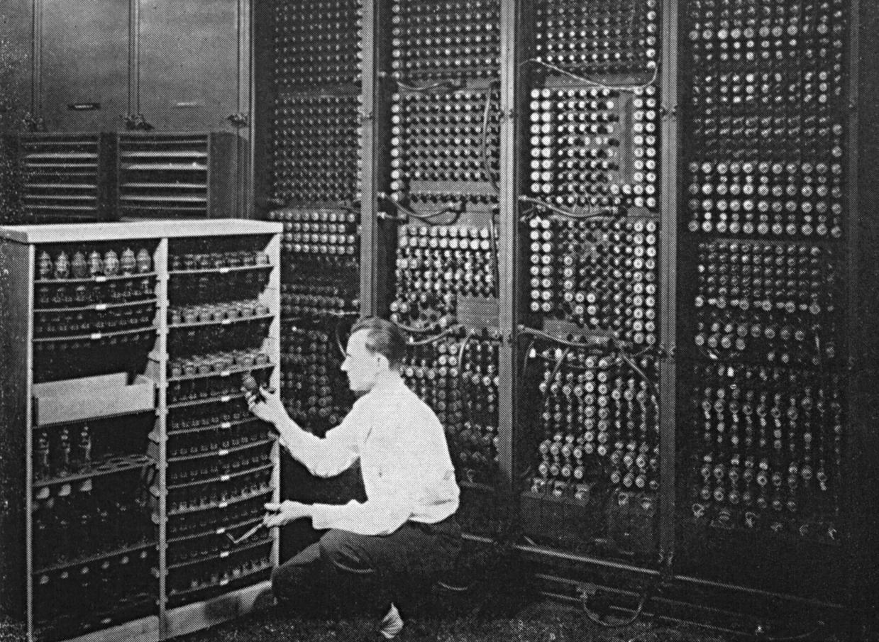
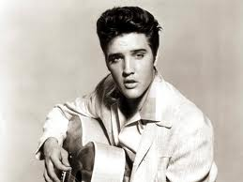
Cloud Computing: Then
Dates back to the 1950s
Large-scale mainframes for government and corporations
Installed in server rooms and accessed by terminals

Slide 4
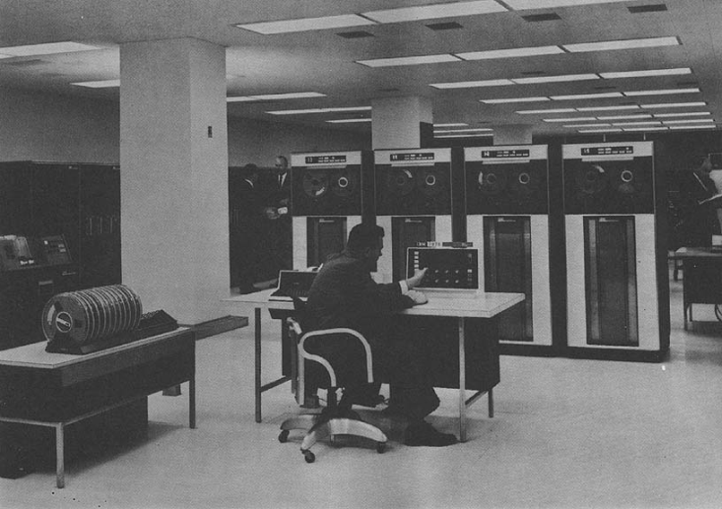
Mainframes
Mainframes were expensive to buy and maintain
Practical for multiple users to share access to same data and CPU from any station
IBM’s 7070 Data Processing System

Slide 5
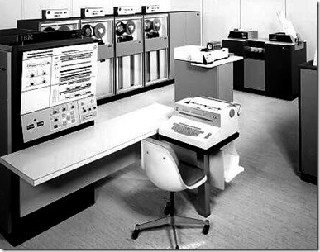
VMs and the 1970s
Virtual machines allowed admins to have multiple systems on a single node
Allowed multiple CPUs in the same environment

Slide 6

More about the VMs
Each VM can run a custom OS, have own memory, CPU and hard drive, etc.
Reiterates resource sharing concept
Virtualization became a technology driver

Slide 7
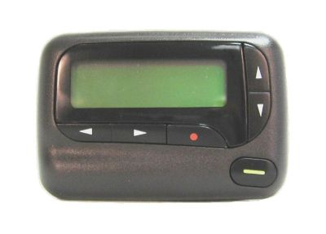
Servers in the 1990s
New virtualized private networks
Reduced costs—shared access over same physical infrastructure
Traffic could be shifted for better network balance and bandwidth control
Moving towards the future: taking virtualization online!

Slide 8
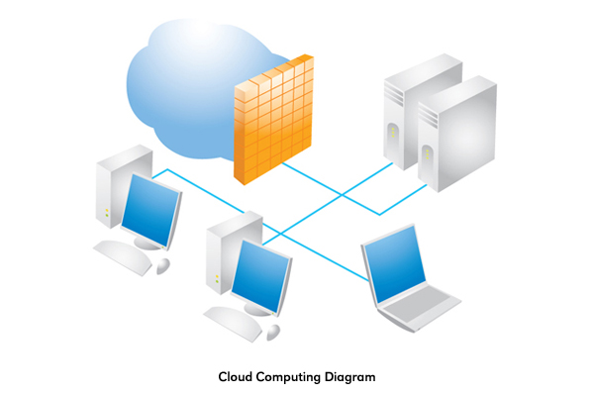
2000 to Now: The Modern Cloud
Users without servers can order ‘cloud computing instances’ or ‘cloud servers’
Taking a share of the pie:
Only ordering what you need from a large available pile of resources
Little overhead, easier management

Slide 9

Important Key Themes
Sharing Resources
Customization
Computing Power
Balance and Bandwidth
Virtualization

Slide 10
People with Disabilities in the Workforce
ODEP Data as of February 2014:
19.1% of PWD are in the workforce
68.5% without disabilities
Most of these jobs use or could use cloud computing as a benefit
How do we fit in assistive technology?

Slide 11
What Opportunities Exist?
Access opens doors
Increased independence in unique settings
Personal experiences are enhanced
Equality is promoted
Improved communication and skills
Increased mobility and movement
Leads to improved quality of life for all

Slide 12
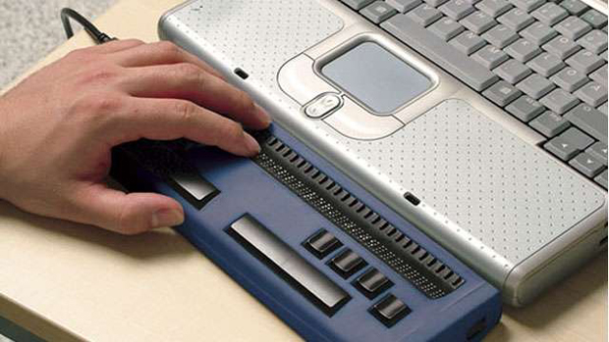
Assistive Technology Today
Screen readers
Magnifiers and Color Contrast
Speech recognition
Refreshable Braille Displays
Alternative input devices
Augmented devices

Slide 13
New Demographics
Baby boomer population growing tremendously
Enthusiastic computer users
Developing disabilities as they age
Looking for technology to facilitate their vision, dexterity, or hearing disabilities
Large print, high contrast, easy-to-activate buttons, higher volume, concise interfaces

Slide 14

Bridging the Gap
We propose a reality where a user can access their accessibility settings and assistive technology from anywhere!

Slide 15
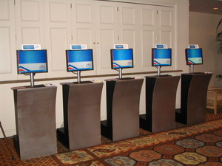
Where can this be used?
Work
Travel kiosks
Shopping portals
ATMs
Museum guides
ANYWHERE!

Slide 16
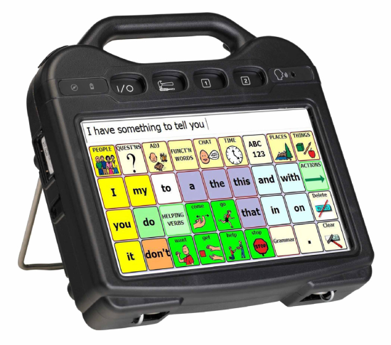
The Role of AT in the cloud
Traditional alternative/augmentation (AAC) devices have been pricey
Now, smartphones and tablets allow for easier and cheaper development
Barriers for reaching PWD today are financial—unless we move to the cloud

Slide 17
Benefits for Home and Work
An office purchases a screen reader, and now a user can access it at home computer
Extra benefit—can be accessed from a friend or family’s computer
Or, if you don’t own a computer, it is preloaded on others

Slide 18

User Recognition
A personalized identity
Secure way to access features
USB
Card swipe
PIN number
Cell phone

Slide 19

Unsure? Use preloaded features!
Variety of standard set-ups to use anonymous
Can access these settings from anywhere
No need for self-identification
Can be anonymous or masked

Slide 20
Cloud Desktops
Goes back to virtualization:
Accessed without barriers of time or location
Connect a business desktop to personal device
Home PC
Smart phone
tablet
Only requirement is an Internet connection
Less ‘complex’ devices connected to software that connects them to cloud servers

Slide 21

Screen Readers in the Cloud
Screen readers are desktop-specific
Requires configuration on local system and the cloud
Administrator on both ends needs to:
Configure and maintain desktop images
Done in advance to be accessible

Slide 22
Setting up a Screen Reader
A screen reader must be installed on:
User’s local system
Cloud desktop
Authentication taken from local
Number of licenses=number of users
Text is sent from cloud desktop, and is read by local system
Text is sent, not audio—improves transfer

Slide 23

Benefits of Cloud Desktops
Reduce time to provision new desktops
Decrease management and support costs
Better than before: only one release as opposed to multiples in the past
Less reconfigurations=resources saved!

Slide 24
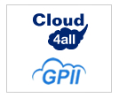
Cloud4All
International project funded by the EU
Objectives:
Simple, instant accessibility for ALL
Anywhere, any device access
Supply and demand better connected
Affordable method to offer diversity needed.

Slide 25

Global Public Inclusive Infrastructure
Those facing accessibility barriers can access the Internet
Disability
Digital Literacy
Aging
Economics
Access to information, communities, and services

Slide 26
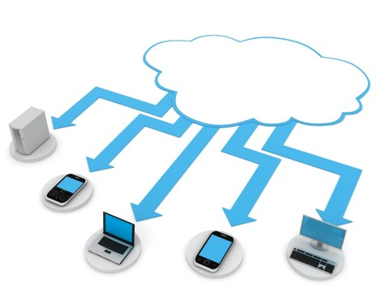
Keeping it on the Cloud
More users can benefit
Simpler, unified interface
More inclusive
Available and accessible from everywhere
More affordable:
Individual users
Businesses
Public areas

Slide 27

Hit the ground running—NOW!
Broadband access is growing
Must ensure that access includes everyone
Avoid barriers
Don’t just connect people, but make sure they can use it!

Slide 28
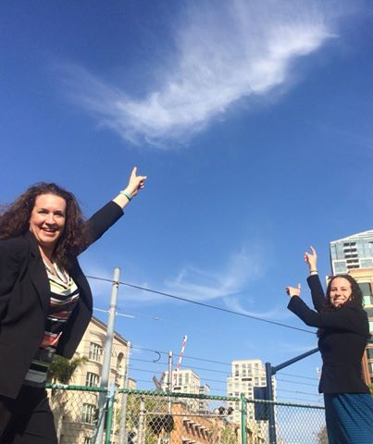
Contact Information
Dana Marlowe Accessibility Partners DMarlowe@AccessibilityPartners.com
301-717-7177 www.AccessibilityPartners.com Thank You!

Slide 29
References:
ENIAC: http://www.seas.upenn.edu/about-seas/eniac/
IBM Mainframes and VMs: http://www-03.ibm.com/ibm/history/exhibits/mainframe/mainframe_intro.html
Salesforce History http://www.salesforce.com/company/#1999
ODEP: http://www.dol.gov/odep/
2010 Census: People with Disabilities: http://www.census.gov/prod/2012pubs/p70-131.pdf
Introduction to AAC: http://www.asha.org/NJC/faqs-aac-basics.htm
Cloud Desktop Accessibility: http://www-03.ibm.com/able/news/cloud_desktop_a11y.html
Cloud4all: http://cloud4all.info/
GPII: http://gpii.net/

