Slide 1
Giving a Picture 1000 Words: Accessibility for Patients with Disabilities in the World of Graphic Medicine
Dana Marlowe
Accessibility Partners

Slide 2
Overview
What is a disability?
Types and prevalence of disabilities
Accessibility and disability
The importance of alternative text
Comics and alt text
Creating meaningful text

Slide 3
What is a Disability?
Americans with Disabilities Act (ADA):
a physical or mental impairment that substantially limits one or more major life activities.

Slide 4
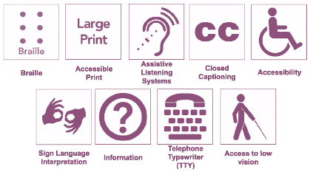
Types of Disabilities
Blindness and Low Vision
Deafness and Hearing Loss
Limited Movement
Speech Disabilities
Cognitive Limitations
Combinations of the above

Slide 5
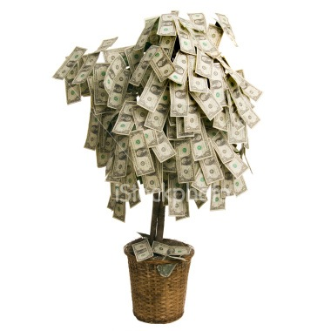
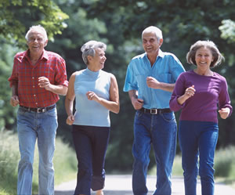
The Numbers
1 in 3 households contain a person with a disability
60 million Americans
76 million baby boomers
$220 billion discretionary income

Slide 6
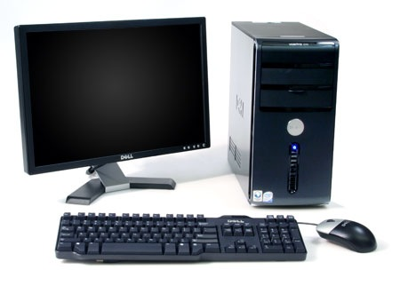
What is Accessibility?
Accessibility means equal access
Technology must be designed and developed to provide equal access and usability to every member of your target audience

Slide 7
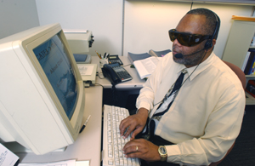
Assistive Technology (AT) & Screen Readers
Assistive technology, like screen readers
“Text to Speech” software application that reads from screen out loud
Other outputs include sound icons or Braille
Often combined with screen magnifiers
How do you ‘read’ an image?

Slide 8
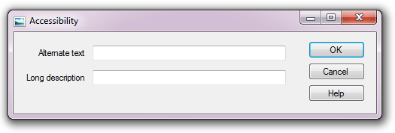
Pairing Accessibility with Alt Text
Make images understandable
Images cannot be seen by users with visual disabilities
More than just a description: textual substitution
Understand content and meaning

Slide 9
Let’s get writing!
Finding a balance between too much and too little
How is image used?
to convey important content
to provide visual enhancements which offer no real content
to link to other areas
Alternate text communicates the purpose of the graphic, not its appearance.

Slide 10
Other tips
Write in a separate document:
Dialogue boxes are small
No editing tools
Spell words out
Acronyms and abbreviations
Provide extra clarification
Spell check
Double check

Slide 11
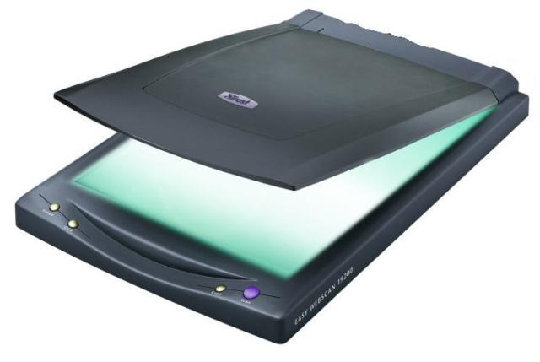
Scanning Content
Many artists and illustrators scan their own content in from handmade designs
Either scan to PDF or save as an image
Consider OCR for text
Optical Character Recognition
Makes text selectable and searchable
Repair any problems during conversion

Slide 12
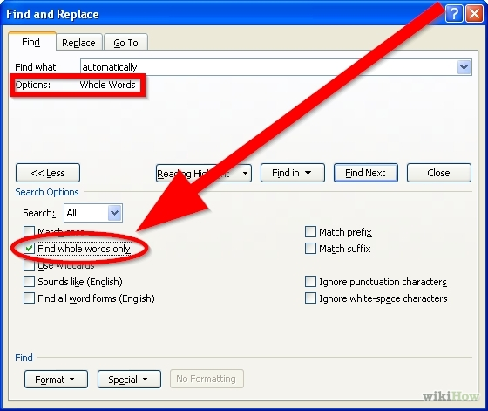
Comics and Alternative Text
Full textual description:
Name characters, locations, actions
Repeats dialogue and narratives
Benefits of searchable text
Locate desired sequences in larger comics
Change browsing from images to text
Textual archiving

Slide 13
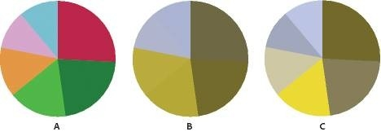
Adobe Photoshop and Accessibility
Creation of accessible web content
Proof images with Color Universal Design (CUD)
Ensure graphical information is conveyed to people with visual disabilities
Color blindness filters: CUD simulates user experience
Alternative text descriptions for images slides
Object > Slice > Slice Options from the Illustrator menu to access the Slice Options dialog box.

Slide 14
Adobe InDesign and Accessibility
Content editors can map common styles
Mark up to create accessible tags
Tags are read by assistive technology
Styles dictate headings, paragraphs, tables, etc.
Map paragraph and character styles
“Articles” panel allows author to choose and organize content by dragging
XML and Digital Talking Book

Slide 15
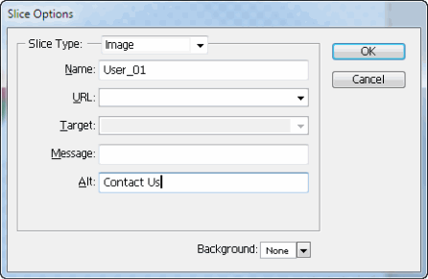
Adobe Illustrator and Accessibility
Web graphics productions tool
Allows developers to insert alternative text
“Slice Options” panel can add for each individual image slice
Similar methodology to Adobe Photoshop

Slide 16
HTML Comics and Alt Text
HTML allows for alt text
Useful when images are saved as JPEGs or TIFF and uploaded at a later date
Descriptive ALT attribute for an image:
<img src=”status_ok.gif” ALT=“Descriptive Text”/>
Example of a decorative and/or formatting image with a null ALT attribute assigned:
<img src=“blank.gif” ALT=“” />

Slide 17
What if my picture has words in it?
A screen reader will not read labels
Built-in captions are not enough
Once saved as an image, text is not readable
Scanning and OCR

Slide 18
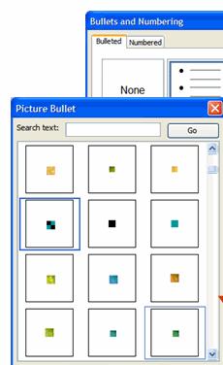
Decorative Images
Leave it blank!
Spacers, formatting, bullets, etc.
Any repeated logo or image
Notes:
For decorative images, leave it blank. But that doesn’t mean ignore it
Most sites contain a large number of images which are there for purely decorative purposes: things like spacer gifs, images forming the corner of a pretty drop shadow effect, floral patterns attached to item headers. All of these should have their alt attributes left empty. They add no extra information to the content, so as far as a screen reader or text browser is concerned they do not exist.
Additionally, if you have repeating image, such as a logo, as a watermark or footer, you don’t need to provide alternative text. Just tag it once at the beginning, and unless it is crucial to have it said again, it is not necessary to keep tagging it.
Often, a screen reader will just say ‘image’ if there is no alt text. You still need to create text, but use two quotation marks. A screen reader recognizes this as a null tag, and nothing is read. The background image is just ‘read over’

Slide 19
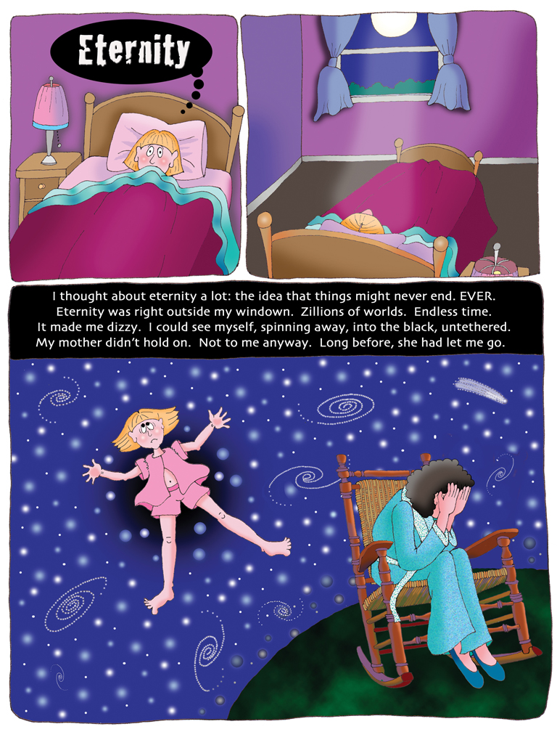
Example:
Thanks to Peaco Todd, from her memoir-in-progress

Slide 20
Accessibility Partners
Questions? Please reach out! Dana Marlowe, Principal Partner
Web: www.AccessibilityPartners.com
E-Mail: DMarlowe@AccessibilityPartners.com
Telephone: (301) 717-7177
@Access_Partners
www.facebook.com/pages/Accessibility-Partners/119858144727286

