Slide 1
Accessibility in Emerging Industries
Accessibility Partners
CSUN 2015

Slide 2
Overview of Industries
Disability Stats
Media & Leisure
The BBC
Major League Baseball
Video Games: AbleGamers
Museums
Pharmacies
Financial

Slide 3
The Numbers
1 in 3 households includes a person with a disability
60 million Americans
76 million baby boomers
$220 billion discretionary income

Slide 4
Media: The BBC

Slide 5
The Media and Accessibility
BBC: British Broadcasting Corporation
The British Broadcasting Corporation is a UK-based international public-service broadcaster headquartered in London
Seriously committed to accessibility

Slide 6
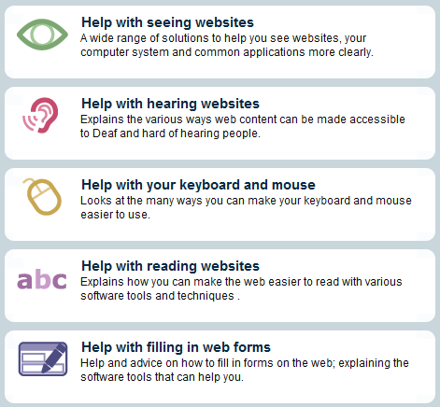
BBC
My Web My Way: www.bbc.co.uk/mywebmyway
Disability on BBC Online
Audio Described Programs
Sign Language Programs
Subtitles
Transcripts
Tools to make web content accessible
iPlayer with captions

Slide 7
My Web My Way
Provides advice and help on accessibility features and assistive technologies
Already existing on your computer
Enablers user to view BBC online and web content in a more accessible way

Slide 8
How-To Guides
‘How To’ Guides
Based on disability
Guides and fact sheets

Slide 9
BBC Web Accessibility Standards
BBC HMTL Accessibility Standards
BBC Mobile Accessibility Standards and Guidelines
Cover technical aspects of accessibility
Some user experience guidelines
Best practices recommended for development
Guidance and techniques
www.bbc.co.uk/guidelines/futuremedia/accessibility/

Slide 10
Actors/Actresses with Disabilities
BBC’s plan to change disability representation
Quadrupling on-screen representation
Disability Executive to champion talent and staff
Develop existing plans to recruit and retain
Open up new opportunities

Slide 11
Major League Baseball & Accessibility

Slide 12
Play Ball! MLB and Accessibility
Using WCAG for MLB.com and Club sites
Accessible media center for Gameday
Increased efforts for Gameday Audio and MLB.TV
Working with assistive technology
Dedicated customer service:
Access@website.mlb.com
Dedicated captions portal

Slide 13
Other online initiatives
Dedicated FAQ for issues pertaining to:
Assistive technology
Keyboard shortcuts
Screen magnification
Types of broadband
Purchasing tickets
Closed captioning

Slide 14
Digital Signage at Parks
Mets and Cubs have new sign
Up to 65% larger than previous
Better for low vision
Superior brightness to combat sunlight
Enhance quality and accessibility

Slide 15
Video Games and Accessibility

Slide 16
AbleGamers
Non-profit charity to improve quality of life of those with disabilities through video games
Special power of gaming
Experience situations that are difficult or limited in the world
Provide social networking opportunities
Participate in the world’s largest past time

Slide 17
The AbleGamers Approach
Outreach:
Community portal of gamers with disabilities
200 mainstream titles
Consultation
Consultation for developers to make games accessible
Updated set of guidelines: Includification
Grants
Grants to gaming community of assistive technology

Slide 18
Who Can Benefit?
Caregivers
Creating set-ups for users with disabilities
Developers
Includification
Mobility, hearing, vision, cognitive
Gamer
Unstoppable Gamer website
Resource for gamers with disabilities

Slide 19
Developers
Includification
www.Includification.com
Suggestions for a variety of disabilities
Alternative configurations for input
Changing audio and adding captions
Altering noise levels
Toggling with color controls
Fonts and color-blind versions

Slide 20
Museums and Accessibility

Slide 21
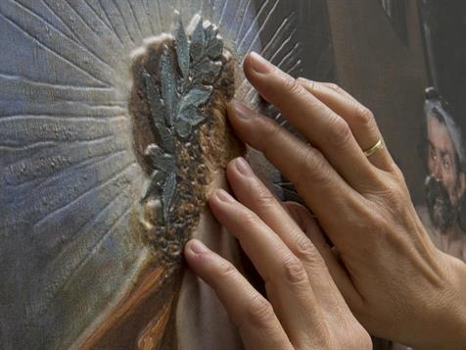
Museums and Accessibility
Touchable masterpieces
Museo del Prado
Graphic arts enables flat images to have relief and texture

Slide 22
Museums and Accessibility
Process gives images a 3D quality
The painting is reproduced in relief: can be explored by touch
Users listen to an audio guide in Basque, Spanish or English
Developed to direct their “touch interpretation” of the painting.
Masks are provided so anyone interested can experience

Slide 23
More Museum Accessibility
Metropolitan Museum of Art
Dedicated access coordinators
High consideration of accommodations for:
Visitors with hearing loss
Blind or have Low Vision
Dementia and their caretakers
Deaf
Developmental Disabilities or Learning Disabilities

Slide 24
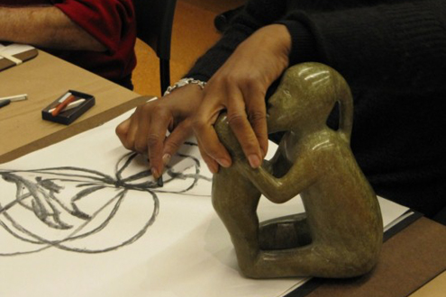
Museum Programming
Visitors with Hearing Disabilities
Assistive listening
Audio Guides
Real-time captioning
Sign language
Blind or Low Vision
Touch Collection
Tactile Experiences
Guided Tours

Slide 25
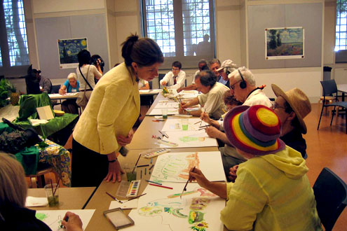
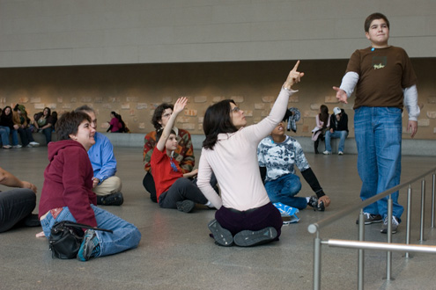
Museum Programming
Developmental and Cognitive Disabilities
Museum Discoveries Programs
Multi-sensory workshops
Tactile opportunities, and art making
Dementia and their caretakers
“Met Escapes”: art handling, art making
Sites and Scents at the Cloisters
Recommended itineraries

Slide 26
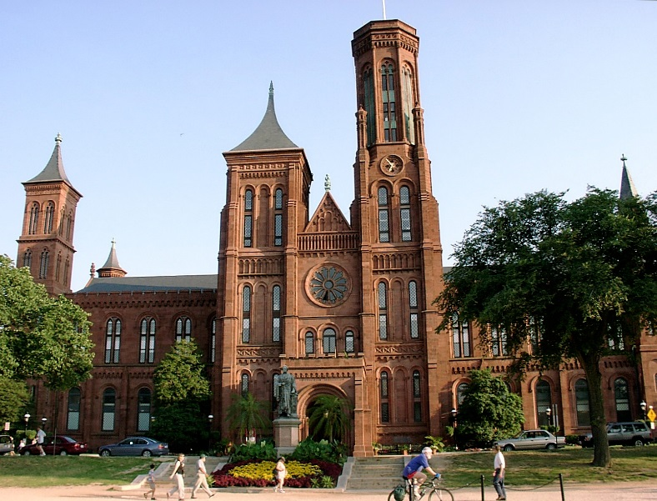
The Smithsonian
Accessible facilities
Free wheelchair loans
Open captioning
Audio description
Tactile elements and tours
Sign language interpretation
IMAX movies with audio accessibility
Publications and brochures in other formats

Slide 27
Pharmacies and Accessibility

Slide 28
Pharmacies and Accessibility
Pharmaceutical industry is covered by ADA
Responsibility to add information in a variety of formats
Effective communications mandate
Providing content in methods that are understandable and useable
Goal is to provide effective and accurate information
People to receive health and preventative care that is equally effective as other people

Slide 29
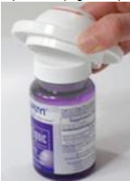
Solutions for People with Disabilities
For physical and limited mobility disabilities:
Easier open lids
One-dose pill dispenser
Pill cutters
Grip openers
Premeasured liquid dosages

Slide 30
Solutions for People with Disabilities
Vision loss can be a safety issue
Some find success with having others provide, but others don’t like that option
American Society of Consultant Pharmacists Foundation and the AFB developed guidelines
Medical information accessible for patients with vision loss
Using large, bold, and sans-serif fonts
Using upper and lower case, not ALL CAPS
Tactile labels (Braille)

Slide 31
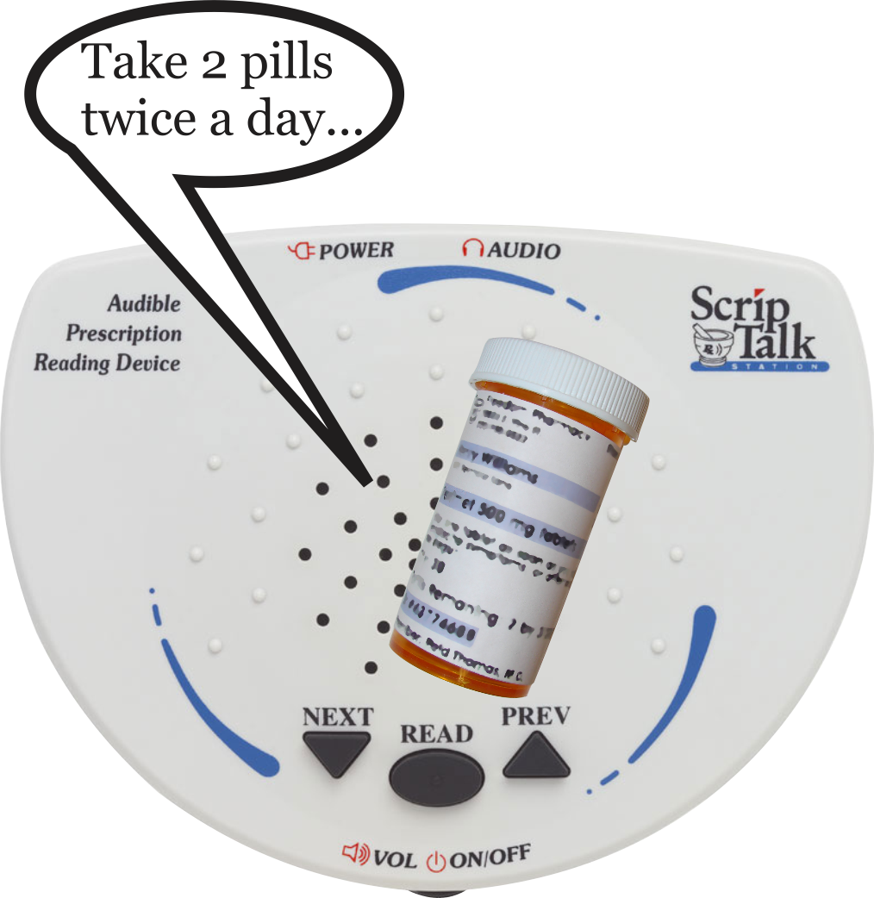
Audible Labels
Option to have label text spoken
Reads drug name, dosage information, and more
Items like ScripTalk use RFID and text-to-speech technology
Meets privacy and safety requirements

Slide 32
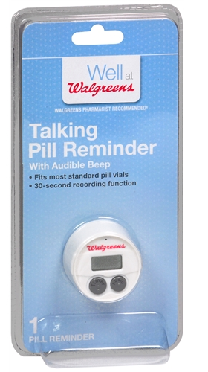
Walgreens
Talking Pill Reminder
Offering from Walgreens
Provided at all chains nationwide
Free to customers that are blind or have visual disabilities
Record information
Audible alarm

Slide 33
CVS and Walgreens: Champions at Hiring Employees with Disabilities
Models of Employment
Have workplace programs
CVS Caremark
Walgreens Disability Inclusion

Slide 34
Finance and Accessibility

Slide 35
New Innovations in Finance
“Pay Your Way”—UK invention
Previous versions were less accessible:
Using chips and PIN
Safety risk in having another person have access to your account
Pay Your Way provides safety information when someone does banking on your behalf

Slide 36
Pay Your Way
New tips for banking done on Internet and mobile apps
Can create ‘one-time only’ PIN
Also the option to use prepaid cards
Third party mandates
Who has access and what they are able to do

Slide 37
Accessibility in Mobile Banking Apps
Leaves room for debate: are mobile apps and online banking ‘public accommodations’?
WCAG 2.0 addresses banking and financial institution suggestions:
Voice-activated banking commands
Apps that leverage cameras for deposits
Easier card deactivation
Increased accessibility will increase the app functionality

Slide 38
Breaking out of technology confines
Accessibility transcends technology traditions
Time to insert accessibility in new markets:
All industries deal with accessibility, whether they realize it or not!

Slide 39
Why accessibility should be considered now!
Helps customers use your services
Regardless of ability or disability
Promotes diversity of customer pace
Competitive differentiator
Better user experience:
Reach mission critical goals
Customers utilize services better

Slide 40
Thank You!
Contact Information:
Dana Marlowe
Accessibility Partners
www.AccessibilityPartners.com
Info@AccessibilityPartners.com 301-717-7177

Slide 41
References
BBC/News and Media
http://www.bbc.co.uk/accessibility/
http://www.bbc.co.uk/accessibility/best_practice/about.shtml
http://www.bbc.co.uk/accessibility/best_practice/standards.shtml
http://www.bbc.com/news/blogs-ouch-31161511
http://www.today.com/style/first-model-down-syndrome-walk-runway-new-york-city-fashion-2D80489188

Slide 42
References
MLB and Accessibility
http://mlb.mlb.com/mlb/help/accessibility.jsp
FAQs: http://mlb.mlb.com/mlb/help/faq_accessibility.jsp
http://www.daktronics.com/news/Pages/Chicago-Cubs-Partner-With-Daktronics-for-LED-Video-Displays-at-Wrigley.aspx
AbleGamers
http://www.ablegamers.com/
http://www.includification.com/
http://www.unstoppablegamer.com/

Slide 43
References
Museums
http://usa.news.net/article/2902479/art-exhibition-for-blind-people-opens-in-madrid
http://www.metmuseum.org/events/programs/programs-for-visitors-with-disabilities
http://www.si.edu/Visit/VisitorsWithDisabilities
Accessibility and Disability Numbers
http://www.census.gov/people/disability/
http://www.ada.gov/busstat.htm

Slide 44
References
Pharmacy:
http://www.afb.org/info/programs-and-services/public-policy-center/guidelines-for-prescription-labeling/125
http://www.hfcdhp.org/wp-content/uploads/Communicating_Deaf_Patients.pdf
http://www.envisionamerica.com/products/scripability/scriptalk/scriptalk-station-for-patients/
http://www.dol.gov/odep/alliances/cvs.htm
http://www.walgreens.com/topic/sr/disability_inclusion_home.jsp

Slide 45
References
Banking and Finance:
http://www.bbc.com/news/blogs-ouch-31108792
http://www.bairdholm.com/publications-feed/entry/accessibility-in-mobile-banking-apps.html
http://blog.barrierbreak.com/online-banking-and-accessibility-wcag-a-legal-issue/

