Slide 1
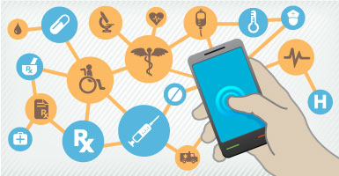
Personal and Productive Accessible Healthcare IT: An Individualized Approach for the Workplace
Dana Marlowe, Accessibility Partners March 24, 2016 CSUN Conference

Slide 2
From an apple a day…

Slide 3
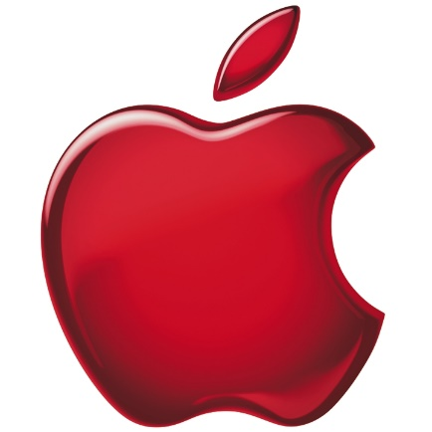
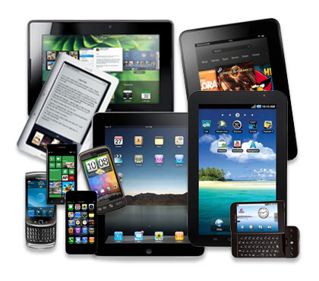
..to an Apple, Android, Windows Phone, Fitbit or any device to keep the doctor wherever and whenever!

Slide 4
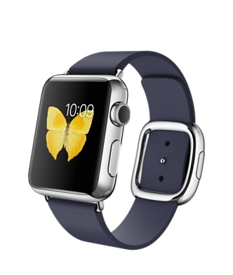
Agenda
Health Information Technology (HIT)
Intersection with accessibility and disability
Health wearables and apps
Workplace incentives: positive or negative?
Introduction to mindful technology
Questions and Answers

Slide 5
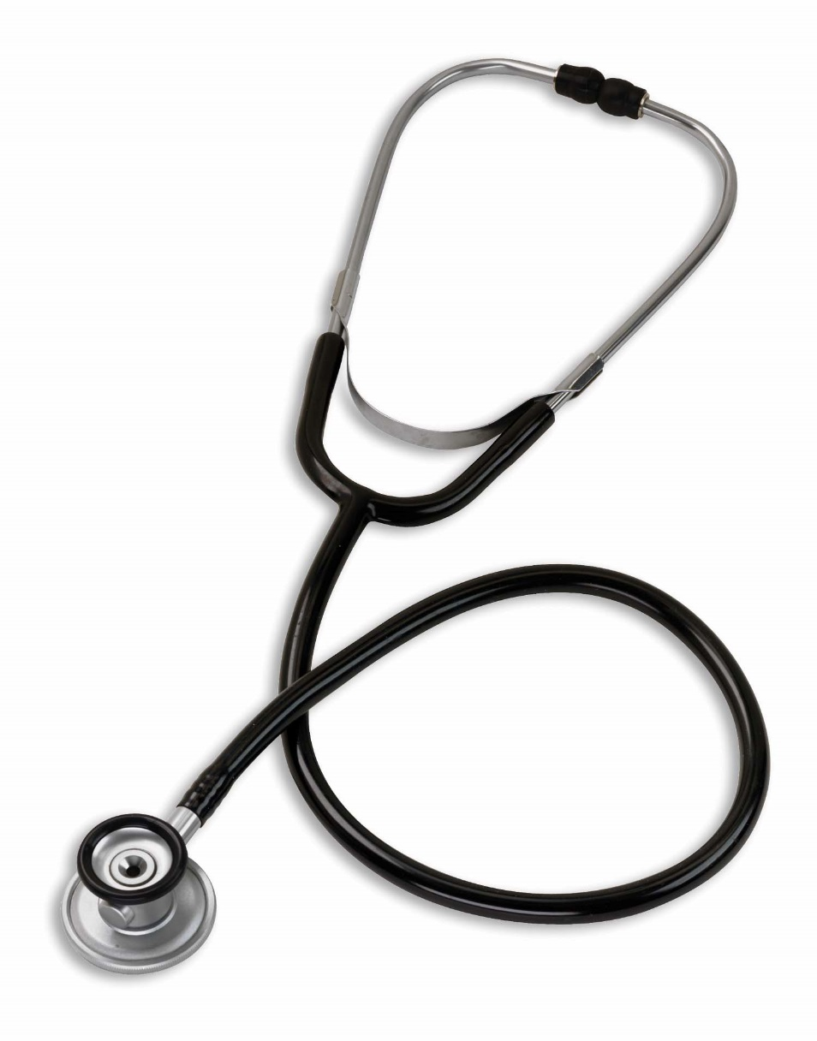
Health Information Technology
Get ready for acronyms:
Healthcare Information Technology (HIT)
Electronic Health Record (EHR)
Electronic Medical Record (EMR)

Slide 6
Mission and Vision
Vision: “Health IT is accessible when and where it is needed to improve and protect people’s health and well being.”
From the Federal Health IT Strategic Plan 2015-2020. http://healthit.gov

Slide 7
Accessible Health Information Technology
AHIT:
“To advance the priority of accessibility in HIT systems and tools from a compliance-­oriented approach toward one that is user-‐driven, responsive to human-­centered consumer experiences, and results in increased patient engagement and improved health and wellness for individual disabilities, older adults, and caregivers”.
Interagency Committee on Disability Research

Slide 8
Making it Accessible: W3C
Accessibility & usability linked; both essential
Is the content on web sites accessible?
Is the user interface accessible?
Do all the browsers support accessibility, and work well with assistive technology?
Are accessibility features integrated into mobile?
Are the tools for creating content accessible, and do they support production of accessible content?

Slide 9
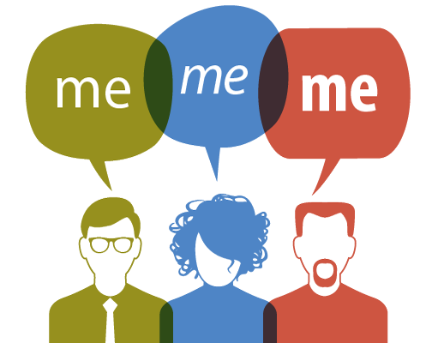
Making IT personal
Individuals
Mobile apps
Website
Monitor your health
Input information
Insurance
Success is best when user-driven!

Slide 10
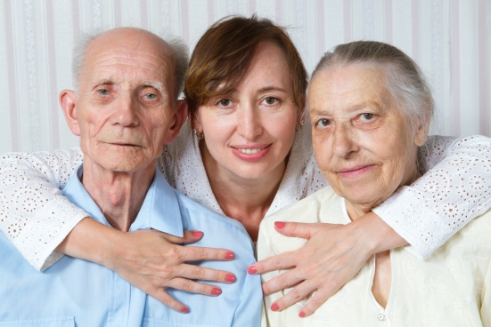
A Community of Users
“There is a complex array of healthcare, social services, insurance and legal information that we have to assimilate in order to support our loved ones”.
Mary Anne Sterling: Connected Health Resources

Slide 11
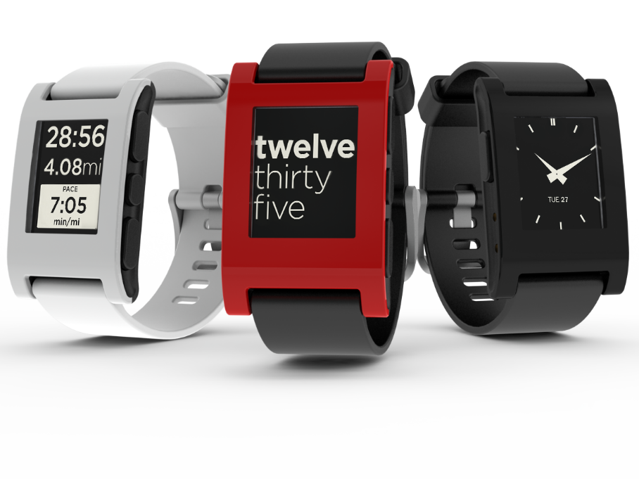
Wearables
Incorporated into cloth and accessories
Sophisticated and agile: feedback
Communications capabilities

Slide 12
Beyond Our Bodies
We wear the hardware
Smaller and cheaper
Synced to mobile devices or computers
View and analyze more data
Stored on the cloud

Slide 13
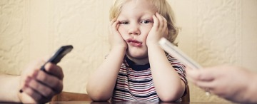
Wearable and Mobile Apps
Integration with handhelds: common occurrence
Difference in form/function
Massive productivity and information potential

Slide 14
Where are wearables?

Slide 15
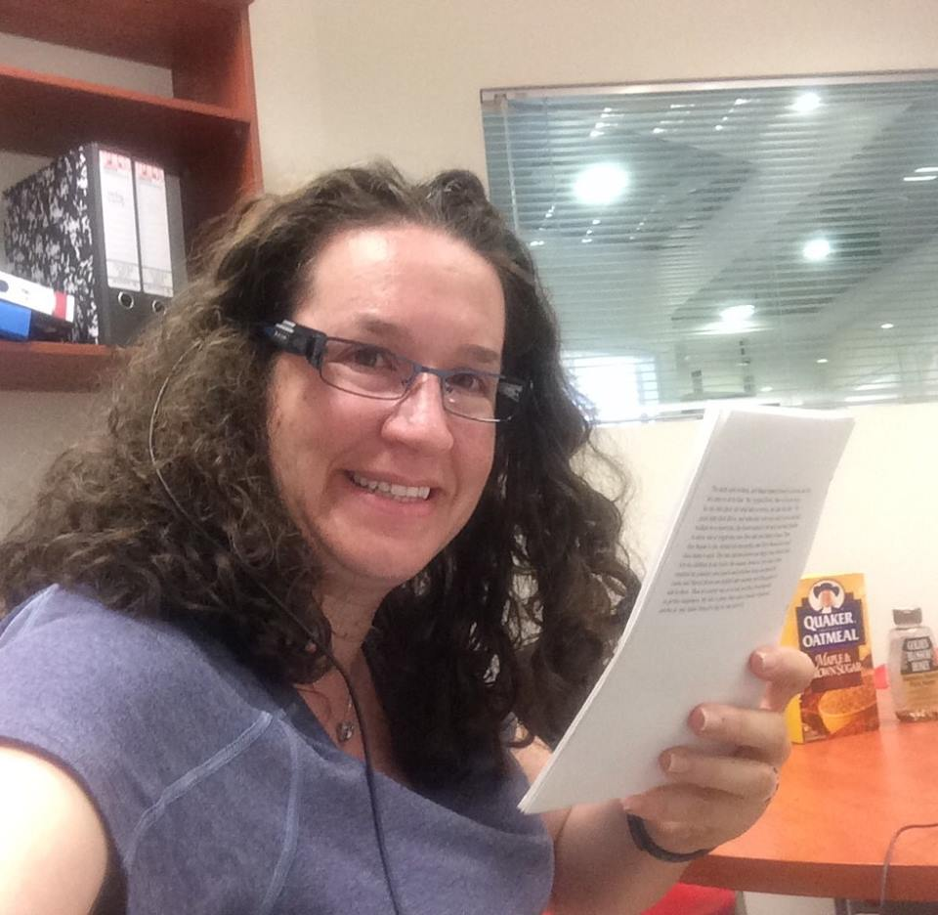
Wearables for People with Disabilities
Soundhawk
OMSignal
eSight
OrCam-MyEye

Slide 16
How accessible are they?
Anna Dresner, author of:
Watching Without Looking: A VoiceOver User's First Month With the Apple Watch
Accessibility built into Apple Watch
Taps for navigation
Setting vibrations
Physical response over VoiceOver

Slide 17
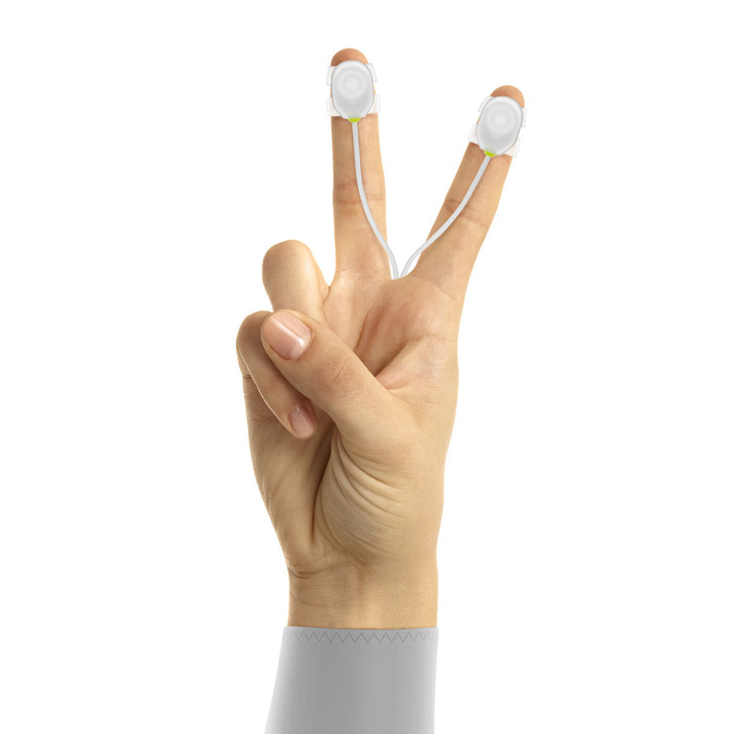
What about other wearables?
Biggest concern was the interface
Direct access vs. indirect access
Some apps don’t have alternatives for visual elements, auditory, or sensory
Need an equivalent

Slide 18
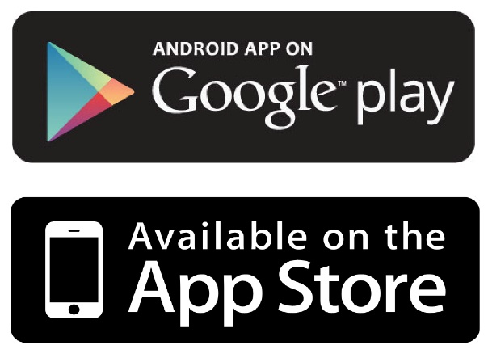
What happens when you sync?
Data needs to be accessible
Issues with user experience
Especially constantly updating data and AT
Hard to reach developers
Apps could use accessibility statements

Slide 19
Moving the Personal to Professional: Wearables at Work
What wearables do people wear?
Incentives and reimbursements
Changing workplace

Slide 20
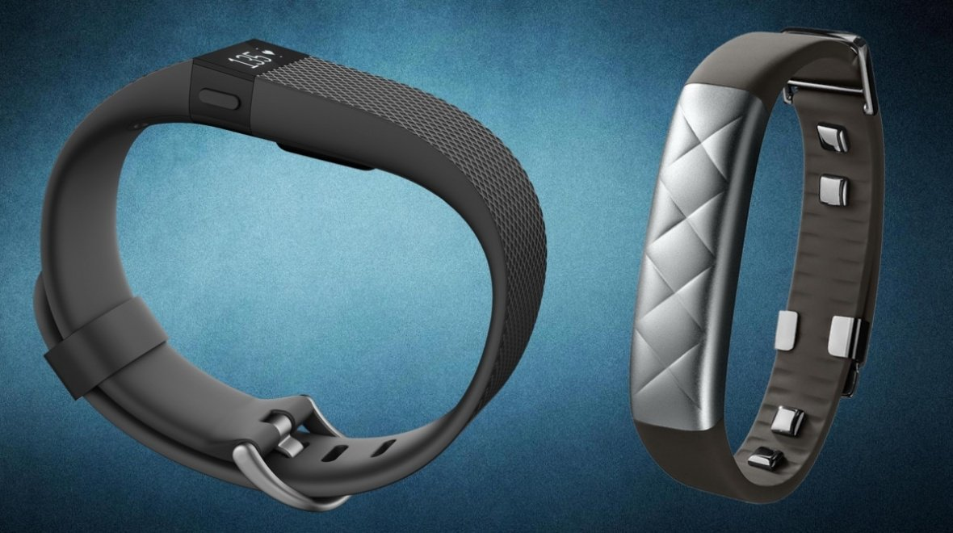
Wearables at Work: Health
Wearsafe (GPS safety)
Fitbit and Jawbone
Muse
Atos Connected Assistance

Slide 21
Linking Employment & Healthcare
Surge of healthcare wearables and apps
Increase productive and morale
Incentives: financial and health
Workplace large corporations have gyms, health club members, massage, yoga, meditation
Privacy concerns

Slide 22
But how accessible is it?
Technology limitations
How accessible are they?
WCAG and wearables
Physical limitations
Can workplace policies discriminate?
Some ‘ableist’ concerns

Slide 23
Legalities of Wearables
Leads to legal issues:
Americans with Disabilities Act
Genetic Information Nondiscrimination Act

Slide 24
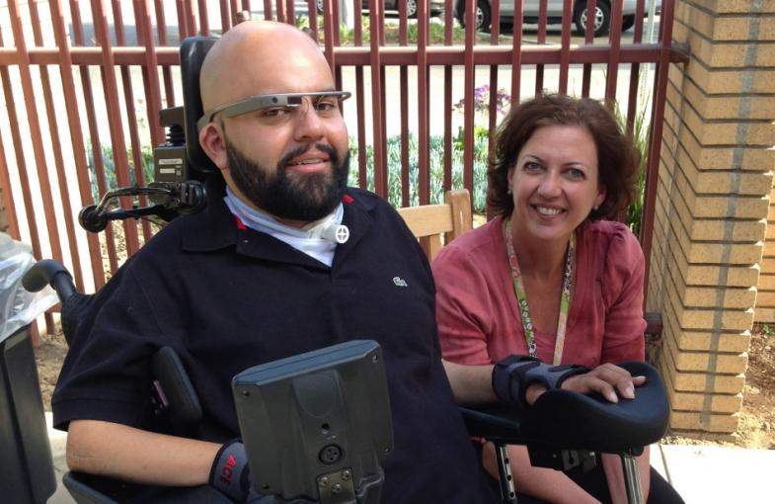
Reasonable Accommodation Request
Request to not wear: alternate
Similar language: undue burden
Avoid discrimination with ADA

Slide 25
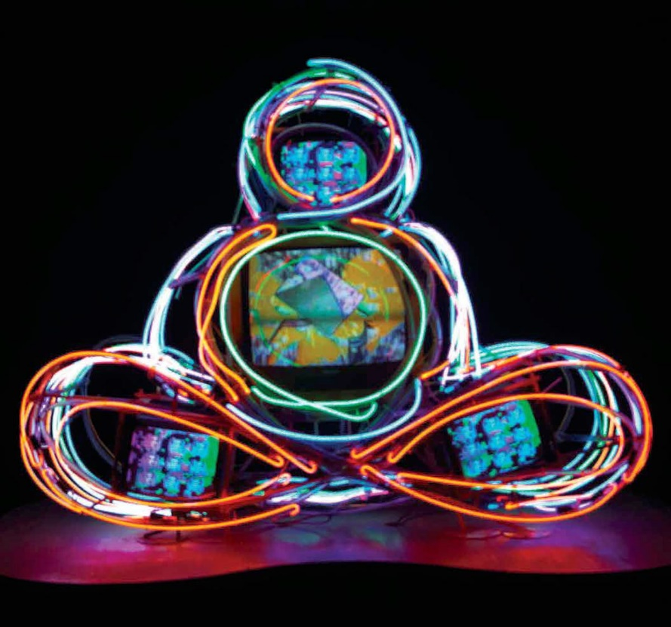
Mindful Adoption of Devices
An exercise in discipline
Mindfulness involves:
Vigilance upon acting
Justified decisions
Consider numerous factors

Slide 26
Tying it all together
The future of AHIT is now!
Wearables and mobile apps need accessibility
Responsible adoption at work:
Consider the accessibility
Responsibility of developers, employers, etc.
Reasonable accommodations
Keep technology personal

Slide 27
Resources
AHRQ
Wearables and Welfare: How Connected Assistance Helps to Improve Lives
ICDR
CMO’s Mind-Blowing Stats About Wearable Technology
Wearable Devices Magazine
Financial Times: Wearables at Work
Fortune Magazine: Wearables and Disability
JD Supra: Wearable Technology: Rewards and Risks
Wall Street Journal: Your Company Wants to Make You Healthy
PWC: Health Wearables
ARC: Why Wearables Are The Next Frontier For Accessibility
Mobi Health News
Verizon: Wearable Tech is Changing the Lives of People With Disabilities
Watching Without Looking: A VoiceOver User’s First Month with the Apple Watch
Mobile Accessibility: How WCAG 2.0 and Other W3C/WAI Guidelines Apply to Mobile

Slide 28
Contact Information
Dana Marlowe: DMarlowe@AccessibilityPartners.com
www.AccessibilityPartners.com 301-717-7177
www.facebook.com/AccessibilityPartners
@Access_Partners

