Slide 1
Conscious Accessibility: Mindfulness and Mental Health
CSUN Conference
March 2, 2017
Sharon Rosenblatt

Slide 2
Namaste! Here’s our agenda:
What is mindfulness?
Fusing mindful and accessible design
The mindful technology revolution
Mindfulness apps
The future of design

Slide 3
What is mindfulness?
The basic human ability to be fully present, aware of where we are and what we’re doing, and not overly reactive or overwhelmed by what’s going on around us.

Slide 4
Mindful Usage of Technology
Research and design
Aware of present moment
Don’t get lost in a device

Slide 6
Using technology too much
Caveat: We are all here because we are fascinated by technology
This is CSUN, after all!
We work in the technology industry and/or use it everyday!

Slide 7
Principles of Mindful Design
Improve the well-being of users
User-oriented design: user first
Orients along three principles:
Intent
Attention
Action

Slide 8
Principles of Accessible Design
World Wide Web Consortium (W3C)
Enables people with disabilities to participate equally on the Web
Removal of barriers that exclude
UN Convention on the Rights of Persons with Disabilities
Information and communications technologies, including the Web is a basic human right

Slide 9
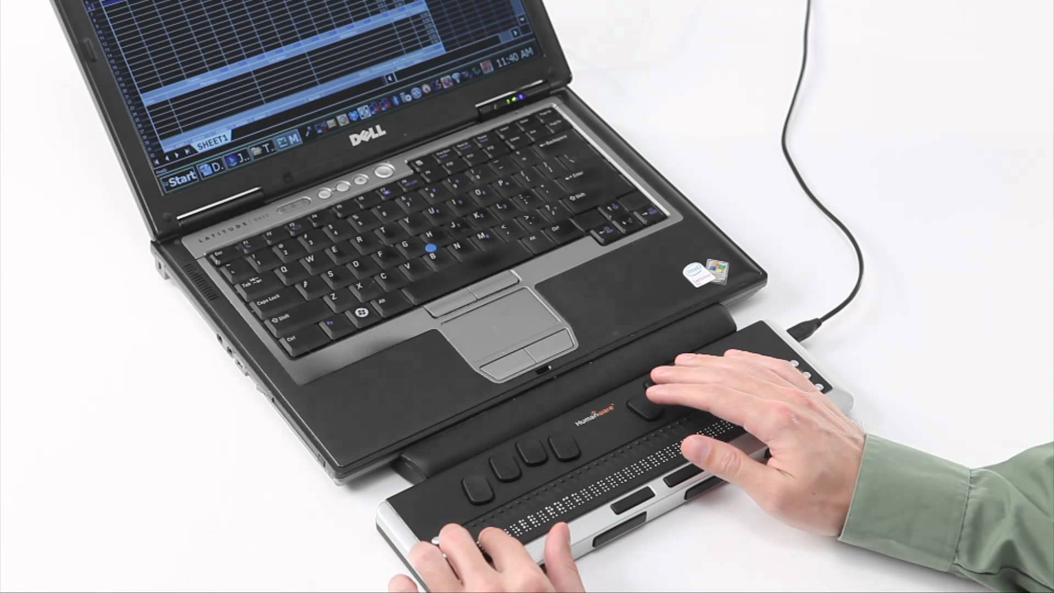
Mindfulness and Accessibility
That’s fine, but I need technology!
Simultaneous connection while disconnected.

Slide 10
Fusing Mindful and Accessible Design
Mindfulness and accessibility: work with us, instead of against us
Technology can ground you in the present with seamless access
Inaccessibility promotes frustration/anxiety

Slide 11
Mindful Adoption of Technology
Value human attention
Respect information zones
Discourage addictive usage
Minimize social anxiety
Apply principles company wide
https://www.designingmindfulness.com

Slide 12
Here’s what we did
Tried some apps on our devices
Mobile
Desktop
Asked our friends for their experiences
Accessibility professionals

Slide 13
Value Human Attention
Attention-based product impacts wellbeing
Accessibility would change to interaction
WCAG 2.4.7 Focus Visible: Any keyboard operable user interface has a mode of operation where the keyboard focus indicator is visible. (Level AA)

Slide 14
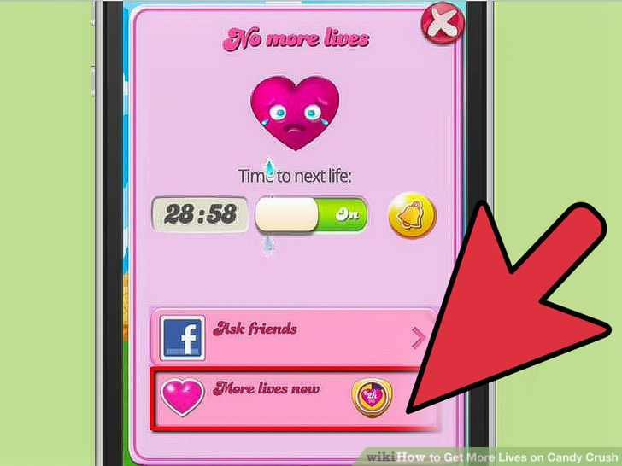
“Paying” for Attention
The lack of focus is detrimental for users with mental health disabilities.

Slide 15
Solution: Control your time!
Time trackers:
RescueTime
Klok
ManicTime
iOS
Hours Time Tracking
Chrome:
StayFocused

Slide 16
Respect Information Zones
Modes of communication between your products and users
Ties into product support and accessible modes of contact
Section 508 1194.41c: Support services for products shall accommodate the communication needs of end-users with disabilities.

Slide 17
Breath Trackers on iOS: Negatives
Not as accessible
Constant changing breath prompts, always engaged
Can’t be mindful and ‘tune out’
Don’t announce timing (if needed)

Slide 18
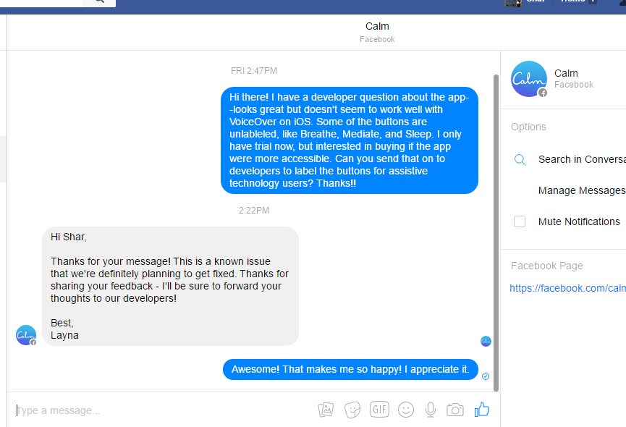
When things don’t work

Slide 19
Promote Positive Usage
Prevent FOMO: fear of missing out
Allowing mobile and remote solutions
Principle 4 of WCAG:
Content must be robust enough that it can be interpreted reliably by a wide variety of user agents, including assistive technologies.

Slide 20
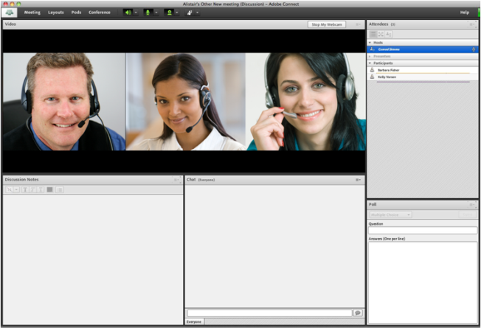
Adobe Connect: No FOMO!

Slide 21
Minimize Anxiety
Reduce social anxiety and stress
Accessibility could be the primary fix
Frustration comes from inaccessibility
WCAG: 1.2.2 Captions are provided for all prerecorded audio content in synchronized media

Slide 22
Solution: Captioned Videos or Audio with Transcript
Requires less user input=mindfulness
Captions/audio description for ‘relaxing sounds’

Slide 23
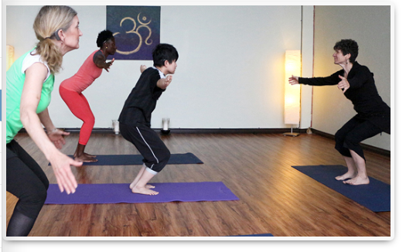
Mindfulness in the Deaf Community
Multiple ways to be mindful while Deaf
Inner world/validate experience
Deaf yoga

Slide 24
Apply the Principles
Let everyone play a role
Internal culture, practices=decisions, environment
Companies have mindfulness policies
General Mills, Aetna, Google

Slide 25
What’s the big deal?
Mindfulness is a practice
Awareness to direct experiences via thoughts and emotions
Remodel brain structure

Slide 26
Challenges and Solutions
Trying to accommodate a lot
Sounds work for some, distracting for others
Try before you buy
Talk to doctor/therapist/employer

Slide 27
Wrap your mind around this:
What do you see as potential challenge?
What would you like to see?
Any other questions?

Slide 28
Contact Information
Sharon Rosenblatt: SRosenblatt@AccessibilityPartners.com
www.AccessibilityPartners.com 301-717-7177
www.facebook.com/AccessibilityPartners
@Access_Partners

Slide 29
Resources and Further Reading
Psychology Today: The Mindful Use of Technology
Convention on the Rights of Persons with Disabilities (CRPD)
Medium: Designing Mindfulness
Mindful Magazine
Technology Addiction 101
Psychology Today: Getting Unstuck With Mindfulness Practice
NPR: Affordable Virtual Reality Opens New Worlds For People With Disabilities
University of Denver: Exploring mindfulness as a culturally sensitive intervention for the Deaf community
Designing Mindfulness Principles
Washington Post: French employees can legally ignore work emails outside of office hours
Deaf Yoga
Tecla Shield
Illuminating Information

