Slide 1
Mindful Design to Accommodate Mental Health Disabilities
CSUN Assistive Technology Conference 2018
Sharon Rosenblatt

Slide 2
Namaste! Here’s the Agenda:
What is mindfulness?
Fusing mindful and accessible design
Mental health disabilities
The mindful technology revolution
Mindfulness apps
The future of design

Slide 3
What is Mindfulness?
The basic human ability to be fully present, aware of where we are and what we’re doing, and not overly reactive or overwhelmed by what’s going on around us.

Slide 4
Mindfulness is NOT Meditation
Mindfulness is within meditation
Meditation can be mindful
Don’t force it!

Slide 5
Mental Health Disabilities
What comprises a mental health disability?
Effective functioning in daily activities
Healthy relationships
Ability to adapt to change and cope with adversity
1 in 4 people (World Health Organization)
Can be temporary or permanent
Types of treatment
Smashing the stigma

Slide 6
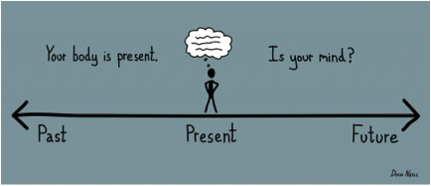
Mindfulness in Therapy
Addition to Cognitive Therapy
Presence in Dialectical Behavior Therapy
How effective?
Changes in brain structure/processes

Slide 7
Mindful Usage of Technology
Research and design
Aware of present moment
Don’t get lost in a device

Slide 9
How Much is Too Much?
Caveat: We are all here because we are fascinated by technology
Tech conference, after all!
We work in the technology industry and/or use it everyday!

Slide 10
Principles of Mindful Design
Improve the well-being of users
User-oriented design: user first
Orients along three principles:
Intent
Attention
Action

Slide 11
Mindfulness and Accessibility
That’s fine, but I need technology!
Simultaneous connection while disconnected.

Slide 13
Mindful Adoption of Technology
Value human attention
Respect information zones
Discourage addictive usage
Minimize social anxiety
Apply principles company wide
www.designingmindfulness.com

Slide 14
Here’s what we did
Tried some apps on our devices
Mobile
Desktop
Asked our friends for their experiences
Accessibility professionals

Slide 15
Value Human Attention
Attention-based product impacts wellbeing
Accessibility would change to interaction
WCAG 2.4.7 Focus Visible: Any keyboard operable user interface has a mode of operation where the keyboard focus indicator is visible. (Level AA)

Slide 16
“Paying” for Attention
The lack of focus is detrimental for users with mental health disabilities.

Slide 17
Control Your Time!
Time trackers:
RescueTime
Klok
ManicTime
iOS
Hours Time Tracking
Chrome:
StayFocused

Slide 18
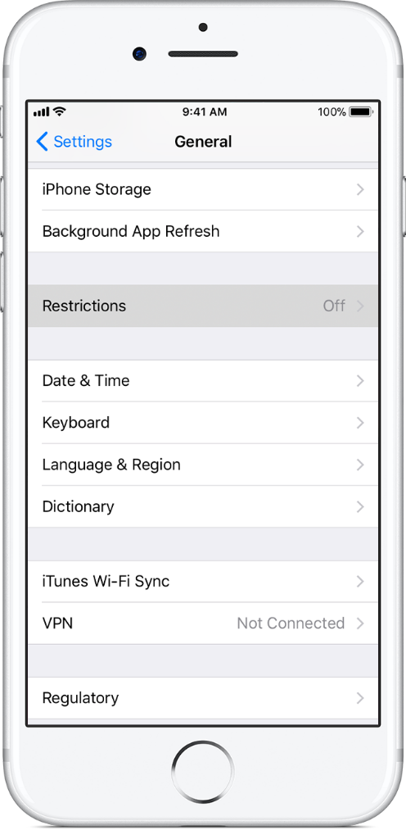
Taking Power Back

Slide 19
Respect Information Zones
Modes of communication between your products and users
Ties into product support and accessible modes of contact
Section 508 1194.41c: Support services for products shall accommodate the communication needs of end-users with disabilities.

Slide 20
Breath Trackers on iOS: Negatives
Not as accessible
Constant changing breath prompts, always engaged
Can’t be mindful and ‘tune out’
Don’t announce timing (if needed)

Slide 21
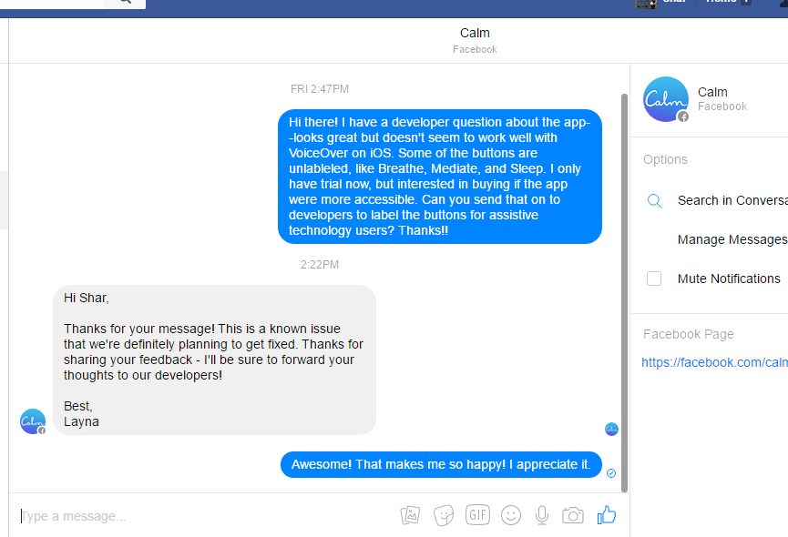
Take a Deep Breath….and Chat

Slide 22
Promote Positive Usage
Prevent FOMO: Fear of missing out
Allowing mobile and remote solutions
Principle 4 of WCAG:
Content must be robust enough that it can be interpreted reliably by a wide variety of user agents, including assistive technologies.

Slide 23
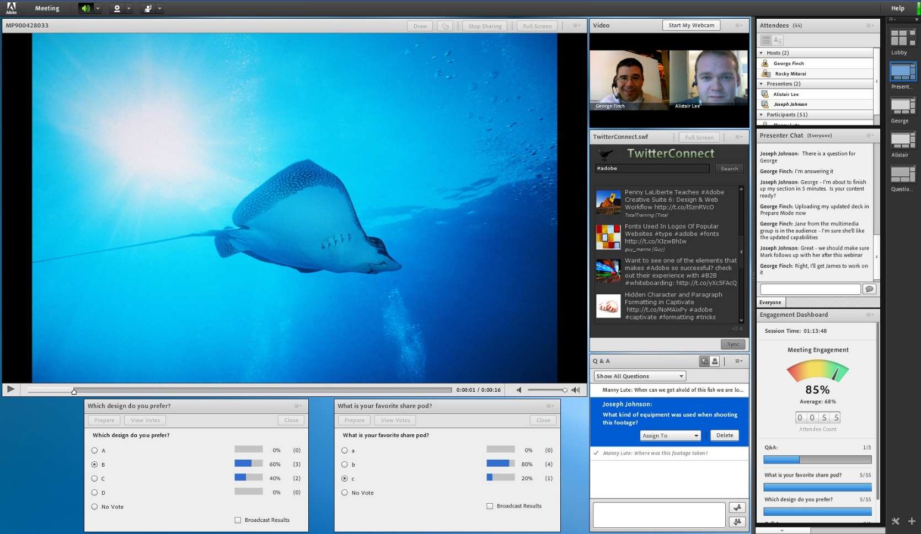
Adobe Connect: No FOMO!

Slide 24
Minimize Anxiety
Reduce social anxiety and stress
Accessibility could be the primary fix
Frustration comes from inaccessibility
WCAG: 1.2.2 Captions are provided for all prerecorded audio content in synchronized media

Slide 25
Audio Description
Requires less user input=mindfulness
Captions/audio description for ‘relaxing sounds’

Slide 26
Apply the Principles
Let everyone play a role
Internal culture, practices=decisions, environment
Companies have mindfulness policies
General Mills, Aetna, Google

Slide 27
Evaluating Mindful UX
No national standards (yet!)
Reach out to mental health care providers
Be available within reason
Don’t make false statements
Look into PubMed database
http://www.ncbi.nlm.nih.gov/pubmed/
Try it yourself! How do you feel?

Slide 28
Success with Mindful Design
As a UX Designer, I continually seek ways to empower users through mindfully designed products. When we redesigned an application for customer service representatives, we carefully prioritized where data is placed. This enables reps to close inquiries quickly and accurately. The result is a positive experience for reps and the customers they service.
Tracy Parkin, Illuminating Information

Slide 29
Challenges and Solutions
Trying to accommodate a lot
Sounds work for some, distracting for others
Try before you buy
Talk to doctor/therapist/employer

Slide 30
What’s the Big Deal?
Mindfulness is a practice
Awareness to direct experiences
Thoughts and emotions
Remodel brain structure

Slide 31
Wrap Your Mind Around This
What do you see as potential challenge?
What would you like to see?
Any other questions?

Slide 32
Contact Information
Sharon Rosenblatt: SRosenblatt@AccessibilityPartners.com
www.AccessibilityPartners.com 301-717-7177
www.facebook.com/AccessibilityPartners
@Access_Partners

Slide 33
Resources and Further Reading
Psychology Today: The Mindful Use of Technology
Convention on the Rights of Persons with Disabilities (CRPD)
Medium: Designing Mindfulness
Mindful Magazine
Technology Addiction 101
Psychology Today: Getting Unstuck With Mindfulness Practice
NPR: Affordable Virtual Reality Opens New Worlds For People With Disabilities
University of Denver: Exploring mindfulness as a culturally sensitive intervention for the Deaf community
Designing Mindfulness Principles
Washington Post: French employees can legally ignore work emails outside of office hours
Deaf Yoga
Tecla Shield
Illuminating Information
World Health Organization

