Slide 1
Swipe Right for Accessibility in Online Dating Dana Marlowe Sharon Rosenblatt Accessibility Partners March 21, 2018

Slide 2
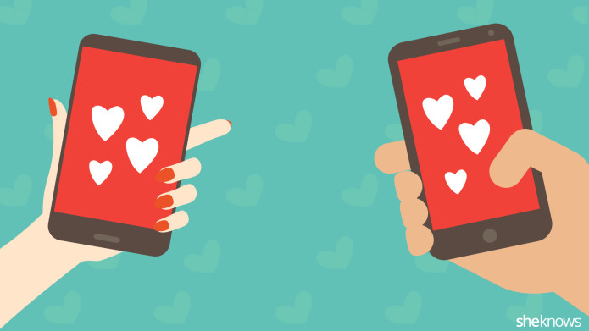
Connecting in the Digital Age

Slide 3
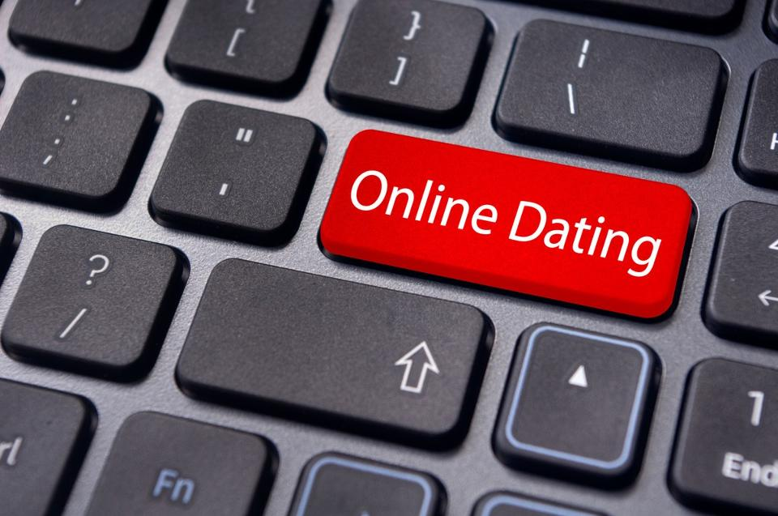
The Romance of WCAG
This presentation isn’t dating with a disability
Focus on the technology and accessibility
User case studies

Slide 4
The Dating Game
History of online dating
What are people using?
The accessibility of dating apps and sites
The morning after: feedback from users

Slide 5
The Journey Begins:
1959: IBM 650 and punch card questionnaire
1965: Operation Match

Slide 6
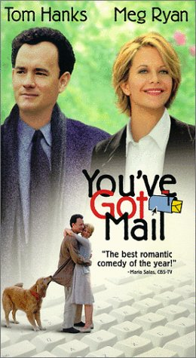
Love in Your Inbox
1990s: modern Internet
Instant messaging
AOL, ICQ
1998: You’ve Got Mail

Slide 7
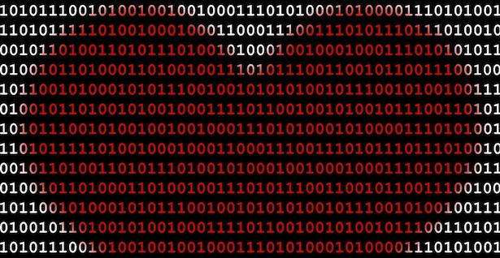
"Twenty years from now, the idea that someone looking for love won't look for it online will be silly, akin to skipping the card catalog to instead wander the stacks because the right books are found only by accident.“
(Wired Magazine, 2002)

Slide 8
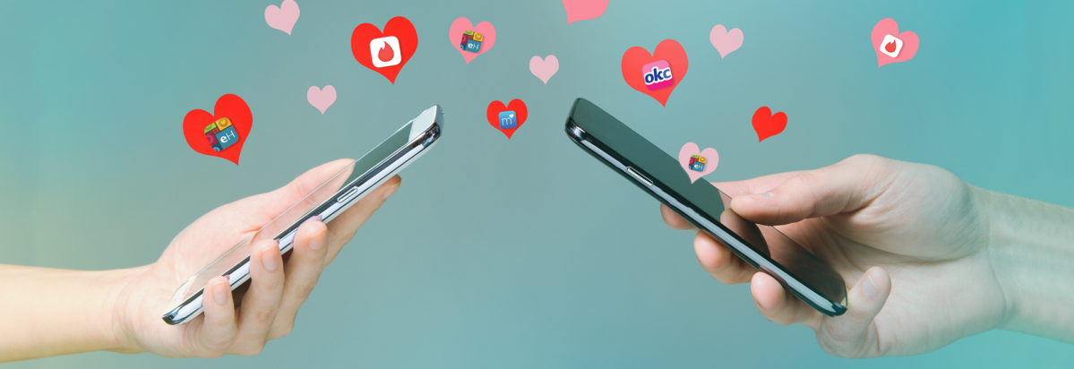
Dating in the New Millennium
2003: Skype changes everything
2004: Social media really changes everything
2007: Abundance of mobile devices
2012: Location-based apps

Slide 9
Online Dating: The Scene Today
Popular Websites: Free=best value
OkCupid
Tinder
Grindr
Less popular:
Match
eHarmony
More than 50% of single people have a profile
40% dated someone they met online
25% met a first date through a friend

Slide 10
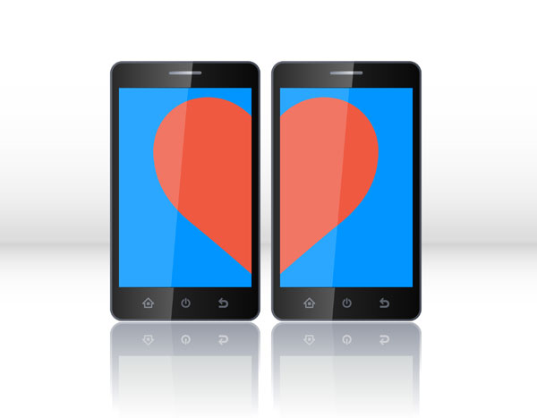
Most Popular Dating Apps
OkCupid
Happn
Coffee Meets Bagel
Bumble
Tinder

Slide 11
Most Popular Dating Sites
Match
PlentyOfFish
Zoosk
OkCupid
eHarmony

Slide 12
Different Strokes for Different Folks
Religious:
Christian Mingle, JDate, Muslima
Age-oriented: over 50
Activity-oriented
Fitness Singles, Farmers Only, Military Cupid
Political
Other types of ‘personalization’
Financial, lifestyle, etc.

Slide 13
Online Dating with a Disability
DisabilityDating.com
Whispers4u
Dating 4 Disabled
Disabled Passions
Prescription4Love
NoLongerLonely
POZ Personals
eHarmony and Match give advice

Slide 14
Blind Date: Documentary

Slide 15
First Date? First Audit!

Slide 16
No Alternatives for Visual Content

Slide 17
Graphical Links—Not Labeled
How do you know who you are clicking on or tabbing to?

Slide 18
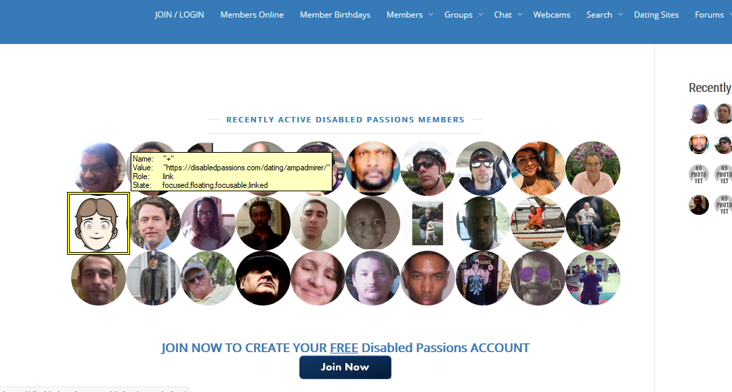
Disabled Passions: No Alt Text

Slide 19
One Solution: Substance

Slide 20
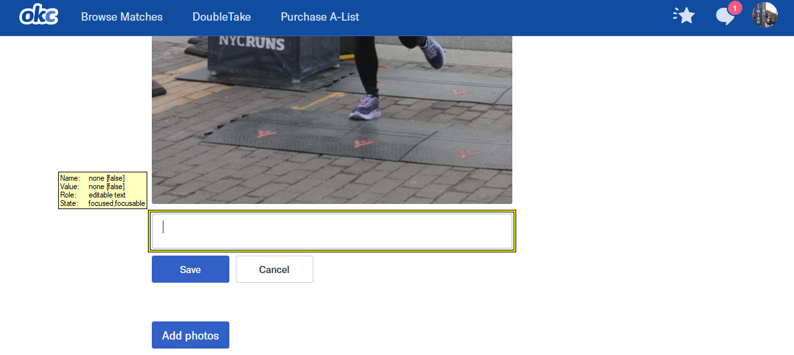
Captioning Images

Slide 21
Issues with Profile: Buttons

Slide 22
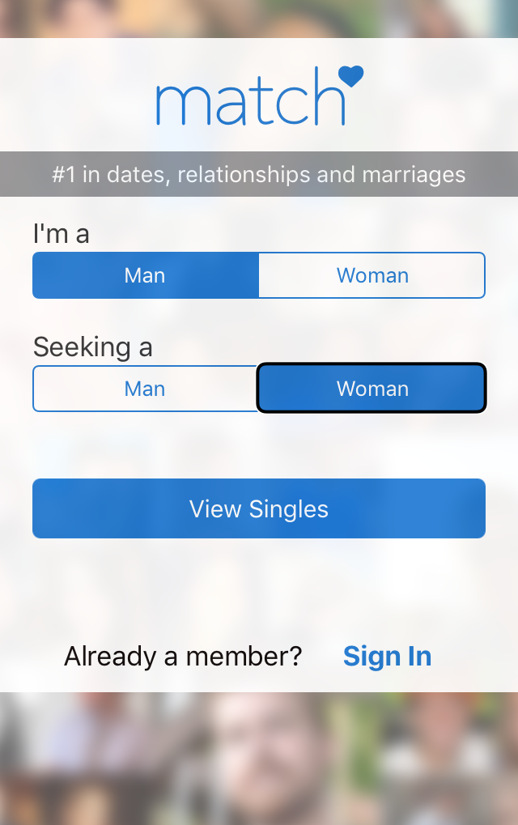
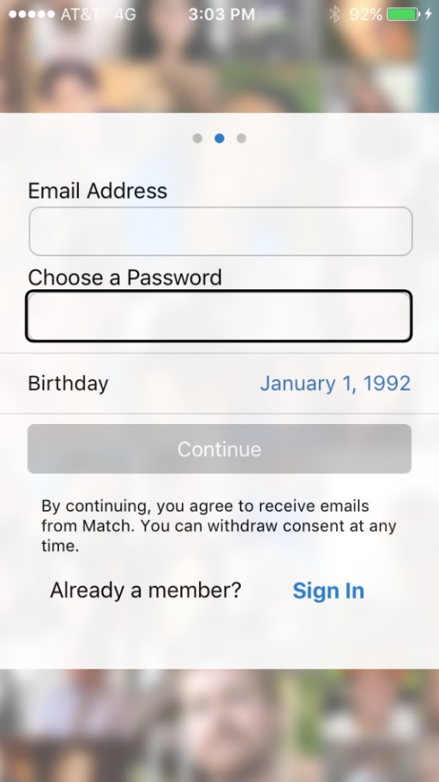
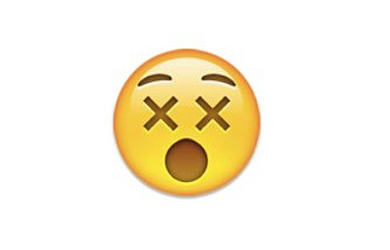
MisMATCHed

Slide 23
Form Fields: A Deal Breaker
Almost all sites we saw had at least one, but more often, multiple unlabeled form fields.
Prevents signing up and filling out a profile.

Slide 24
Visual Focus: OK Cupid

Slide 25
Making a Profile

Slide 26
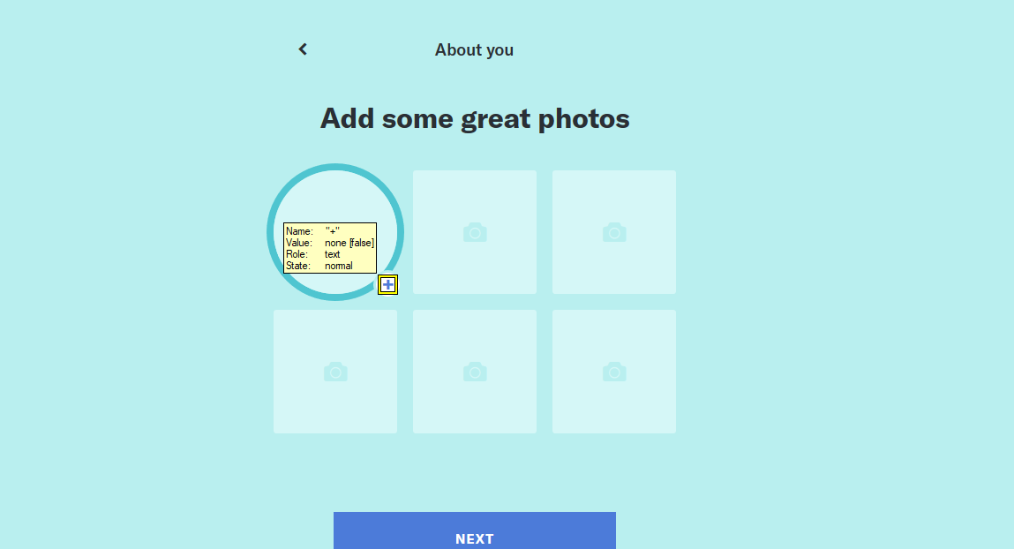
We’re Just Not Clicking…

Slide 27
No Timeouts on Dating!
The clock doesn’t stop if you’re not ready to continue.

Slide 28
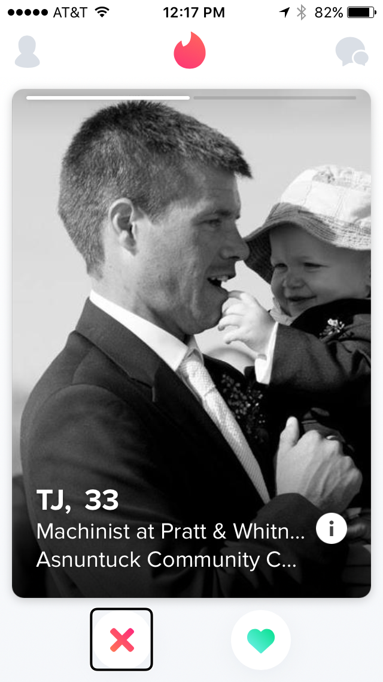
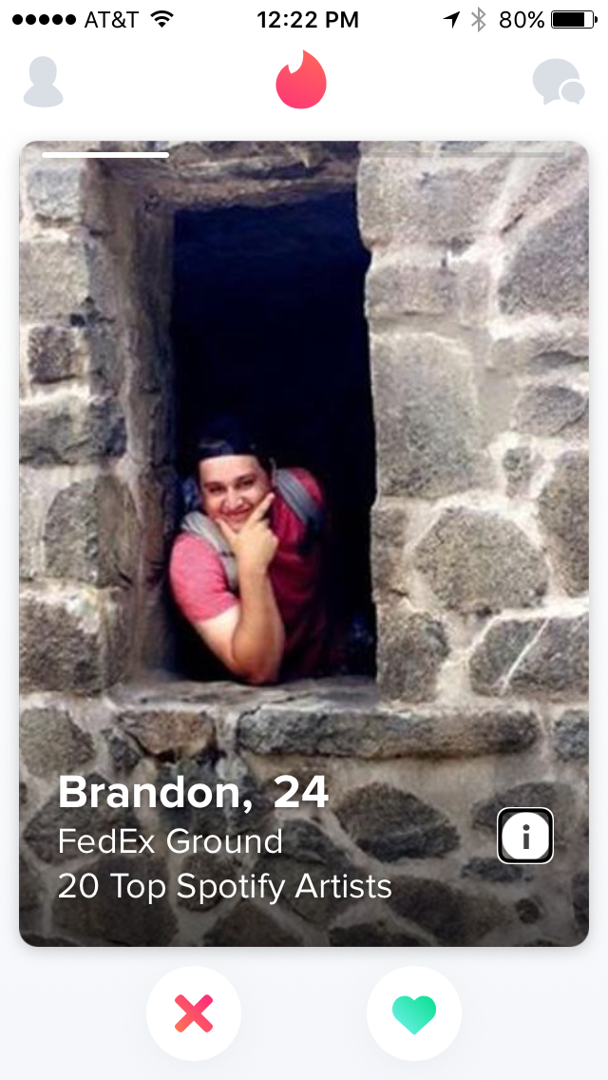
Swiping for a Connection

Slide 29
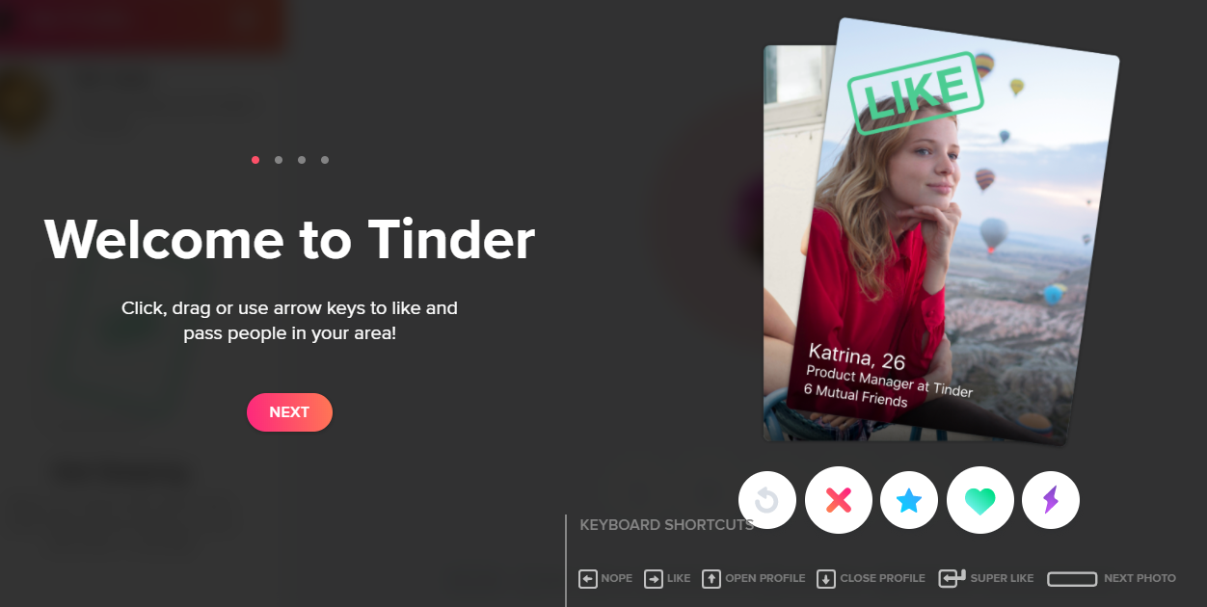
Desktop Equivalent

Slide 30
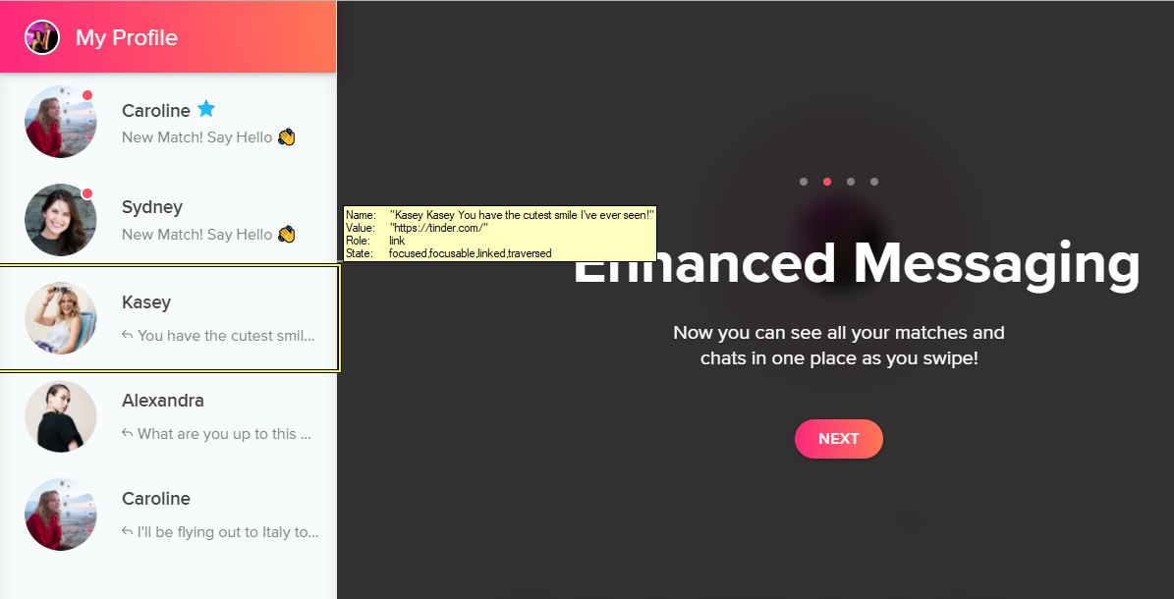
Communicating with Members

Slide 31
Video Dating: Hinge and Zoosk
Now playing: YOU!
How accessible is your video?

Slide 32
Overall Findings
Form fields need to be labeled
Button accessibility could be improved
Workarounds for images
Apps may be better than sites
KISS: Keep it simple, stupid

Slide 33
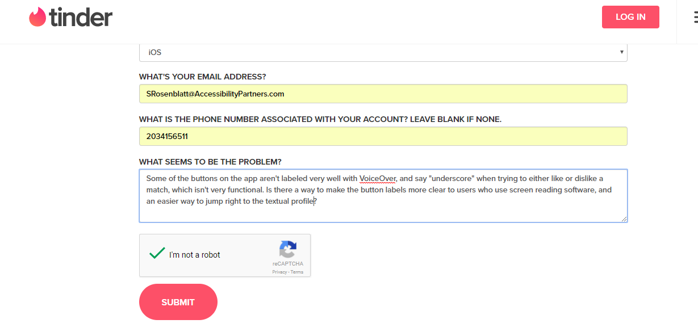
What About a Second Date?
Date on your preferred platform
Don’t settle for inaccessibility

Slide 34
Contact Information
Dana Marlowe: DMarlowe@AccessibilityPartners.com
Sharon Rosenblatt: SRosenblatt@AccessibilityPartners.com
www.AccessibilityPartners.com 301-717-7177
www.facebook.com/AccessibilityPartners
@Access_Partners

Slide 35
Resources
Pew Research Center: 5 facts about online dating
eHarmony: Online Dating Statistics
Huffington Post: The History of Online Dating From 1695 to Now
Wired Magazine: Online Dating
CNBC with Consumer Reports: Online Dating Reports
Business Insider: RANKED: America's most popular dating apps from best to worst
eBiz MBA: Top 15 Most Popular Dating Websites
New York Times: Dating with a Disability
VisionAware: Blind Dating: Looking for Love in the Digital Age
Blind Date Documentary
Dating Apps are Embracing Video

