Slide 1
Going the Distance: The Accessibility of Fitness Apps and Running
CSUN Assistive Technology Conference March 13, 2019
Dana Marlowe and Sharon Rosenblatt

Slide 2
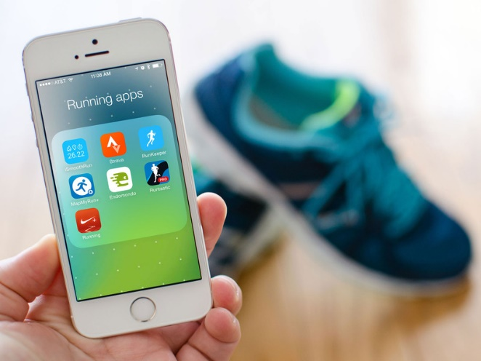
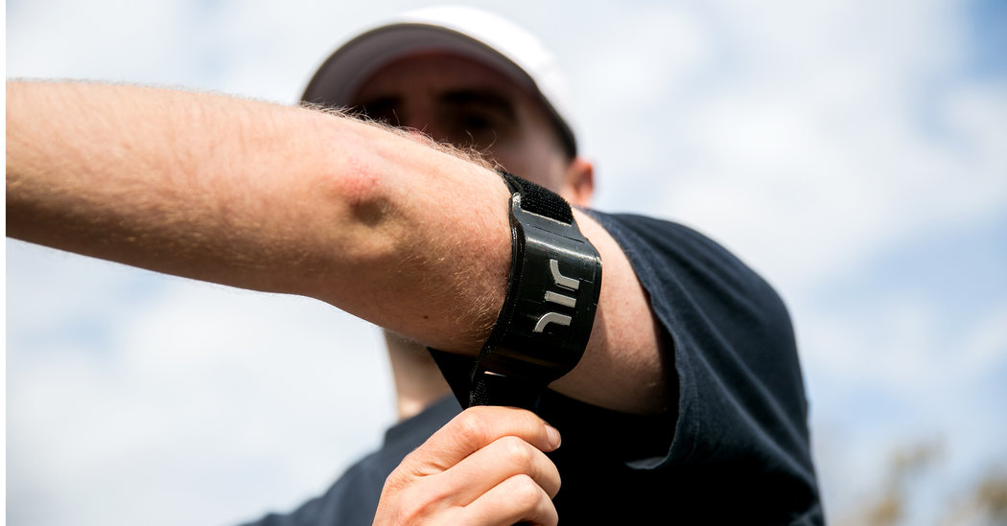
Hit the conference running:
The importance of fitness and running
Challenges to those with visual disabilities
Traditional accommodations
New technologies designed for athletes
Popular apps—are they accessible?
Notes:
Thank you so much for joining us today. It’s wonderful to be back at CSUN.
Both Sharon and I are very amateur runners, me more than her, with a lot of enthusiasm. Yet, our running experience, between the two of us, is very different. And, then we asked our coworkers and friends. We realized that the distance we run may be the same, but the tools that get us from point A to point B varied. So, we welcome you Go the Distance, as we talk about the Accessibility of Fitness Apps and Running.
Today, we’ll start off with an overview on fitness and running with disabilities. I’ll dive into some of the traditional and long-standing accommodations for runners.
While our focus is runners with visual disabilities, we will share some different perspectives.
I’ll pass the baton to Sharon. She will share some of our research about the newest technology to support runners with visual disabilities. She will discuss running apps and wearables that are fairly mainstream, and how accessible they are.

Slide 3
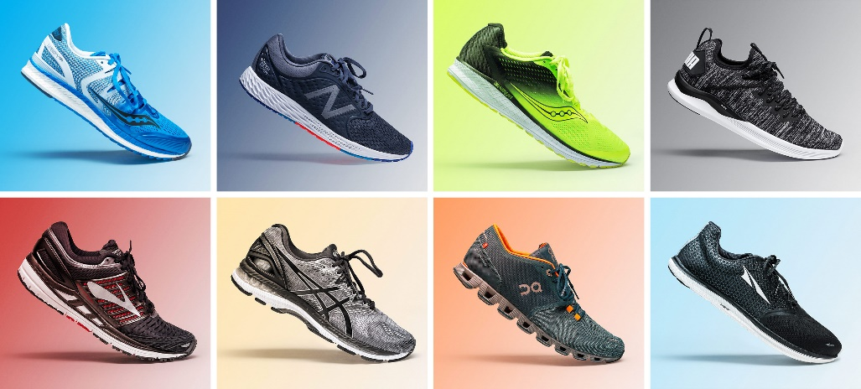
Who? More importantly, why?
Most popular sport worldwide
Nearly 60 million Americans ran or jogged
Walking for fitness had 110 million participants
25% of Americans ran for exercise/health
Continued success—runners report:
Racing
Staying healthy
Relieving stress
Surprisingly fun
Notes:
Running is one of the most popular sports worldwide. In the United States alone, almost 60 million people participated in running, jogging, and trail running in 2017. It is inclusive at any speed. In fact, walking for fitness drew more than 110 million participants in the same year. But why do people do this? Haven’t we heard of cars? We don’t have to run any more.
Improving fitness and better health were huge drivers. Weight concerns and the decision to enter a race, especially a 5K, are also common reasons people began running. Additionally, roughly 80% of runners continue to run to stay healthy. Relieving stress and having fun are top reasons why people stay on track and run.

Slide 4
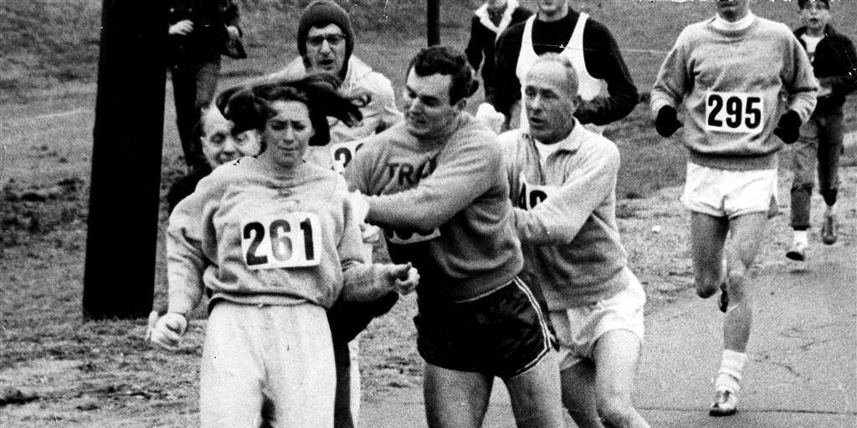
When everyone says you can’t…
Notes:
Running is inherently a difficult and inspirational event. Everyone has their own journey. Pictured on the screen now is an iconic photograph from the 1967 Boston Marathon.
Kathrine Switzer, number 261, was not supposed to be on the course. Why? Because only 50 years ago, this and other marathons were considered a men’s only event.
When Kathrine was discovered by the race director, she was physically attacked and almost yanked off course. Her boyfriend and coach helped keep her safe, and she finished the race.
While a hero for many, her story is one of millions who defied the odds to keep running when society said they couldn’t.

Slide 5
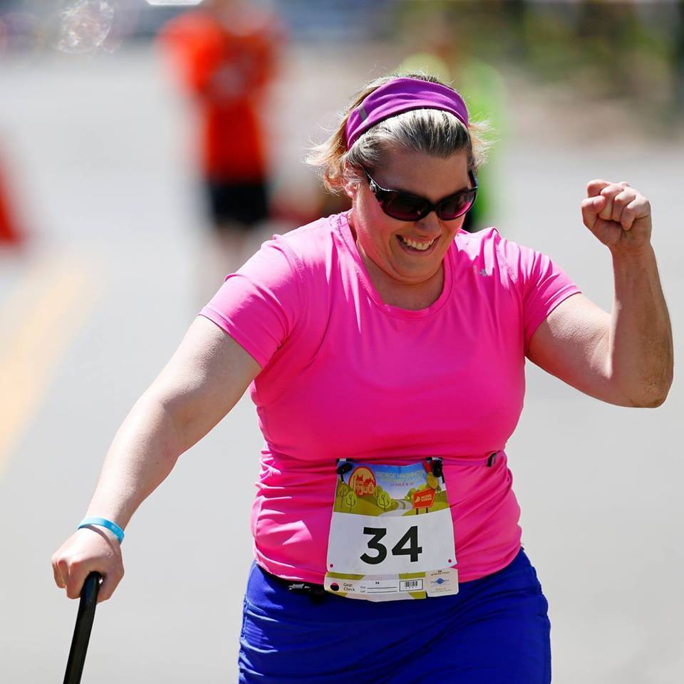
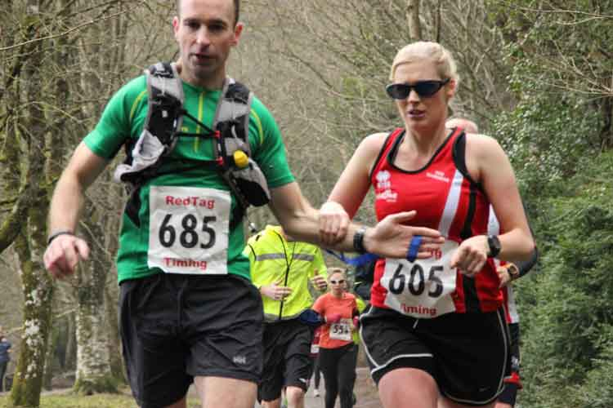
…Prove them wrong!
Notes:
We spoke to a number of people with disabilities, including my friend Jamie Watts and other athletes. Jamie is the woman in pink on our screen, and she has seh-ree-brul palsy.
The women next to her is a blind runner and her guide, respectively.
We often hear how ‘inspirational’ runners with disabilities are, but this presentation’s purpose is not to uplift by sharing someone’s emotional journey or story.
It’s CSUN, and it’s all about the technology making life easier, better, and more inclusive.

Slide 6
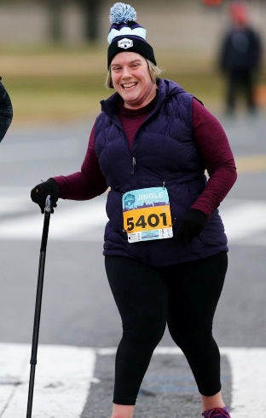
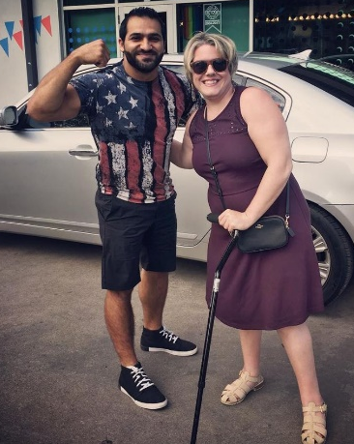
Jamie Watts Runs the World
Picks FitBit over Nike Running App
Loves the low cost/ no cost option
Trial and error
Inclusive
“If I can do it, anyone can do it.”
Notes:
Speaking of Jamie Watts, we chatted with her to get her feedback on running and technology.
Jamie’s disability can sometimes impact her coordination and balance. We asked her how she manages her runs via technology. She shared that initially, she was a huge fan of the Nike running app. Nike has a lot of great timing features, and tracking. They also provide the ability to rank yourself with other runners, which was a frustrating feature. Jamie just wanted to compete with herself and her own times. She then switched to FitBit to track her own steps.
Sometimes, the best accommodations are the lowest tech. For Jamie and her runs, including her first marathon, she’d ask for early course starts and escorts, which she’d provide. She uses her phone to track herself, her distance, and monitor her own safety.
Jamie advocates for the low cost, no cost option. In fact, she finds running to be incredibly inclusive. As she closed our conversation: If I can do it, anyone can do it.

Slide 7
Melissa’s Story: “I run Deaf”
Noisy challenges
Weather unpredictability
Run with your disability
Haptic feedback
Nike Running Club
Apple Watch
Notes:
We spoke with Melissa Manak, a Hard of Hearing runner from Chicago. Melissa loves running outside, but that can be unpredictable. Many runners take advantage of headphones to put on music. That was an opportunity she didn’t have.
In fact, hearing aids had to be turned up, but that amplified traffic noise in a negative way. Also, sweating and rain can seriously damage hearing aids.
Melissa told us she liked to run ‘Deaf’, and use her Apple Watch with the Nike Running Club app for haptic feedback. She would rely on buzzes and other haptics to denote time and her distance run.
As she trains for the Detroit Marathon in the fall, she swears by the Nike Running app for other Deaf runners.

Slide 8
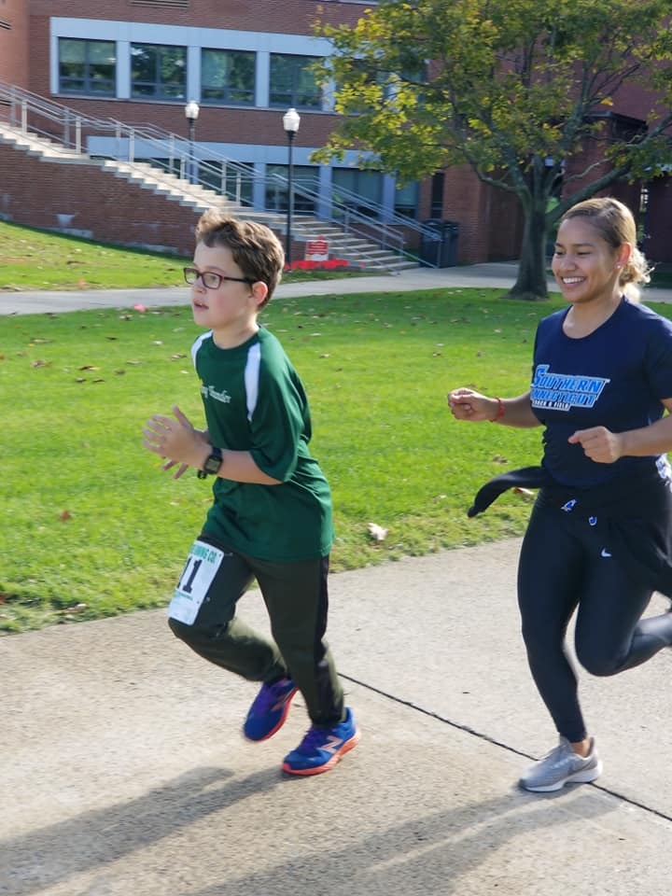
Fast and Fierce: Running with Autism
Child with Autism
Pairs child with a mentor
Run/walk apps
Map features: Garmin
Notes:
A friend of Sharon’s has a son who is autistic. Well-intentioned, but ultimately misguided people, told her friend and his wife to put their running on hold. Instead, the couple just opted to bring their 10 year old son along.
Initially, there was a lack of support. A constant refrain they and other parents heard was that there were so many ‘runs’ benefitting causes for autism, but not nearly enough that support runners with autism. It was a paradox.
So, they matched up with a group for athletes with disabilities. Running was an inclusive space for his stimming, or self-stimulatory behavior. While running, he met up with others who encouraged his stimming as his distinct stride.
Using technology features like timers in fitness apps, he can manage his stride. The counter on the app or the buzz in his wearable reminds him to walk or run, and is a proven way to be faster. He is also a fan of the voice prompts in apps, like MapMyRun, that announce his speed and his distance.
Sharon will share some more features on mainstream apps. But for her friend’s son, this helps with his focus and has made him a better runner.

Slide 9
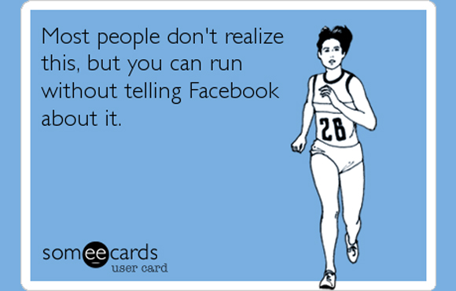
Participation Medal
Notes:
I shared a few stories, but I’m curious about yours. I’ve heard it remarked that if a runner runs a marathon but doesn’t post about it on social media, does it really happen?
So, I want to give us a space to humble brag.
Has anyone ever run a 5K? Do we have any amateur athletes among us? Have you accomplished anything cool or are training for anything? Would anyone like to share their fitness or exercise goals?
[If it gets quiet, Dana can say that Sharon is bursting at the seams to talk about running in all the towns in Connecticut, and eventually all the states]

Slide 10
It isn’t easy for most blind people to run out and join a gym or jump in the car to get to fitness classes. Buying a video in order to take up yoga or find out if Pilates is the answer requires endless explanation and interpretation at the very least.
So what is a blind person to do?
-Robert Leslie Newman, Board of Nebraska Commission for the Blind and Visually Impaired (NCBVI)
Notes:
Thank you for sharing your stories with us! It’s not a huge secret, whether we want to hear it or not, that exercise and fitness is good for your overall physical and mental health.
But just because they are necessary—how accessible are they? And moreover, how challenging, no matter how well-meaning the advice, is it for someone who is blind to work out?
During our research and interviews, we came across this honest quote from Robert Leslie Newman, who is on the board of the Nebraska Commission for the Blind and Visually Impaired. He’s also a strong advocate for fitness and activity by blind individuals. Robert said:
It isn’t easy for most blind people to run out and join a gym or jump in the car to get to fitness classes. Buying a video in order to take up yoga or find out if Pilates is the answer requires endless explanation and interpretation, at the very least.
So what is a blind person to do?
Well, that’s what this presentation is all about.

Slide 11
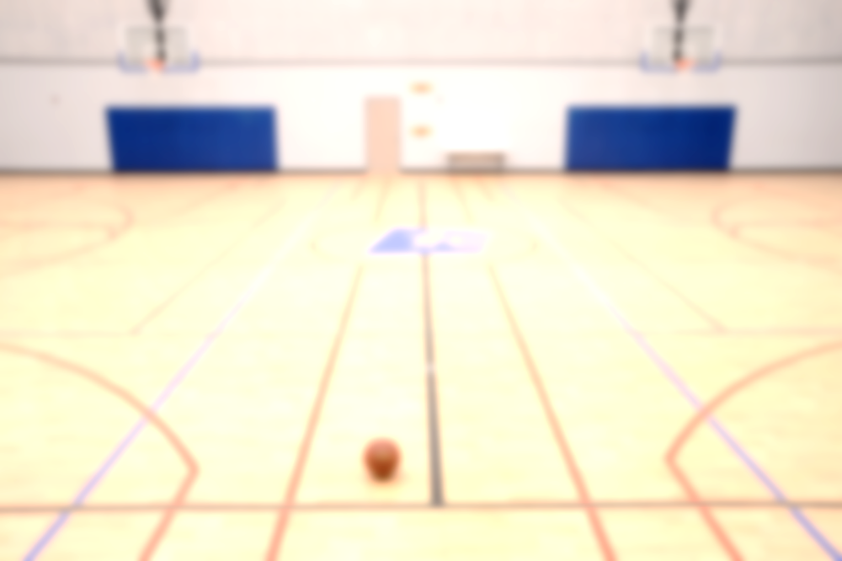
The Need for Speed: Challenges
Misinformation and misunderstanding
Lowered expectations
Few accommodations in schools
Inaccessible spaces/equipment
Safety
Attitudinal barriers
Notes:
Being blind and being fit are not incompatible. But, society does not necessarily design facilities or technology that is inherently accessible. Truly, that’s why conferences like CSUN exist.
The levels of fitness in the blind community are much less than the general population. Why? The misunderstanding of a blind person’s capabilities starts at a young age, and persists into adulthood.
One runner we talked to said in school, her district felt it was such an accomplishment she could read on grade level—which has NOTHING to do with the fact she was blind, but we can address that later—that it mandated she sit in a separate classroom while her friends were at gym class. They assumed gym class would be too much of an ask.
By the time young blind people are making most of their own choices regarding health and fitness, their lives might be indirectly influenced to be sedentary.
As adults, physical spaces are not always the most accessible either. Whether indoors or outdoors, there’s always a safety component. Some people we’ve spoken to prefer to simply not work out, or work out in a controlled environment, like a machine in their own home.
Not unique to this presentation at all, but there are naturally a myriad of attitudinal barriers that people with disabilities face with respect to fitness. Whether they are mocked, pitied, or elevated for their efforts, it can be a negative experience.

Slide 12
Accessibility on Fitness Equipment
Inaccessibility on machines—very visual:
Touchscreens, buttons, and lights
Suggestions:
Braille on buttons
Headphone jacks (like ATMs)
Bluetooth capabilities
Free pass to partner/assistant
Notes:
I haven’t been to the gym yet here, but I bet the equipment isn’t different from a mainstream gym, and most likely, inaccessible.
Often, to modify and track a workout, there’s a touchpad interface. This can be used to adjust timing, speed, resistance, and more. These flat buttons are often not tactilely discernible. The output is rarely audible or treadmills track progress in lighted dots. None of these features are accessible for someone who is blind.
Some suggestions we and our colleagues have come up with is to have Braille, or at least tactically discernible buttons, like the raised bump on telephones or ATMs, for key features.
In an ideal world, fitness machines that have the built-in headphone jacks to listen to overhead TVs or Bluetooth can share their information via audio.
We have seen fitness machines that display QR codes to save and later view workouts.
Additionally, if gym members with disabilities require a partner, allowing them a free guest pass instead of paying a fee or docking a visit is a very accommodating step.

Slide 13
Isolation and Exercise
Royal National Institute for the Blind:
30% cut off from people and things around them
50% limited in activities
65% want to do more physical activity
I’m stubborn, though. My philosophy is that if things aren’t accessible, don’t wait until they are.
-Amar Latif, The Guardian
Notes:
According to the Royal National Institute of Blind People or RNIB in the UK, in 2015, over 30% of blind and partially sighted people felt cut off from people and things around them.
Half of survey respondents felt they were frequently limited in activity participation. Yet nearly two-thirds said they would like to do more physical activity.
Related to that survey, though, was a response from Amar Latif, who is a blind individual. Quoted in The Guardian, he said:
“I’m stubborn, though. My philosophy is that if things are not accessible, don’t wait until they are.”

Slide 14
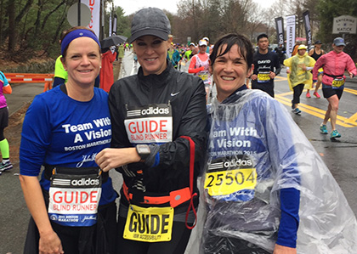
Low-tech Running Aids
Sighted guide
Holds arm
Communication
Terrain
Tether method
Stability
Avoid injury
Treadmill
Increased independence
Notes:
So let’s say you, or someone you know wants to get into running. Often paired with accessible and assistive devices, or used as standalone, these no-cost methods are ‘tried and true’.
One such method is by using a sighted guide. The runner holds the guide runners' elbow, shoulder, or hands. Depending on the degree of low vision, a guide can be followed if he or she wears a bright shirt. There are many great organizations that match runners up with guides, no matter the experience.
Running with a guide can decrease fear, create a more efficient running gait, and increase socialization.
The tether method is a short rope, towel, or shoe lace, held between the guide and the individual who is blind, giving both runners space. If an obstacle appears, the guide pulls the runner closer to avoid injury.
Some blind runners may choose to run on a treadmill. Also, if the user has a wearable or fitness app, they can keep track of speed and distance, all with no need for a guide.
Let me pass the baton over to Sharon now. For our two-person relay, she will share some of the new innovations that directly support running, or how other technologies support blind runners.

Slide 15
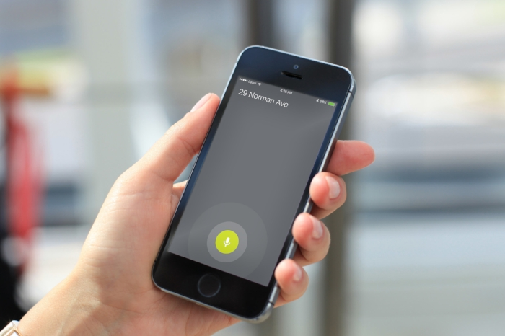
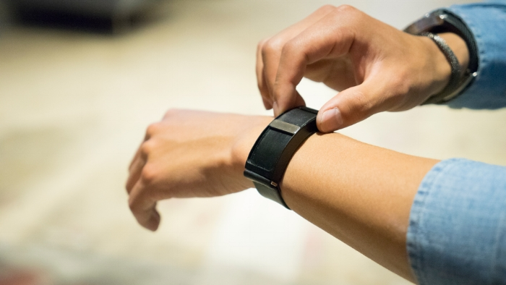
Connecting to your Run: WayBand
Wearable haptic navigation device
Vibration-driven guidance
Download app—tell it where you are going
Wearable guides you the rest of the way!
Notes:
Thanks so much, Dana! That certainly got me in the mood to ditch these shoes for my sneakers.
I want to embark on a different type of race. We did some research to see what’s on the market that is designed specifically to accommodate blind or visually impaired runners. We heard some wonderful stories and recommendations. Here’s the ones that truly stood out for us.
Just as a disclaimer, we did not formally audit them for the company, nor do we endorse them. We can’t make any promises about their accessibility compliance. This is just the sharing of information, and we are always eager to hear your stories.
Let me kick off and talk about WayBand. This is a wearable navigation device from WearWorks. It guides runners using vibration feedback with no visual or auditory components.
The core technology behind the Wayband is relatively simple. A user pairs the Wayband with their phone. The app utilizes GPS to create and map a route. The path is surrounded by what is called virtual “fencing”. Any time a user steps in the wrong direction, or approaches a mapped obstacle, the band buzzes. For example, four quick taps on the bracelet signal a turn left, while two long taps signal a right turn.

Slide 16
The WayBand in Motion
Notes:
Want to see the WayBand in motion? Here’s a video clip featuring Simon Wheatcroft, a blind runner from the UK. He’s going to be a familiar name throughout this presentation, as he is truly a trailblazer in the field of running with a visual disability and using technology to support his run.
Video Summary: He was an experienced marathon runner, but each training session brought uncertainty. While training unassisted in the summer of 2016, Wheatcroft rammed into a burned-out car on his training. He needed stitches in his arm and wondered whether it was worth it to keep running.
In a marathon, he felt the same as any other runner. And, as he chased the finish line, he pursued technology that could help the blind and visually impaired lead more independent lives.
“I love a long shot,” said Wheatcroft.
At the blast of a cannon, he set off on Sunday with more than 60 visually impaired marathoners to run New York for the third time.
He did so with the technology of so-called corrective navigation. Race officials said Wheatcroft appeared to be the first runner to use it in New York to negotiate the course’s 26.2 miles, including five bridges, tricky turns, the rolling hills of Central Park and, most challenging, 50,000 other participants.
If the race went according to plan, the friends who accompanied Wheatcroft would intervene only as a last resort to prevent him from colliding with another runner.
On his left arm, Wheatcroft wore the WayBand.
Pulses from the armband were designed to keep Wheatcroft running on Sunday within a virtual corridor, about 20 feet wide, and to help him turn right and left. Four short, rapid vibrations signaled that a left turn was ahead. Two longer vibrations signaled a right turn.
He also wore an ultrasonic sensor on his chest. Two sharp vibrations alerted him to runners crossing his path. No vibrations meant he was free of obstacles. Gentle pulses suggested he was securely cocooned in a pack of runners moving at roughly the same speed.
Also attached to a strap on his chest was an iPhone. On his right arm was a separate GPS device to provide more accurate positioning on the course and to save battery life on the cellphone.
WearWorks, say that tactile feedback is less intrusive and more intuitive than oral cues: Vibrations are not vulnerable to being drowned out by loud noises. The visually impaired are freed to use their sense of hearing to listen for approaching vehicles and pedestrians and to more fully engage in their surroundings. While he didn’t hit his goal time because of the intensity in running a marathon and having to be focused on haptics simultaneously, Simon shared:
“Today was always about pushing the technology to its limit,” Wheatcroft said. “We found the limit earlier in the race than we would have liked. But it was lessons learned. We can improve, move forward, make it better. It’s not the end, it’s just a start.”

Slide 17
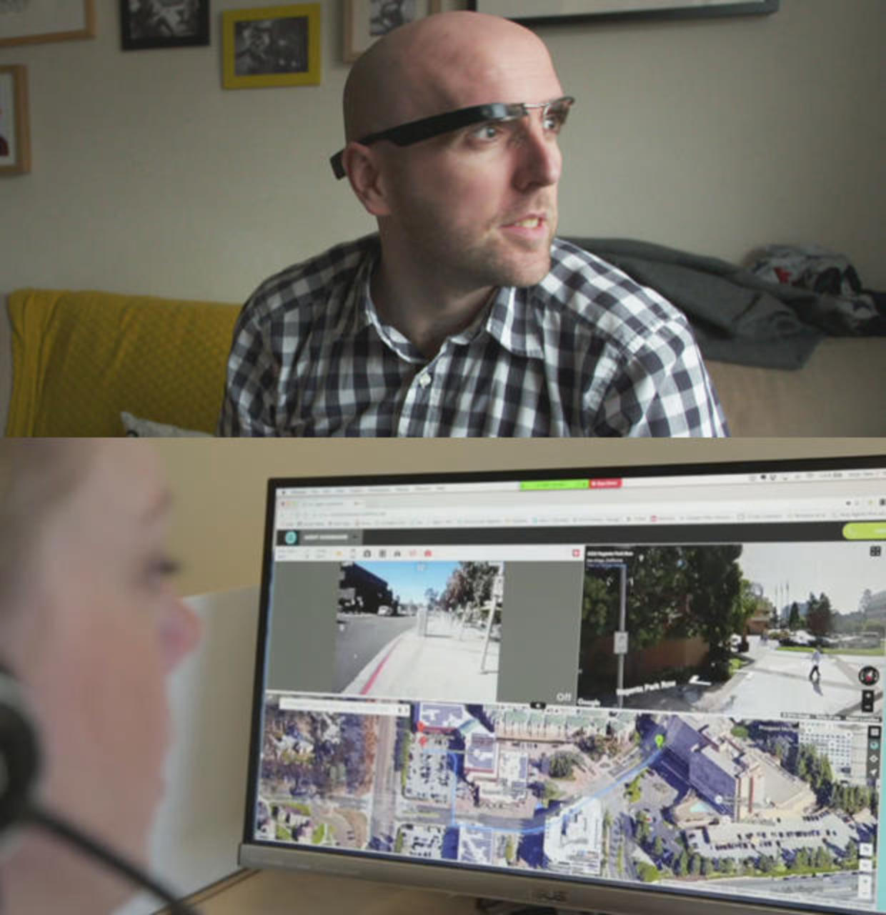
Aira
Connect to agent
Wearable
Acts as user’s eyes
“When I have to use a treadmill, I use Aira to check the digital display post run.”
Richard Hunter
USABA Marathon National Championship, Program Coordinator
Notes:
My next example, Aira, is actually here at CSUN.
An Aira user wears glasses that have a small camera. That camera beams video back to a remote sighted agent, who then acts as the user's eyes.
On my slide, I am sharing a picture of someone wearing the Aira, and the image below is a sighted agent describing: "Directly in front of you, Juan, is a sign. If you'll go slightly to the right, towards one o'clock, to avoid it.“
I reached out to Richard Hunter, the program coordinator for the United States Association of Blind Athletes. He is an award winning marathon and ultra marathon runner.
Richard shared:
“When I have to use a treadmill, I use Aira to check the digital display post-run.”

Slide 18
eAscot from IBM
Beeping noise to align you
Keeps on straight path, think car sensors
Notes:
Here’s something neat from IBM: an in-development app called eAscot, centered around the principle of unassisted independence.
The eAscot app uses coordinates to plot a route, which they did for Simon Wheatcroft’s Boston Marathon.
IBM’s Holly Cummins shared: ”It’s like a cross between satellite navigation and the reversing sensors in your car. So if Simon is too far left from where he is going it beeps and if he is too far right it beeps with a different pitch,”
Simon shared a bit more: “To run in the right direction all you need is a bearing… So we created an app that would notify me if I deviated from the desired bearing”
Wheatcroft then used eAscot to run an ultra marathon in the desert in 2016, and made it over 100 miles in Namibia. Which is really great if that’s where you’d want to run an ultra marathon, but we support him!

Slide 19
RunGo: Voice Guided Running
Notes:
RunGo allows runners to have visually-described running routes. This app features turn-by-turn voice directions and descriptions of landmarks with customization. A user can either individually plot their own runs, or access a library of preset runs.
Not only is voice navigation very accommodating for users who are blind, but also tourists, who appreciate the extra detail and direction.
Run Go was specifically designed with accessibility and pairs with wearables, like the Apple Watch. Using built-in GPS, RunGo lets the runner transfer their routes from the phone to their watch. Then, when paired with headphones, they can run without the bulky phone but still with navigation, including haptic feedback to designate turns.
I’m going to play part of a video of a runner with visual and auditory disabilities using RunGo, and how well it pairs with her hearing aids.
Video Summary: Rose Kamma Sarkany is a marathon runner, kayaker, rock climber, hiker, cyclist, swimmer, water colorist, writer, photographer and public speaker. She does all this and more with only 10 degrees of peripheral vision (tunnel vision) and moderate to severe hearing loss. Rose was diagnosed with Usher Syndrome when she was 16. It’s a hereditary condition that slowly robs her of her sight and hearing but she’s not letting that define her.
Rose faces various challenges in her day-to-day life but she’s learning to adapt by making use of the tools that are available to help her. She finds RunGo to be a particularly useful tool, that enables her to run “as if she has no vision issues at all”
Rose shared: “A couple years ago I had met the founder of RunGo, Craig Slagel at the BMO marathon event in Vancouver. After downloading the app I used it for some of my training but after getting a new phone, the app laid dormant for a while. I decided to revisit this app to train for this marathon but I never realized how big of a role it would play for my running”.
She had trouble on trails and listening to traffic cues, didn’t see people pass her right away. She had registered for a trail race, a 10K and wanted to try the RunGo. There were no errors in turns, directions were perfect, and she could hear every turn. Everything was in sync. Her hearing aids are paired up with the running app to audibly hear directions. Apple Watch paired with hearing aids too.
Every time she goes for a run, she pairs with Apple Watch for music, hearing aids, and more.

Slide 20
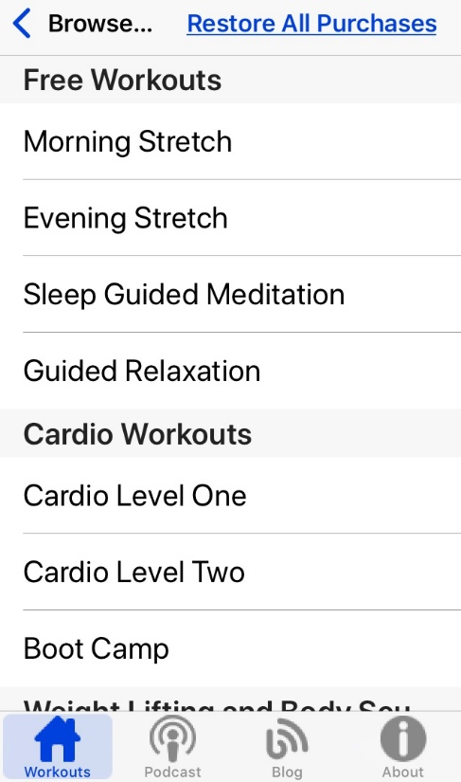
Eyes-Free Fitness
Free and paid routines: download mp3
Dynamic font with easy-to-use interface
VoiceOver accessible
Created by BlindAlive
Notes:
Finally, the last example is not necessarily limited to running, but encourages fitness. Available for free online to download, Eyes-Free Fitness shares exercise routines described specifically for the blind.
According to BlindAlive, these workouts allow you to stretch, strengthen, condition, and tone your body, all without needing sight.
All of these programs are thoroughly audio described with extra text materials, should they be needed.

Slide 21
BlindAlive
Notes:
BlindAlive just uploaded this video to their YouTube channel in January.
While maybe some of you would like a bit more cardio than just listening to me talk, here’s a quick preview of what these workouts sound like.
(play 20 seconds)

Slide 22
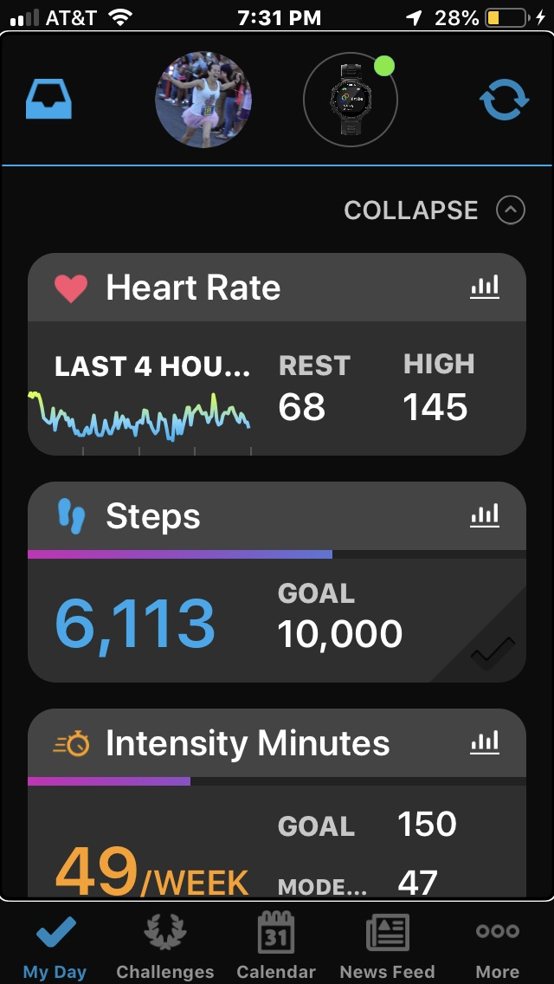
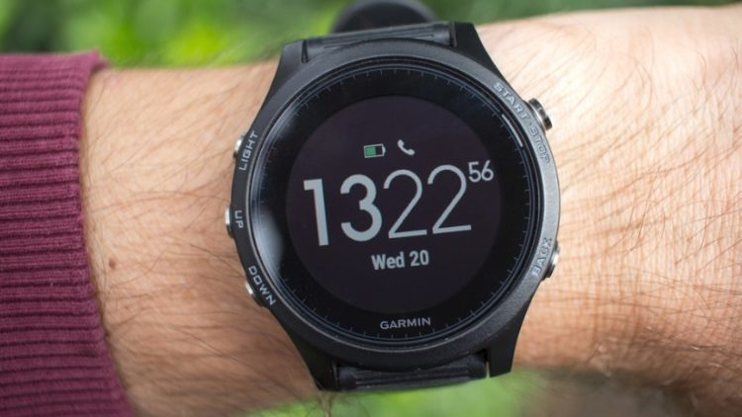
Running Wearables and Apps
Garmin
FitBit
TomTom
Apple Watch
Notes:
Those are just a few of the great apps designed specifically for runners who are blind. Now let me jump into some of the common running products for people of all abilities.
Some of the most popular wearables are the Garmin, FitBit, TomTom and the Apple Watch. Each of these have varying features but they all have fitness tracking components that can track your location, speed, elevation and more. They can track steps and biometrics, like heart rate and calories burned. When paired with a phone, the associated apps can track your run and progress with dashboards and link up with friends to see theirs.
We wanted to see how accessible these products were. Our methodology was using built-in assistive features to look at some of the interfaces. Our testing was conducted by informal usage by our staffers with a disability, using an iPhone.
Basically, we weren’t testing for a VPAT. This was a typical blind user who is adept at their iPhone, and emulating what they would encounter after a purchase.
I’ll start with my experience with Garmin and the Garmin Connect app.
Garmin supported the changes we made with respect to magnifier, zoom, and larger text. However, one of the larger issues that we noted with Garmin Connect—and spoiler alert—this will be a common theme, is unlabeled buttons and not immediate feedback. When we would try to sync the watch with the app on the phone, the progress was not identified audibly. Moreover, the actual button to sync was not labeled. (point on screen)
Other buttons to expand fitness information, like heart rate, steps, intensity minutes, and more, are all labeled the same way as identical ‘overview icons’. (point)
One of the main reasons why people purchase a Garmin is for the GPS tracking capabilities, and yet few of the buttons in the map view are labeled. While it’s easy to determine distance, calories burned, and speed of the run, bar graphs of activities to track days and streaks are not easily read by VoiceOver.

Slide 23
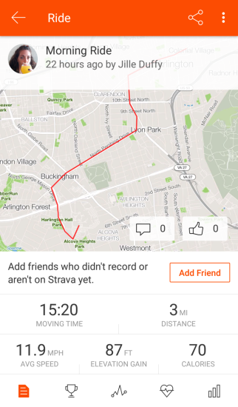
The Running Apps
Tested on iPhone
Strava
Nike Run Club
Runkeeper
MapMyRun
Notes:
After our foray with Garmin, we checked out a few more apps. Many of my colleagues and I prefer Strava, because it will sync workouts from other wearables and apps, like Garmin, Runkeeper, Nike, and more.
It’s a very social app, and you can cheer on your friends, view their runs, share pictures, and track a friend’s progress, sometimes in live time.
When we spoke earlier to Rich from the USABA, he found Strava to be the most accessible. In fact, he stopped using a wearable like the Garmin watch as his vision got worse and he couldn’t see the screen.
As we found with Strava and the three other apps I will discuss next, many of them have innate accessibility features built-in.

Slide 24
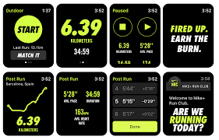
Nike Run Club
Dynamic app
Internal voice feedback
Unlabeled buttons/inactive
Lack of consistency
Notes:
I’ll delve into Nike Run Club. A few of you may have heard of this app, when it was initially Nike+. And, as Dana shared, it’s also Melissa Manak’s app of choice.
With respect to accessibility, we found it limited. The app itself was visually appealing and flashy. Yet, we noted that many buttons were not labeled and some data was unreadable. However, Nike had its audio output, and would read data out when the app was paused. This was not unique to Nike, as many running apps announce feedback via audio to prevent interruptions by pausing your run to read a screen. But if you turned off that audio and turned on VoiceOver, you couldn’t get the same data consistently.
Unless you knew specifically what you were looking for, data was read out of order, and did not make immediate sense. The unlabeled buttons especially made it hard to know whether we were pausing or resuming a workout, or uploading a picture by activating the camera.

Slide 25
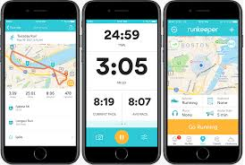
Runkeeper
Most accessible
Buttons for feedback labeled
Some buttons not named well
Internal screen reader
Notes:
Runkeeper was one of the more accessible options we tested. It accepted our changes for Zoom and large text. The app would announce location changes as we ran when VoiceOver was on.
After the run, there was a section for saying how your run felt and what hurt. The buttons had faces with expressions, or illustrations of body parts and weather-related complaints. We were pleased to see that each was descriptively labeled. Still, some other buttons had file path names,
We were able to hear our feedback read aloud via the internal screen reader. There was customization, too. A runner could change the voice and select the volume, instead of having presets.

Slide 26
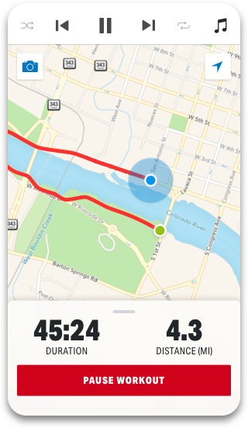
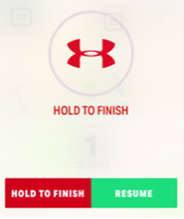
MapMyRun
Accessible maps
Unlabeled buttons
Internal screen reader
Finishing workout
Notes:
Finally, with MapMyRun, our experience was varied. The app was mainly accessible, but button labeling was inconsistent. For instance, the buttons to adjust settings mid-run, like music, weren’t labeled. Other buttons just had the name “button”.
MapMyRun had voice feedback. You could adjust the volume, and the intervals to be prompted, such as every tenth of a mile, all the way up to every 25 miles, or every 30 seconds to every 20 minutes.
Another issue we found was the lack of feedback when finishing a run. There was a visual ticker where you would hold with your finger to finish a workout. This is a good safety feature to prevent someone from accidentally stopping their run prematurely.
However, the status of that ticker is not made audible via VoiceOver, so you wouldn’t know how long you were holding for.

Slide 27
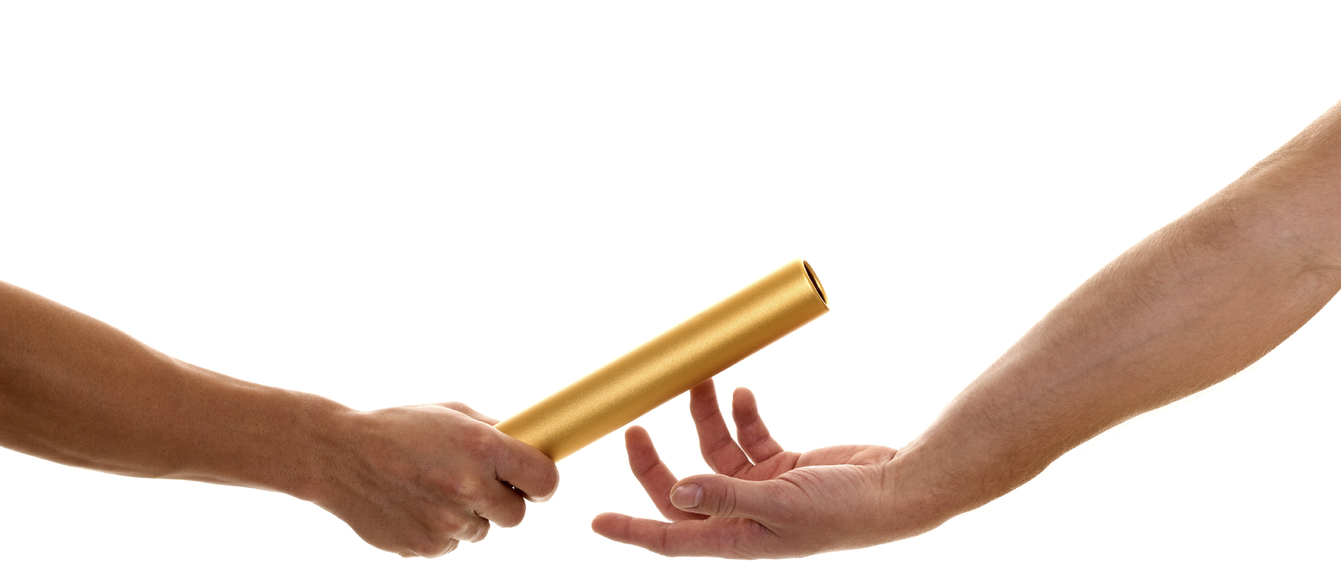
Overall findings
Labeled buttons would increase accessibility
More access to the interface
Screen readers and vibrations
Nothing truly ‘outside the box’ accessible
Notes:
Our results are truly a sprint, and this topic is more of a marathon. Essentially, the features happened to be accessible, but they were not designed to be accessible. By having labeled buttons or more interfaces available to assistive technology, the apps could be more accessible.
One interesting thing we noted was the dual audio output. On one hand, it was helpful that the apps had these audible feedbacks. However, if you wanted to hear more functionality, you still needed VoiceOver, which could cause duplicate voices sharing the same data. They seemed to be a battle with themselves, so it may make sense mid-run to not use VoiceOver, but then switch it on after the run was completed.
Overall, there was nothing really out-of-the-box accessible. We are hopeful that our feedback we shared to the developers in the app store and other user stories will drive these running apps to be more accessible.

Slide 28
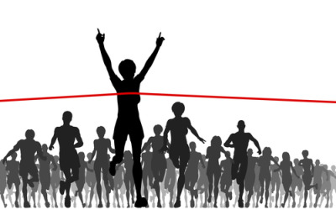
Conclusion
Running with a disability is inclusive
Challenges still persist
Great innovations for running technology specifically for blind runners
No truly accessible run tracking app
Not yet!
Notes:
I hope this was a good introduction to what you find out on the market today. Based on the stories from the runners we heard there’s all sorts of accommodations that can be made, but room for so many improvements. There’s no great, out-of-the-box accessible solution to download. Challenges persist in mainstream spaces, the lack of access in gyms, and even promoting fitness for people with disabilities.
Still, the innovations driven by Simon Wheatcroft’s story, other developers, like the Run Go and BlindAlive, and Robert’s attitude show that fitness can be made a priority, and that there are new developments on the horizon.
Yet, our feedback to developers for mainstream apps like Garmin, Nike, and Map My Run can only go so far. It is up to more runners to be vocal about their experiences and advocate to developers to make more accessible designs.
Running is sometimes a solitary pursuit, but the race to be inclusive can be a relay too. We welcome anyone on our team who wants to get over the design hurdles and leap towards more accessibility. Okay, enough running puns.

Slide 29
Organizations for Runners
U.S. Association of Blind Athletes (USABA)
United in Stride
Achilles International
Challenged Athletes Foundation (CAF)
Team Red, White, and Blue (RWB)
C Different Foundation
Notes:
If you’re interested in running with others or soliciting feedback from runners with disabilities, here’s a quick rundown of some organizations we are either members of, or have heard great feedback about their inclusion.
While all of them have their merits and distinguishing features, the summary is that they are great organizations that support runners with disabilities in various capacities.
I have links for more information about these in our resources slide, but the organizations I have on my slide include:
U.S. Association of Blind Athletes (USABA)
United in Stride
Achilles International
Challenged Athletes Foundation (CAF)
Team Red, White, and Blue (RWB)
C Different Foundation

Slide 30
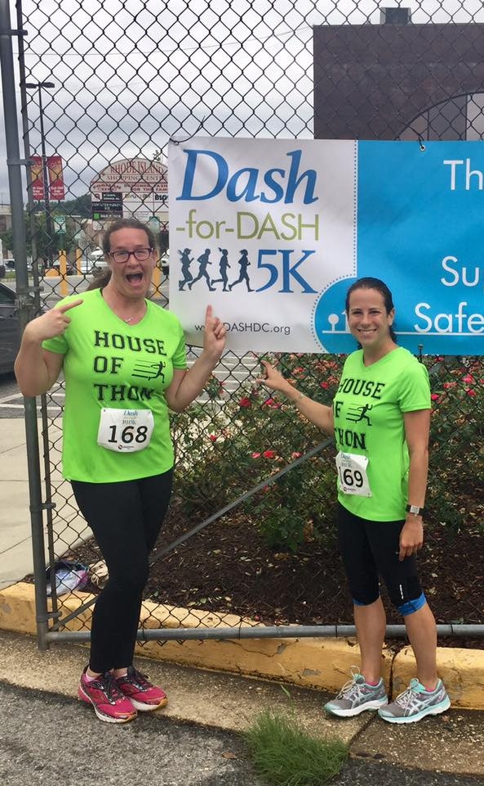
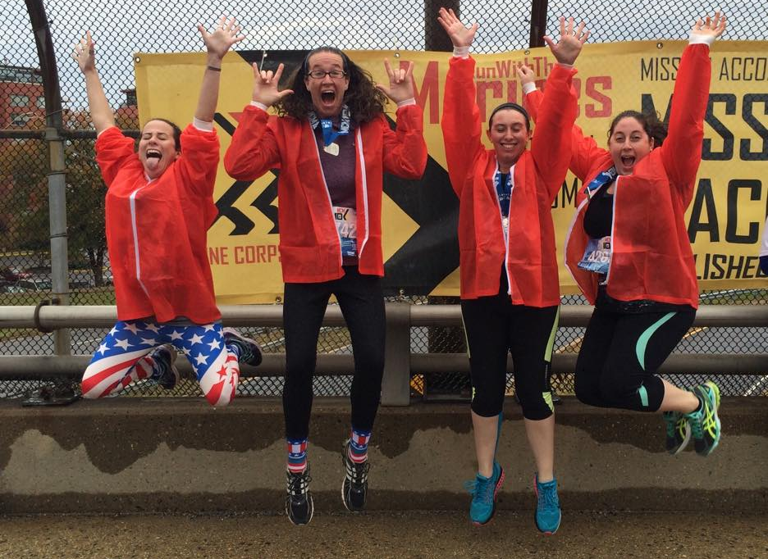
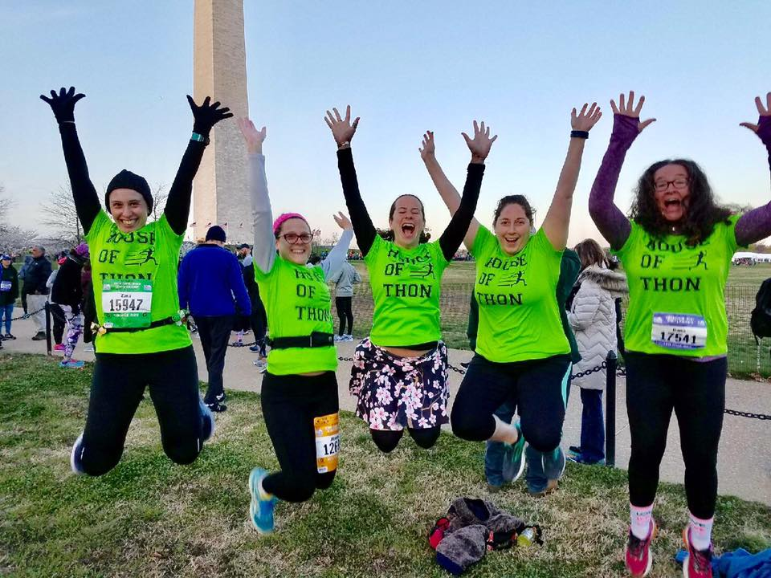
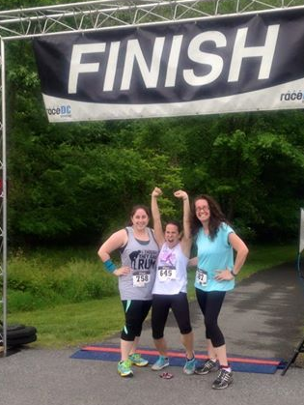
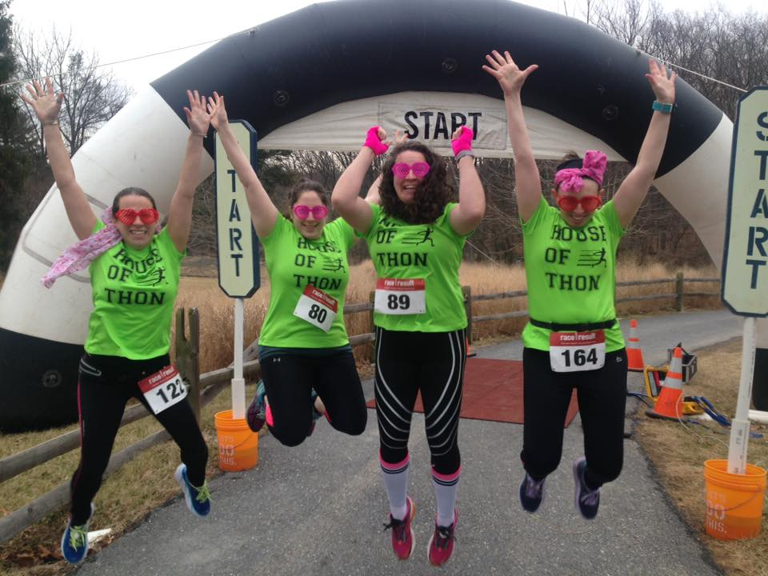
Thanks for lacing up with AP!
Notes:
Thank you for lacing up and joining us! Dana and I are happy to answer any questions you may have about our presentation, and we formally invite you to join us on any run. From the pictures we share on the slide, Dana and I are pretty much in our happy place when we wear lime green and take jumping finisher shot pictures. Running, for us, is half fitness and half fun. If there’s any interest during the conference, please reach out to us via Twitter @Access_Partners or with our contact information on the next slide to talk further or go for a run during CSUN.

Slide 31
Contact Information
Dana Marlowe:
DMarlowe@AccessibilityPartners.com
Sharon Rosenblatt: SRosenblatt@AccessibilityPartners.com
www.AccessibilityPartners.com 301-717-7177
www.facebook.com/AccessibilityPartners
@Access_Partners
Notes:
Say website first, then Dana’s information and then Sharon’s information.

Slide 32
Resources
Running & Jogging - Statistics & Facts
NFB: Being Blind and Being Fit Are Compatible Characteristics
The Guardian: Why do gyms make things so difficult for blind people?
RNIB: My Voice 2015: The views and experiences of blind and partially sighted people in the UK
Access to Fitness
APH: Fitness for Individuals Who Are Visually Impaired or Deafblind
Beyond the finish line: How technology helped a blind athlete run free at the New York Marathon
Eyes-Free Fitness: Described Workouts for the Blind and Visually Impaired
CBS News: Running Blind
Revolutionary eAscot app guides blind marathon runners
United in Stride
Achilles International
Run Go
Challenged Athletes Foundation
United States Association of Blind Athletes (USABA)
Team RWB
C Different Foundation
Running with Hearing Loss
Notes:
Here’s a link for further information about some of the technologies and products we talked about, as well as some of the running groups.
If you share your business card or contact information to share, we are happy to distribute this presentation.

