Slide 1
Going the Distance: The Accessibility of Fitness Apps and Running
CSUN Assistive Technology Conference March 13, 2019
Dana Marlowe and Sharon Rosenblatt

Slide 2
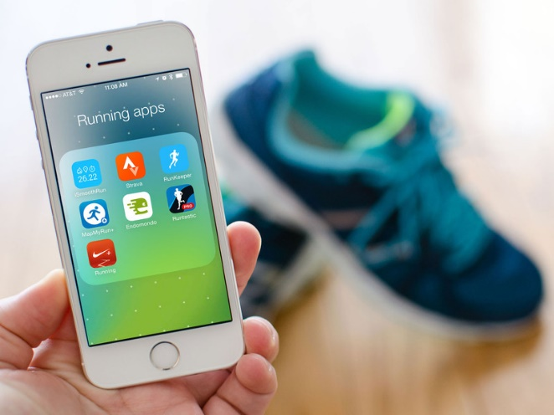
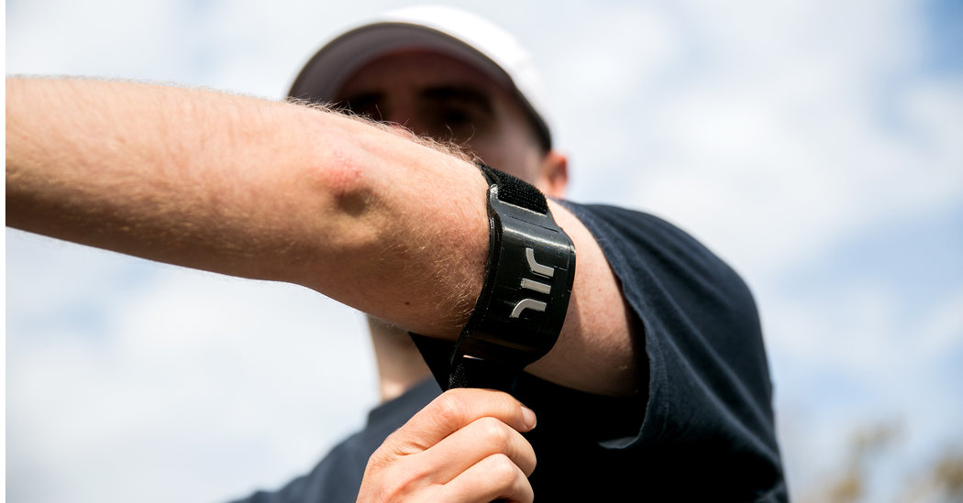
Hit the conference running:
The importance of fitness and running
Challenges to those with visual disabilities
Traditional accommodations
New technologies designed for athletes
Popular apps—are they accessible?

Slide 3
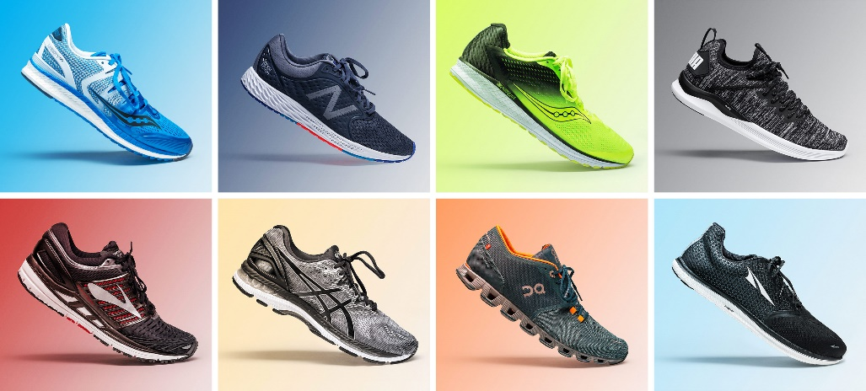
Who? More importantly, why?
Most popular sport worldwide
Nearly 60 million Americans ran or jogged
Walking for fitness had 110 million participants
25% of Americans ran for exercise/health
Continued success—runners report:
Racing
Staying healthy
Relieving stress
Surprisingly fun

Slide 4
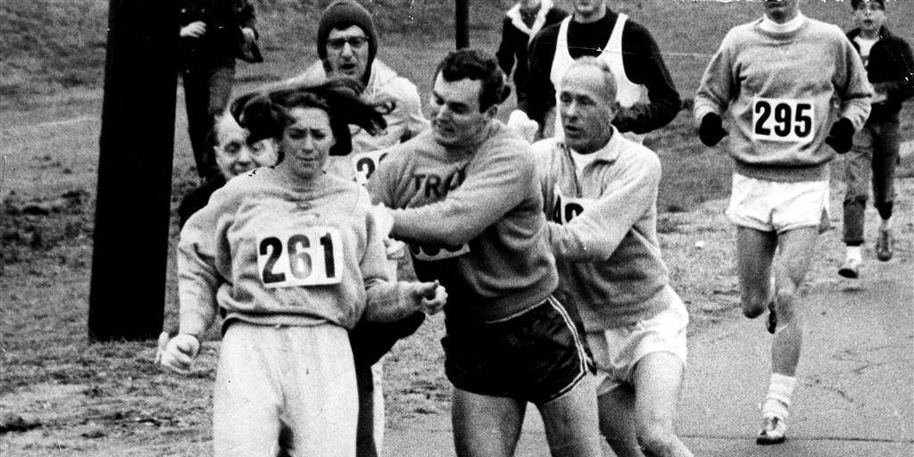
When everyone says you can’t…

Slide 5
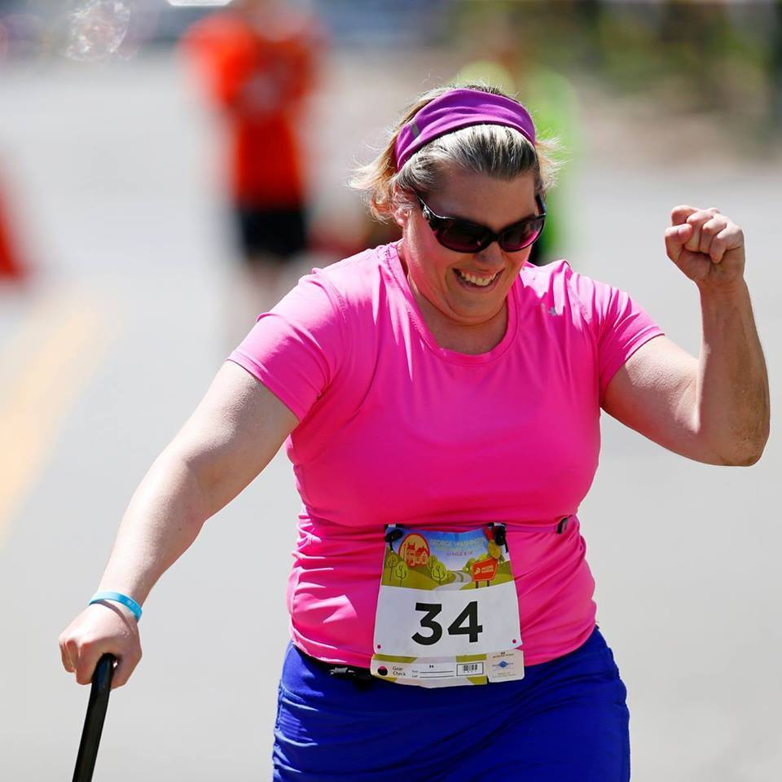
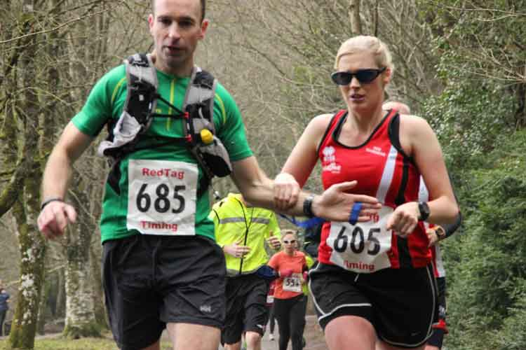
…Prove them wrong!

Slide 6
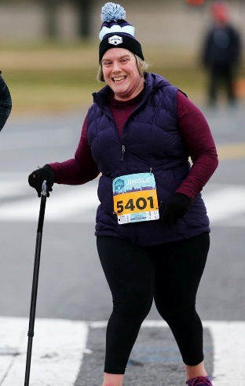
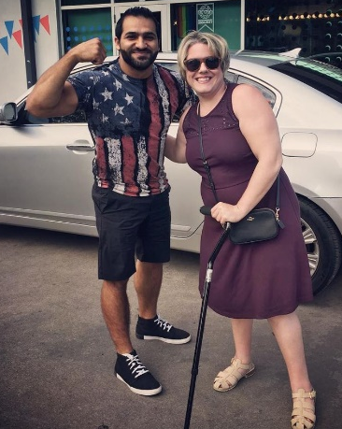
Jamie Watts Runs the World
Picks FitBit over Nike Running App
Loves the low cost/ no cost option
Trial and error
Inclusive
“If I can do it, anyone can do it.”

Slide 7
Melissa’s Story: “I run Deaf”
Noisy challenges
Weather unpredictability
Run with your disability
Haptic feedback
Nike Running Club
Apple Watch

Slide 8
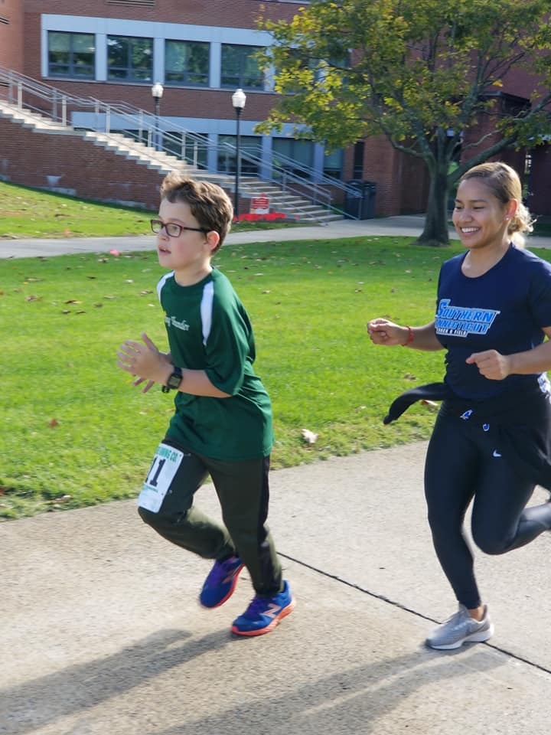
Fast and Fierce: Running with Autism
Child with Autism
Pairs child with a mentor
Run/walk apps
Map features: Garmin

Slide 9
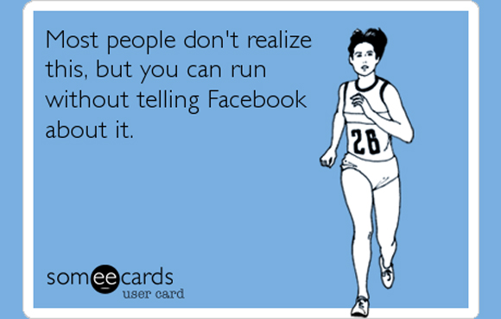
Participation Medal

Slide 10
It isn’t easy for most blind people to run out and join a gym or jump in the car to get to fitness classes. Buying a video in order to take up yoga or find out if Pilates is the answer requires endless explanation and interpretation at the very least.
So what is a blind person to do?
-Robert Leslie Newman, Board of Nebraska Commission for the Blind and Visually Impaired (NCBVI)

Slide 11
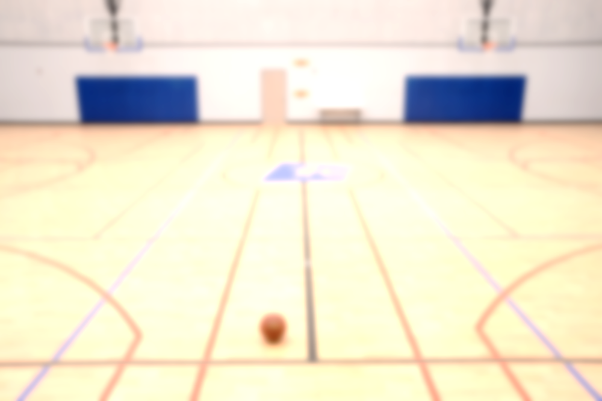
The Need for Speed: Challenges
Misinformation and misunderstanding
Lowered expectations
Few accommodations in schools
Inaccessible spaces/equipment
Safety
Attitudinal barriers

Slide 12
Accessibility on Fitness Equipment
Inaccessibility on machines—very visual:
Touchscreens, buttons, and lights
Suggestions:
Braille on buttons
Headphone jacks (like ATMs)
Bluetooth capabilities
Free pass to partner/assistant

Slide 13
Isolation and Exercise
Royal National Institute for the Blind:
30% cut off from people and things around them
50% limited in activities
65% want to do more physical activity
I’m stubborn, though. My philosophy is that if things aren’t accessible, don’t wait until they are.
-Amar Latif, The Guardian

Slide 14
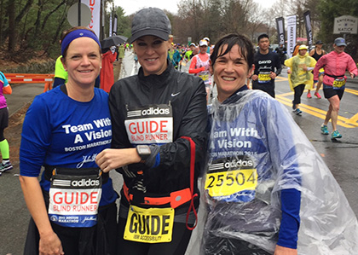
Low-tech Running Aids
Sighted guide
Holds arm
Communication
Terrain
Tether method
Stability
Avoid injury
Treadmill
Increased independence

Slide 15
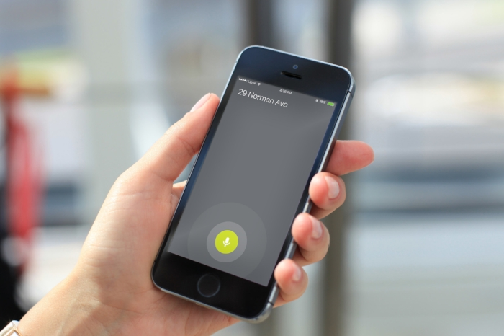
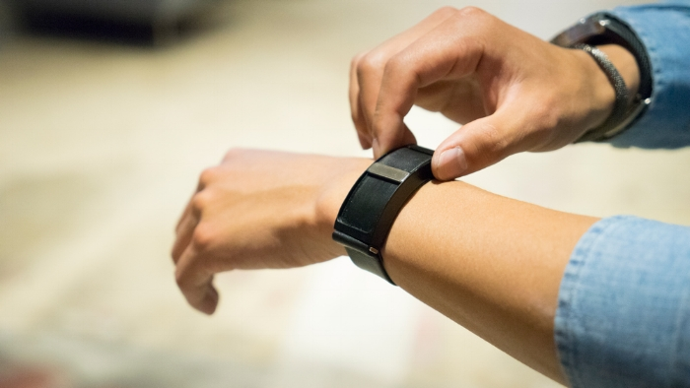
Connecting to your Run: WayBand
Wearable haptic navigation device
Vibration-driven guidance
Download app—tell it where you are going
Wearable guides you the rest of the way!

Slide 16
The WayBand in Motion

Slide 17
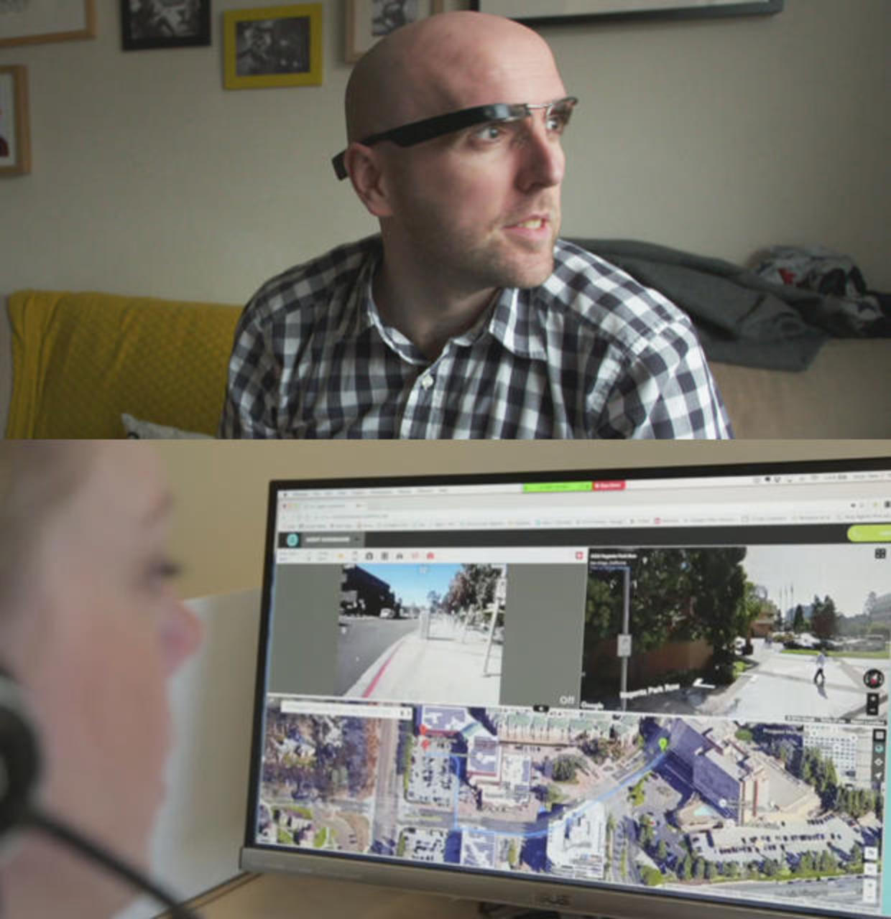
Aira
Connect to agent
Wearable
Acts as user’s eyes
“When I have to use a treadmill, I use Aira to check the digital display post run.”
Richard Hunter
USABA Marathon National Championship, Program Coordinator

Slide 18
eAscot from IBM
Beeping noise to align you
Keeps on straight path, think car sensors

Slide 19
RunGo: Voice Guided Running

Slide 20
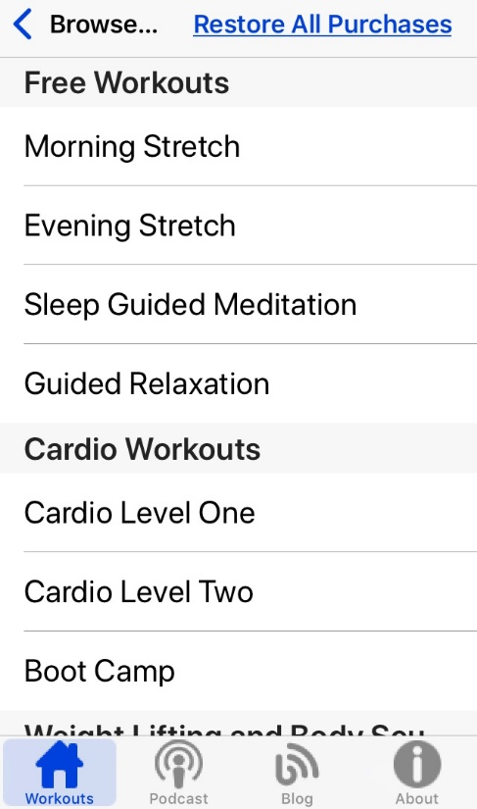
Eyes-Free Fitness
Free and paid routines: download mp3
Dynamic font with easy-to-use interface
VoiceOver accessible
Created by BlindAlive

Slide 21
BlindAlive

Slide 22
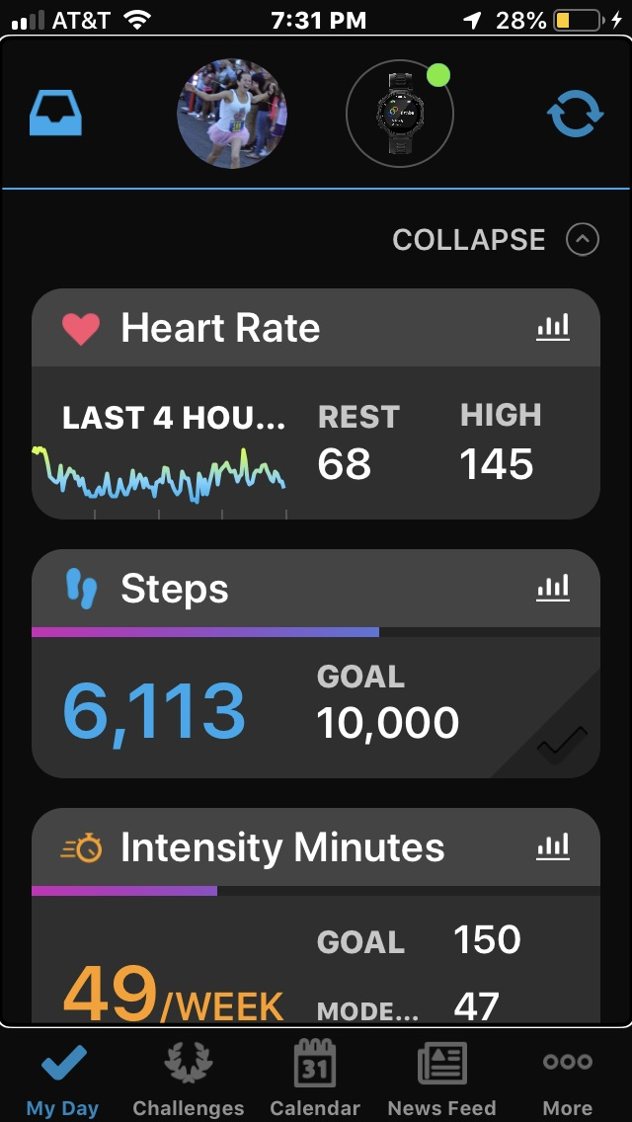
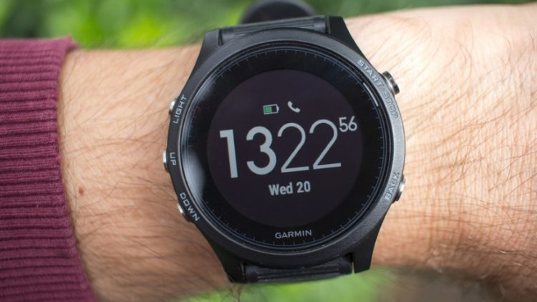
Running Wearables and Apps
Garmin
FitBit
TomTom
Apple Watch

Slide 23
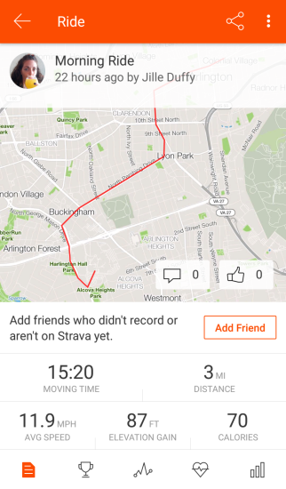
The Running Apps
Tested on iPhone
Strava
Nike Run Club
Runkeeper
MapMyRun

Slide 24
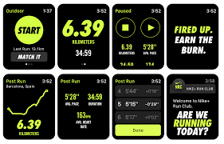
Nike Run Club
Dynamic app
Internal voice feedback
Unlabeled buttons/inactive
Lack of consistency

Slide 25
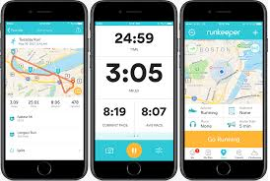
Runkeeper
Most accessible
Buttons for feedback labeled
Some buttons not named well
Internal screen reader

Slide 26
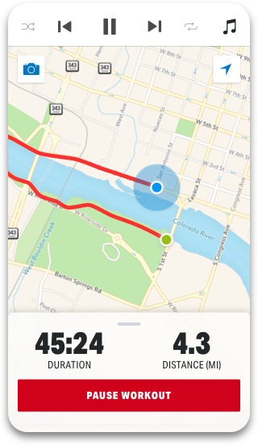
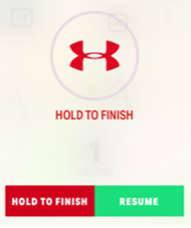
MapMyRun
Accessible maps
Unlabeled buttons
Internal screen reader
Finishing workout

Slide 27
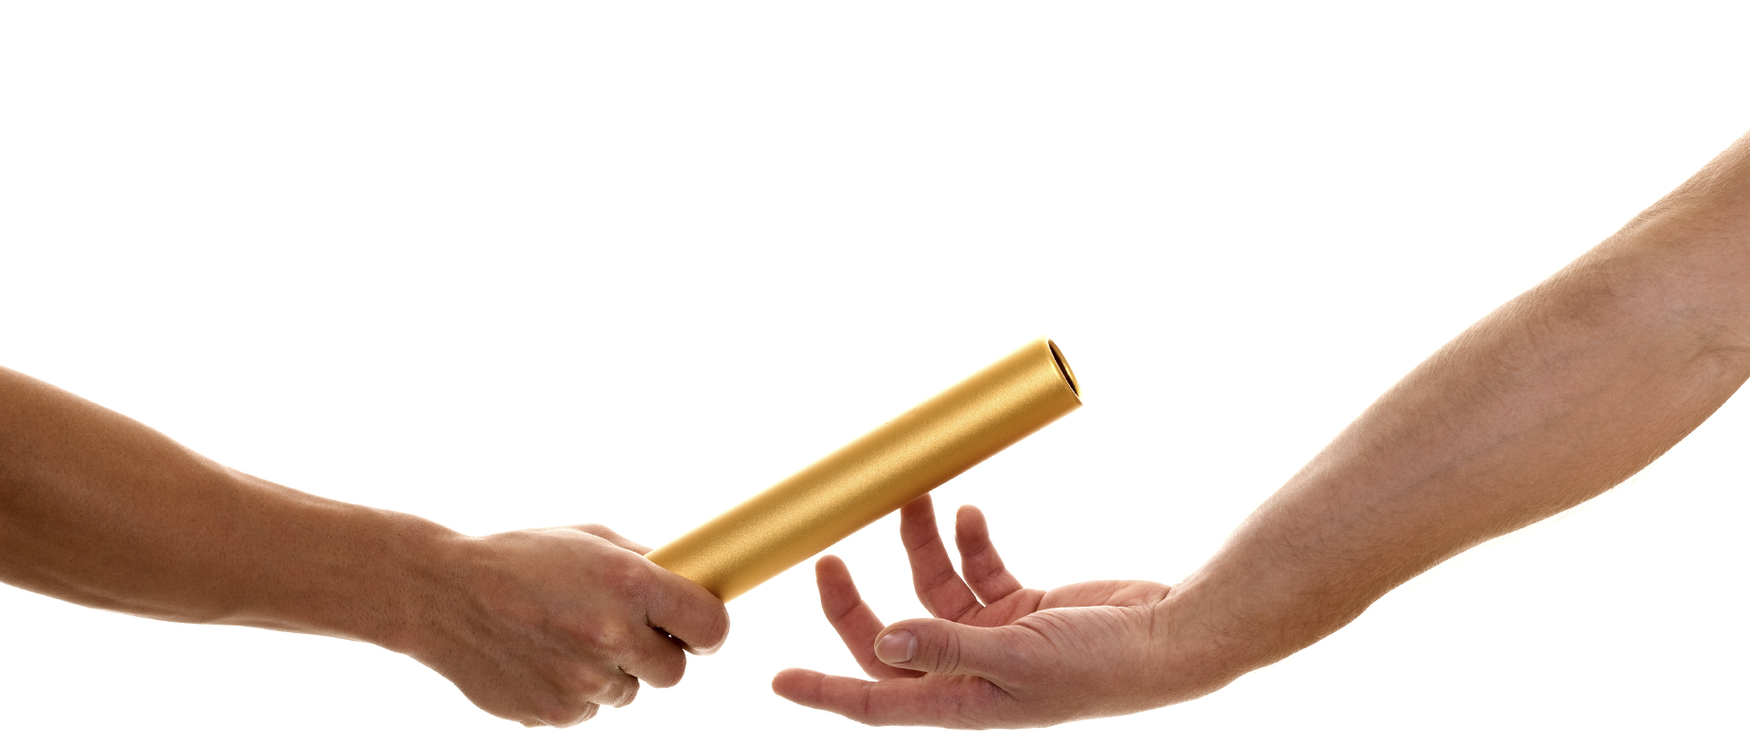
Overall findings
Labeled buttons would increase accessibility
More access to the interface
Screen readers and vibrations
Nothing truly ‘outside the box’ accessible

Slide 28
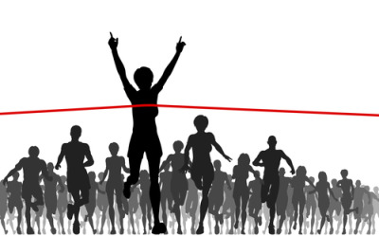
Conclusion
Running with a disability is inclusive
Challenges still persist
Great innovations for running technology specifically for blind runners
No truly accessible run tracking app
Not yet!

Slide 29
Organizations for Runners
U.S. Association of Blind Athletes (USABA)
United in Stride
Achilles International
Challenged Athletes Foundation (CAF)
Team Red, White, and Blue (RWB)
C Different Foundation

Slide 30
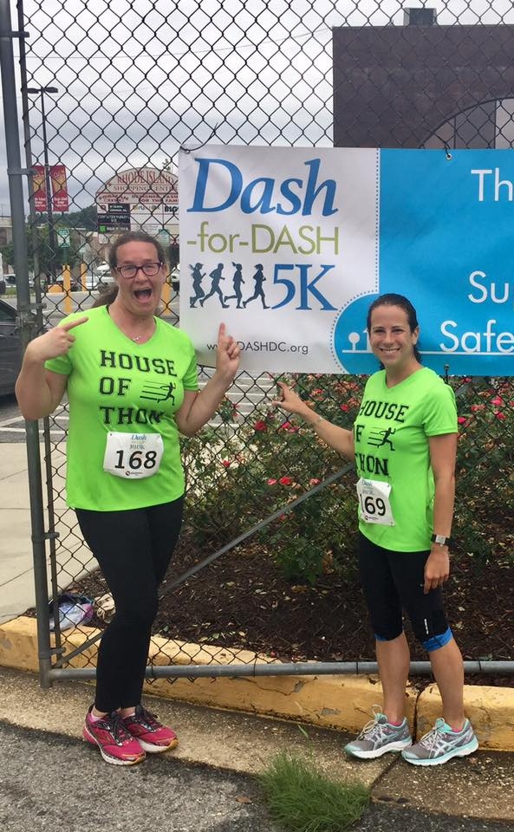
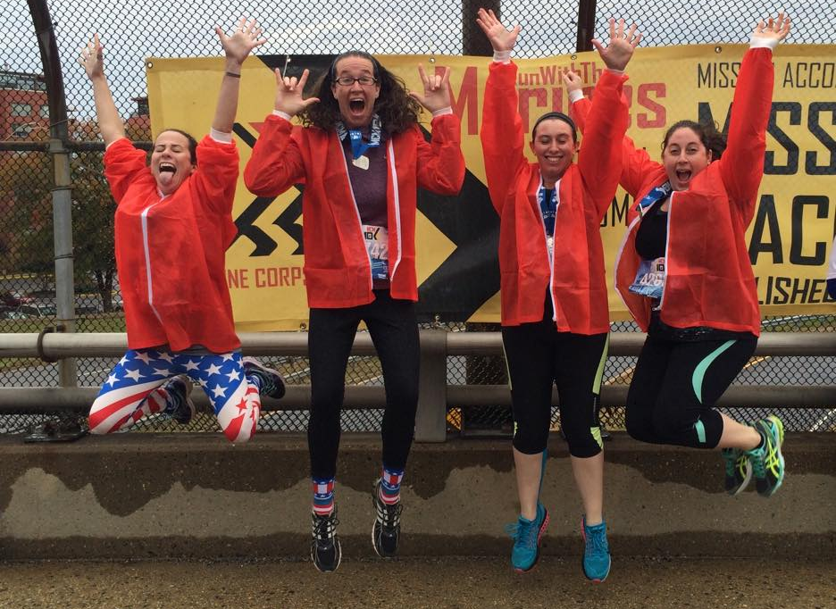
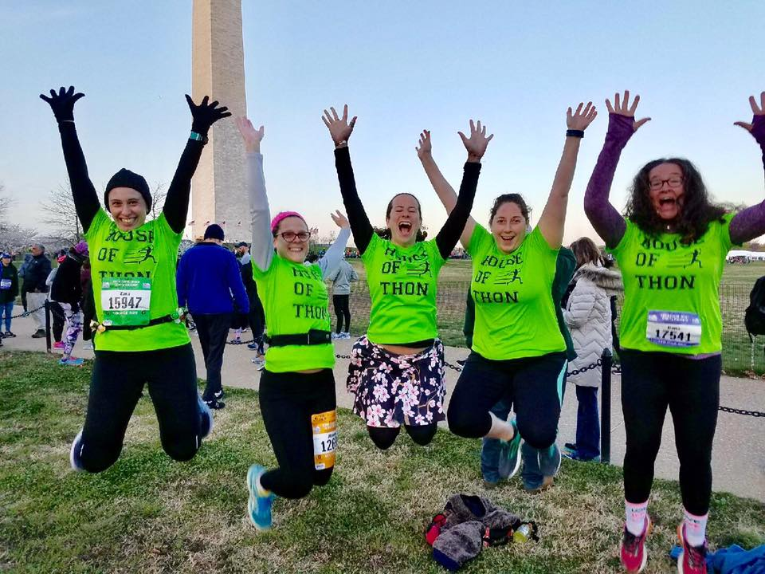
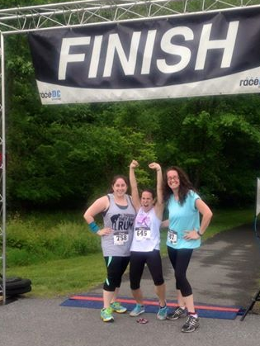
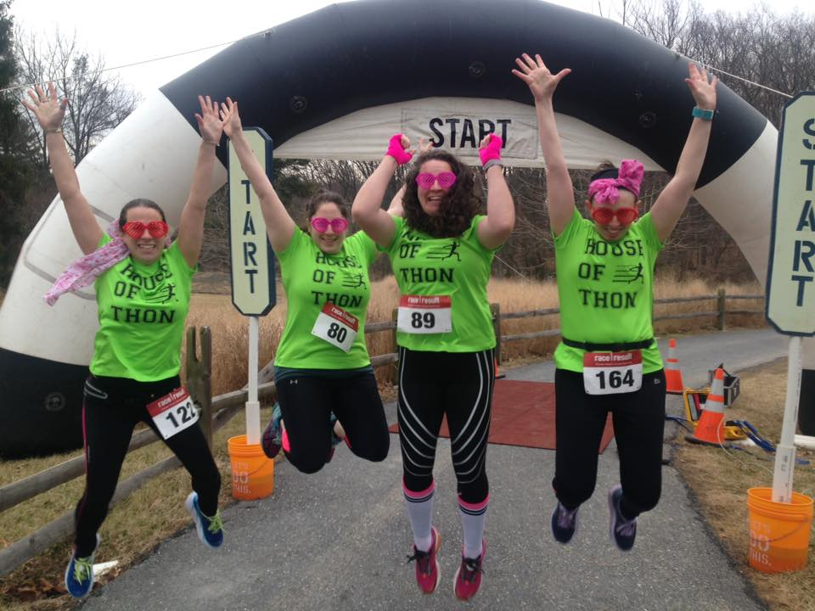
Thanks for lacing up with AP!

Slide 31
Contact Information
Dana Marlowe:
DMarlowe@AccessibilityPartners.com
Sharon Rosenblatt: SRosenblatt@AccessibilityPartners.com
www.AccessibilityPartners.com 301-717-7177
www.facebook.com/AccessibilityPartners
@Access_Partners

Slide 32
Resources
Running & Jogging - Statistics & Facts
NFB: Being Blind and Being Fit Are Compatible Characteristics
The Guardian: Why do gyms make things so difficult for blind people?
RNIB: My Voice 2015: The views and experiences of blind and partially sighted people in the UK
Access to Fitness
APH: Fitness for Individuals Who Are Visually Impaired or Deafblind
Beyond the finish line: How technology helped a blind athlete run free at the New York Marathon
Eyes-Free Fitness: Described Workouts for the Blind and Visually Impaired
CBS News: Running Blind
Revolutionary eAscot app guides blind marathon runners
United in Stride
Achilles International
Run Go
Challenged Athletes Foundation
United States Association of Blind Athletes (USABA)
Team RWB
C Different Foundation
Running with Hearing Loss

