Slide 1
Get in Formation: Making Forms Accessible Using Adobe Acrobat
2019 LEAD® Conference August 7, 2019
Sharon Rosenblatt

Slide 2
Session Goals:
Have a better understanding of the document lifecycle with content creation and distribution, while factoring in the needs of users with disabilities
Be able to take forms from various document authoring software and create accessible forms using Adobe Acrobat
Conduct a validation of their own content to check results of an accessible form

Slide 3
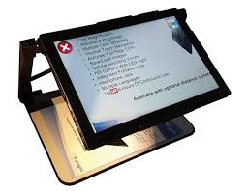
What is Assistive Technology?
Increase, maintain, or improve
Creates a diverse/inclusive world
Communication and organization
Promotes independence

Slide 4
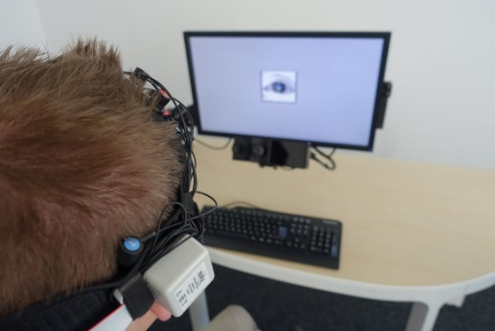
Types of Assistive Technology
Screen readers
Voice recognition
Hearing aids
Reading assistants
Closed captioning/subtitles
Motion or eye tracking
Refreshable Braille displays

Slide 5
What is Accessible Technology?
Technology designed to meet needs of users
Incorporates assistive technology
Customizable tools:
VoiceOver, Narrator, Magnifier
Benefit people with disabilities, but universal design can benefit anyone!

Slide 7
Not Quite Beyoncé, but…
Understand your document
Understand your audience/user
How was the document created?
Fixing your document as source/final
Validate the form for all users

Slide 8
Understand Your Document:
What am I sharing?
What do I want my user to understand?
Are there other ways to share the information?
Did I author the content?
Can I contact other authors of materials?

Slide 9
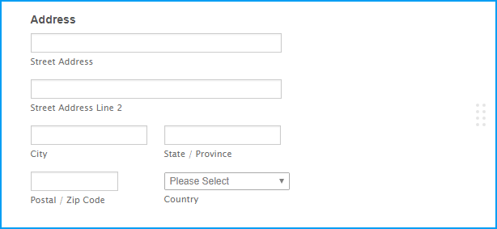
Further Understanding:
What complex elements are there?
Graphics, charts, tables, infographics, form fields…
What are my accessibility responsibilities?
Section 508/WCAG
Your user: think about their access

Slide 10
What is Section 508?
Applies to Federal departments and agencies
Does not apply to private sector
Requirements:
Develop, procure, maintain, or use accessible tech
Unless it poses an undue burden
Comparable access to people without disabilities

Slide 11
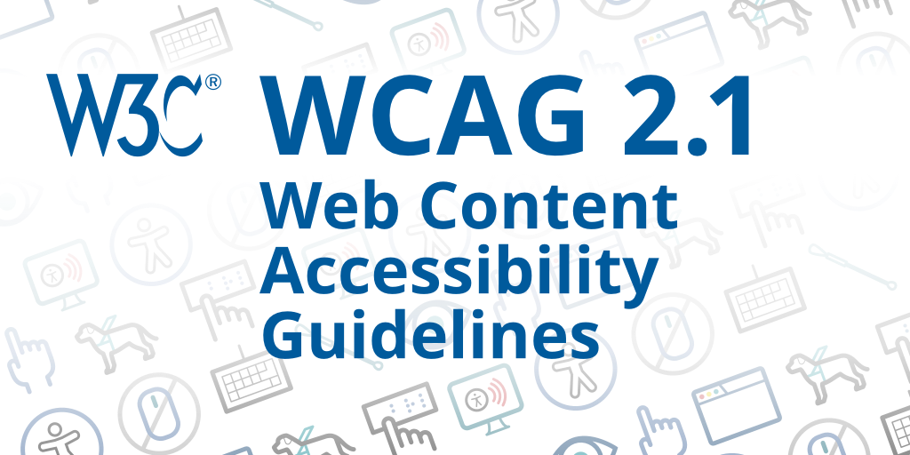
What is WCAG 2.0/2.1?
Web Content Accessibility Guidelines
Via the World Wide Web Consortium (W3C)
Cooperate of individuals and organizations
Single shared standard for web accessibility
Designed for:
Individuals
Organizations
Governments
An international best practice

Slide 12
Let’s Get Technical! Section 508
GSA has online checklist:
PDF Testing Checklist

Slide 13
Let’s Get Technical: WCAG
Section 508 now mirrors WCAG
Are all form fields correctly tagged? (WCAG 2.0 3.3.2)
Do all form fields create understandable labels and tooltips? (WCAG 2.0 3.3.2)
Do all tooltips contain formatting requirements that will be automatically flagged as an error? (WCAG 2.0 3.3.2)
Are required fields programmatically set? (WCAG 2.0 3.3.1)
Is the tab order of the form fields logical? (WCAG 2.0 1.3.2)

Slide 14
Any Questions?

Slide 15
Tag, You’re It!
A tagged PDF factors in accessibility
Tags: hidden structure of the PDF
Presented to screen readers
Not visible, necessary for accessibility
Similar to HTML code
Adobe, Acrobat, and PDF: not interchangeable
Adobe: company/creator
Acrobat: product by Adobe, tools to edit PDF
PDF: format or type of document, open format

Slide 16
Tag Types
Tag Description | Acrobat Generated | Word Generated
Heading | <H1>,<H2> <Heading 1>, <Heading 2> | Heading 1, Heading 2
Paragraph | <P> | <P> or <Normal>
List | <L> | <L>
Figure | <Figure> | <Inline Shape>, <Inline Object>
Table | <Table> | <Table>
Table Row | <TR> | <TR>
Table Header Cell | <TH> | <TH>
Table Data Cell | <TD> | <TD>

Slide 17
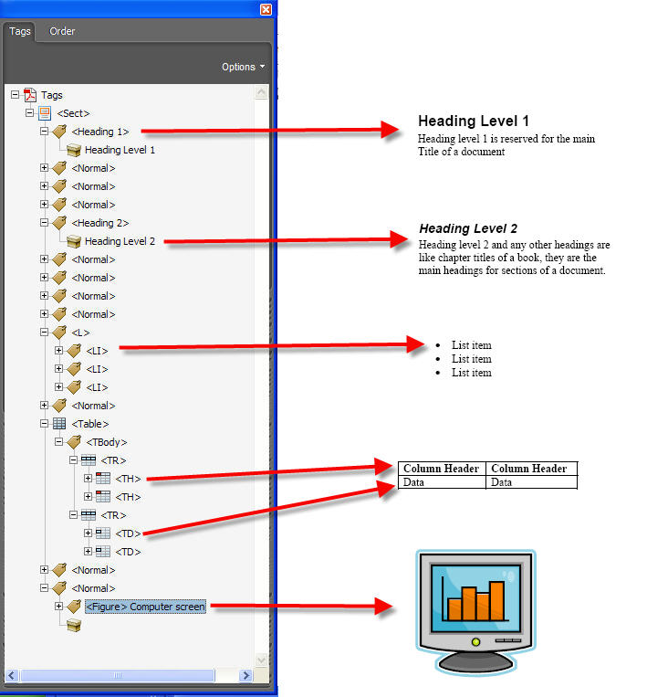
In the Real World…

Slide 18
Your Workflow
Consider accessibility before converting
Add fillable form fields
Add other accessibility features
Tag PDF
Evaluate and repair
Distribute

Slide 19
All Roads Lead to PDFs
Where was your document created?
Automatically generated from data
Most converted to PDF (Word or InDesign)
Some work must be done in Acrobat
Documents in Word will retain:
Headings
Alternative text
Table structure
Links
Lists
Columns

Slide 20
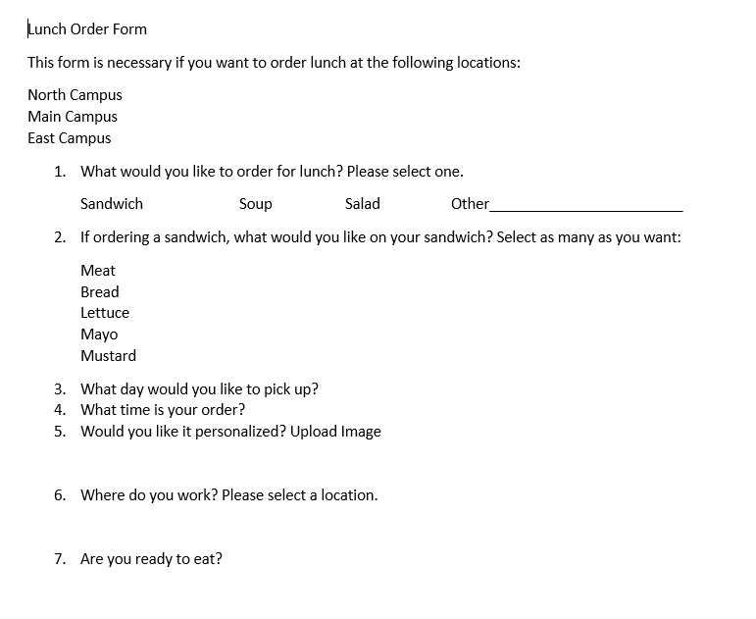
Our Word Form

Slide 21
Converting to Tagged PDF
Main methods for converting to PDF:
Converting Microsoft Office documents to PDF using Adobe Acrobat
Converting files into PDF within Microsoft Office applications using the Adobe Acrobat plug-in
Converting a scan to PDF

Slide 22
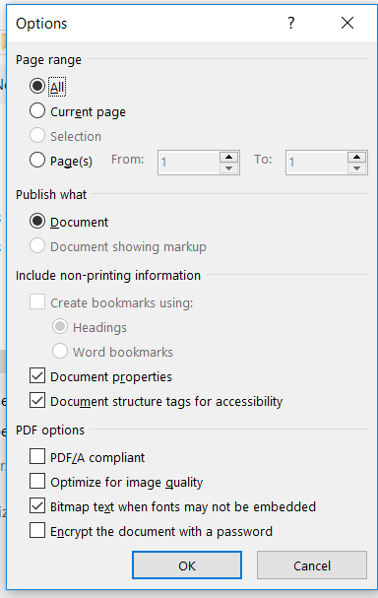
Focus on Word Plug-In
To create a PDF in Office, select File > Save As
Acrobat: Save as Adobe PDF
Ensure structure tags

Slide 23
Show Me the Tags!

Slide 24
Show Me the Tags!

Slide 25
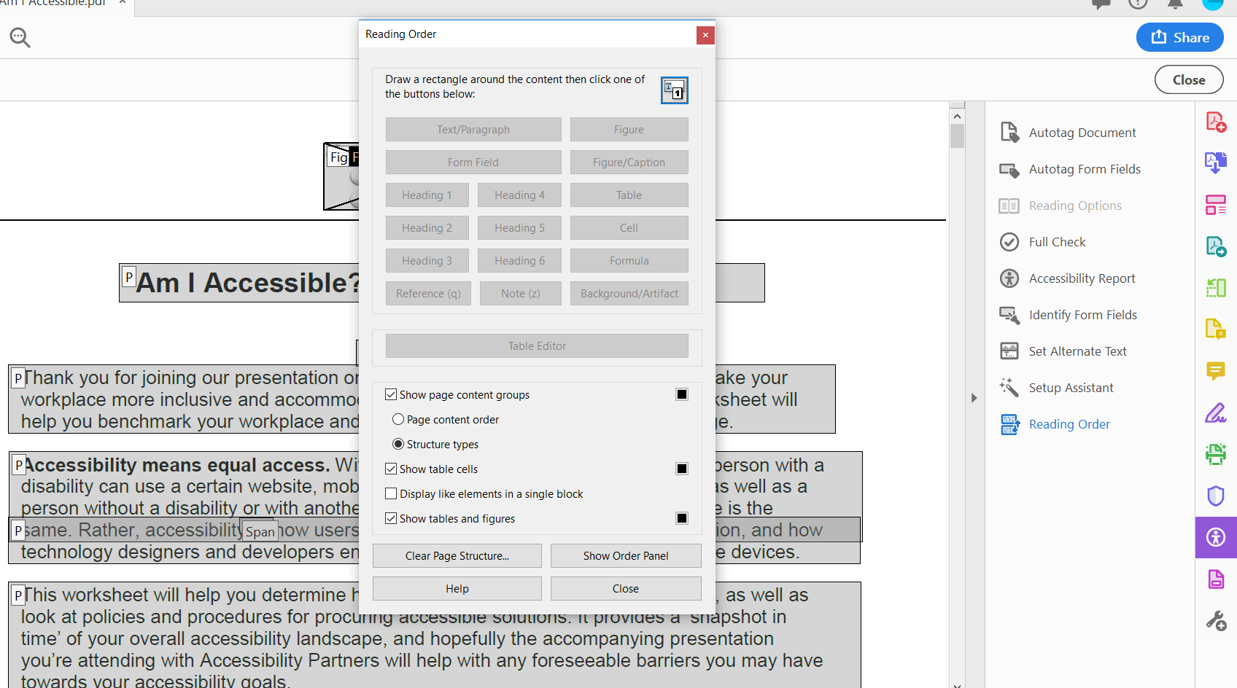
Touch Up Reading Order (TURO)

Slide 26
Demonstration:
Form field types:
Text fields
Date
Check boxes
Radio buttons
Dropdown lists
List of choices
Button

Slide 27
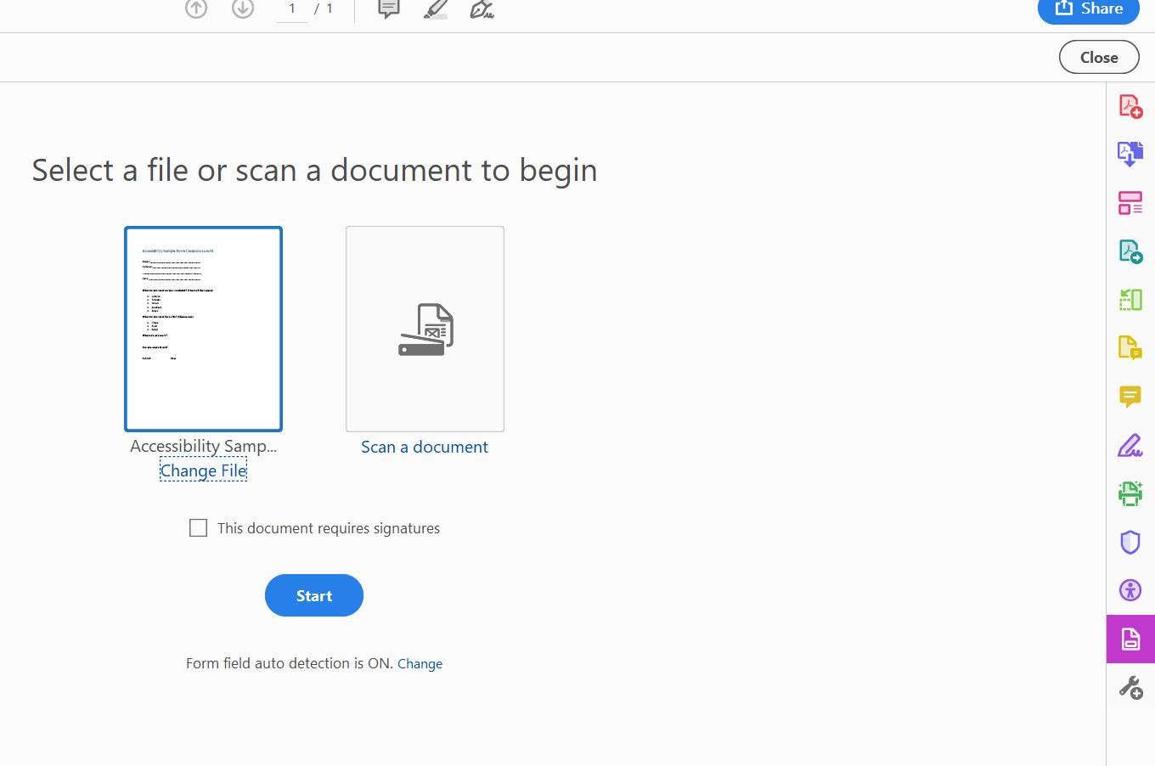
Inserting a Form Field
Prepare Form
Keep signatures in mind

Slide 28
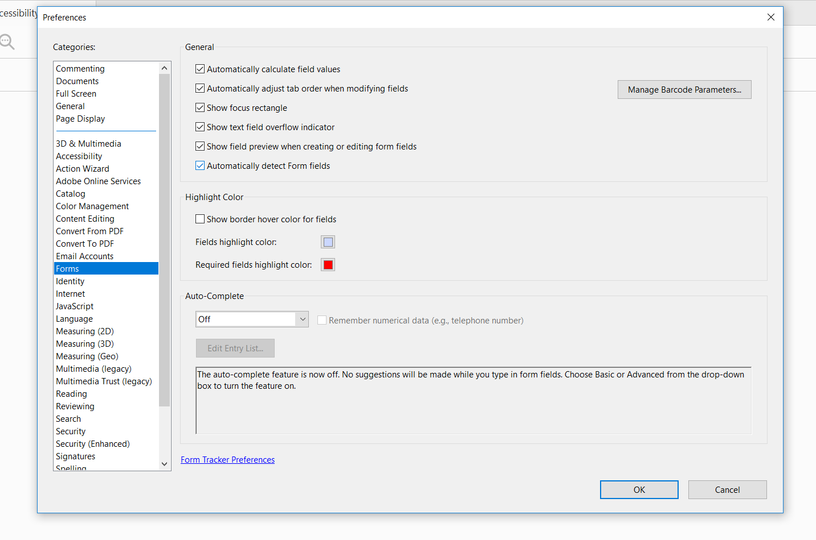
Up To You—Automatic or Manual!

Slide 29
The ToolTip
Text read by assistive technology

Slide 30
The Forms Toolbar

Slide 31
Inserting a Text Field

Slide 32
You Have Options…

Slide 33
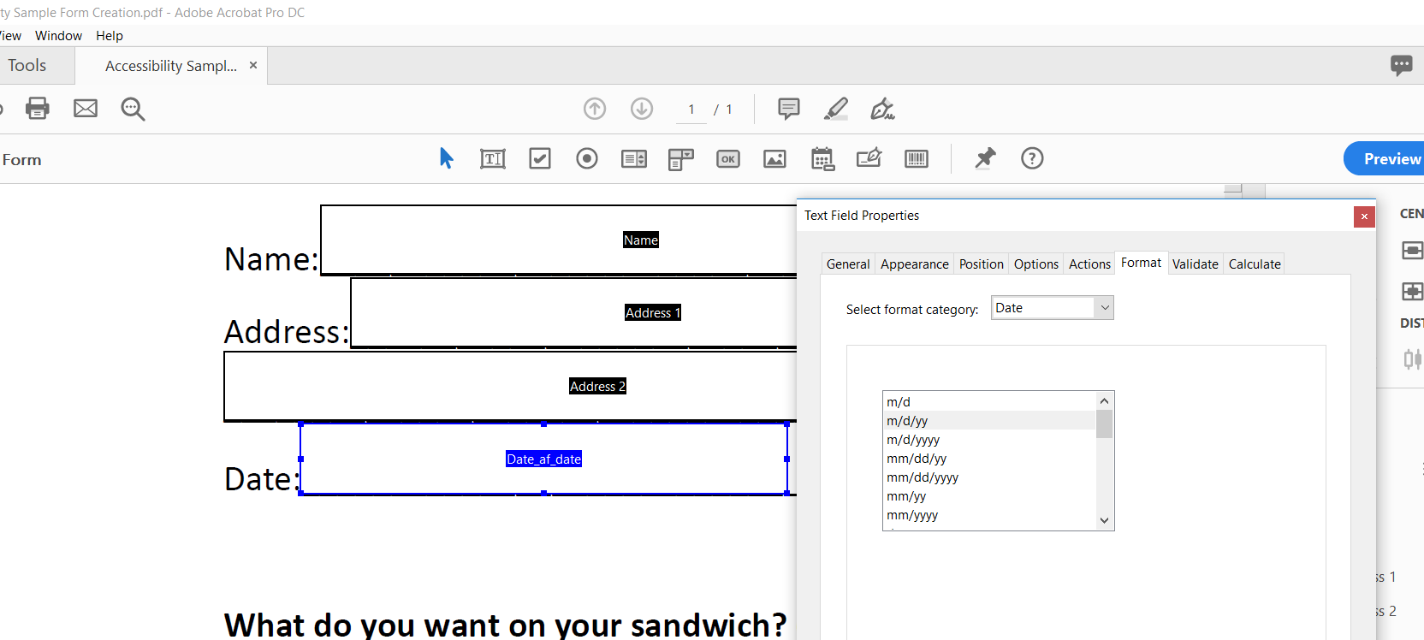
Your Best First Date

Slide 34
‘Check’ You Out!

Slide 35
If You Don’t Like What You See:

Slide 36
Add Your ToolTips!

Slide 37
Radio This One In

Slide 38
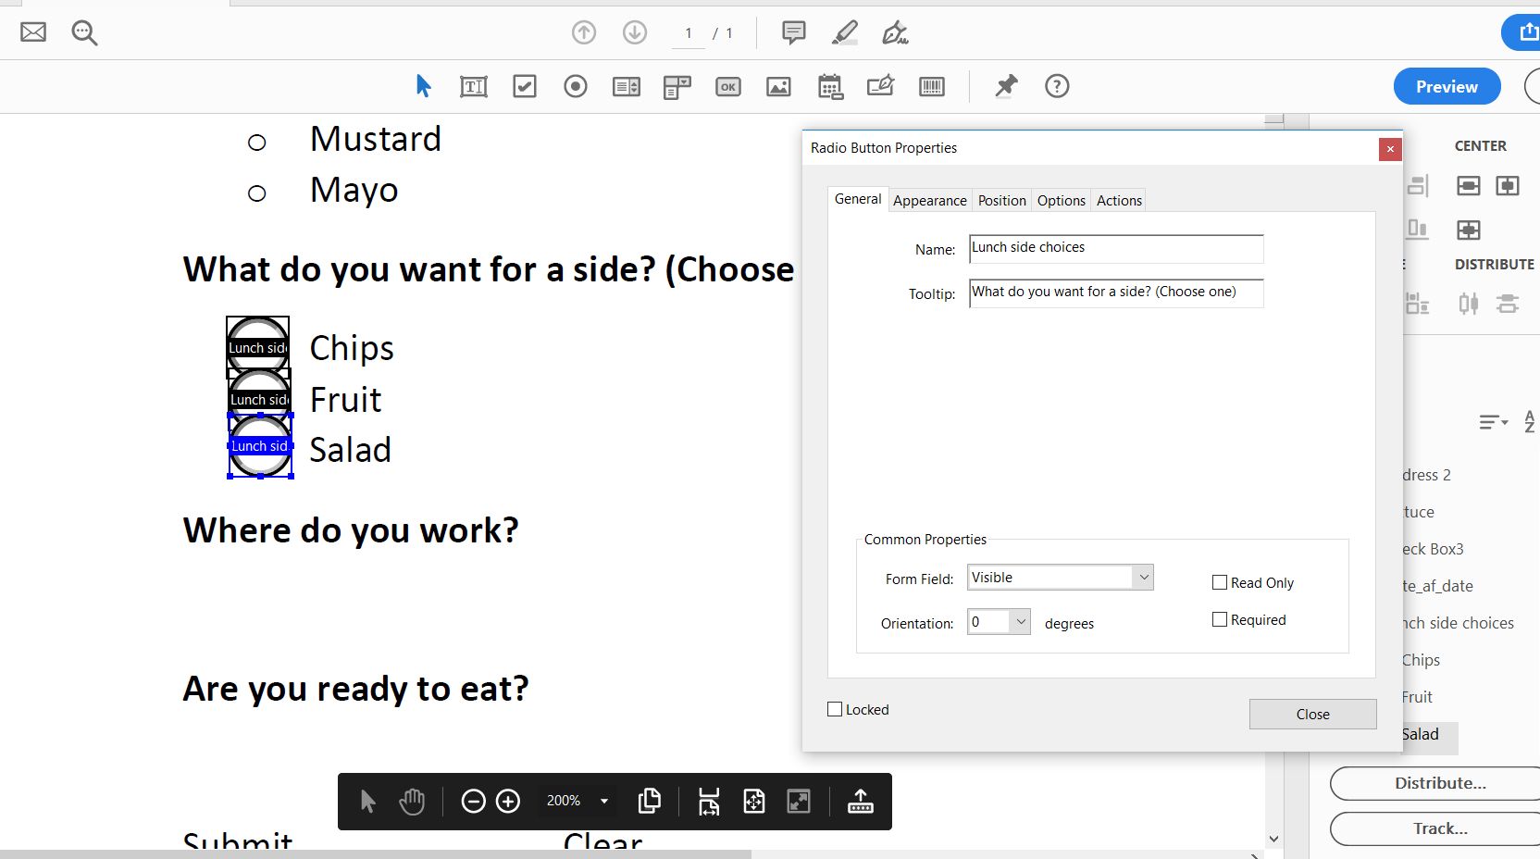
ToolTips for Radio Buttons

Slide 39
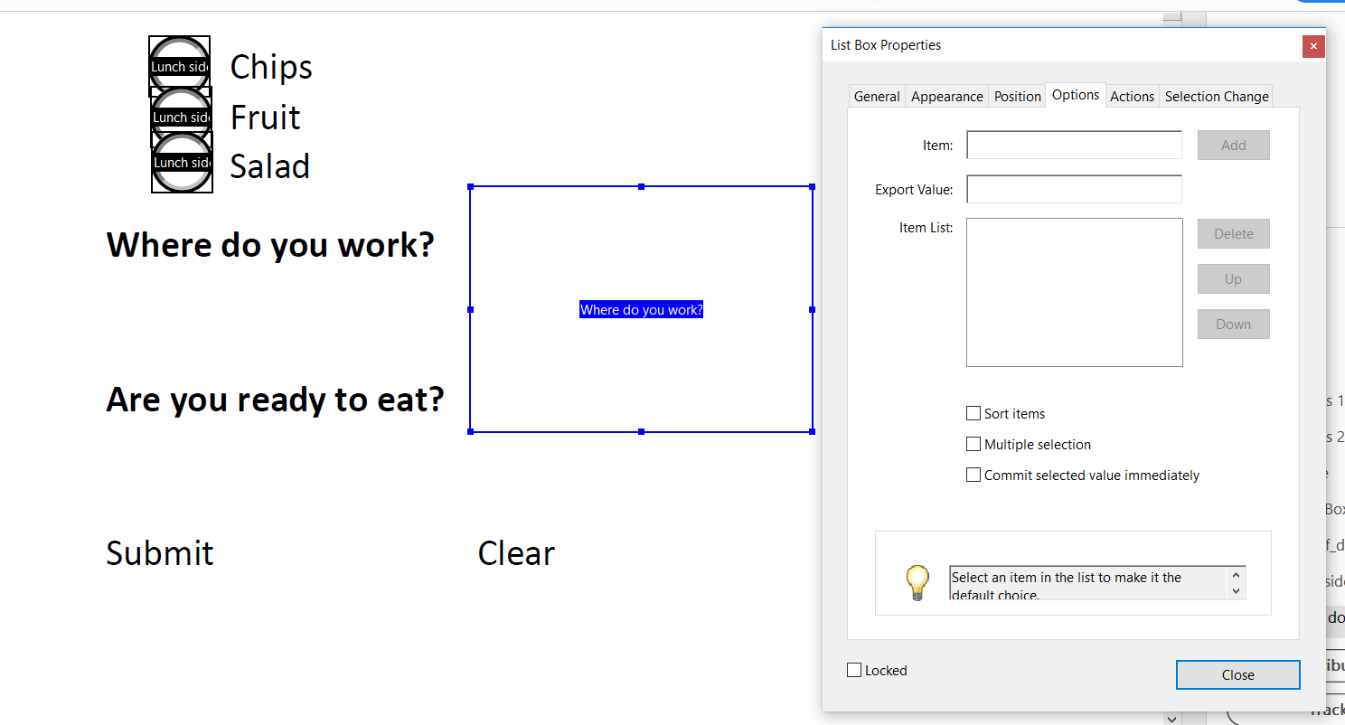
Making a list…

Slide 40
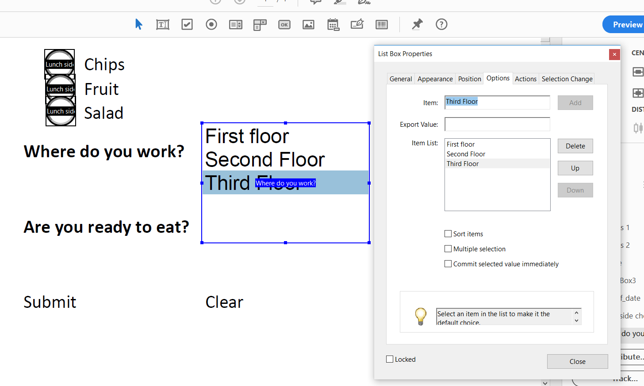
Checking it twice!

Slide 41
The Dropdown List

Slide 42
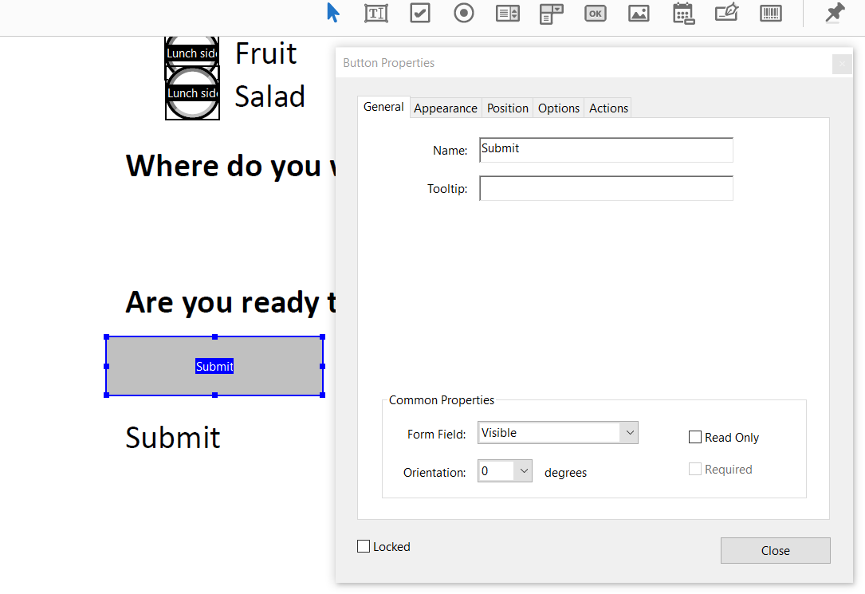
Don’t Push My Buttons

Slide 43
Execute Options for Buttons

Slide 44
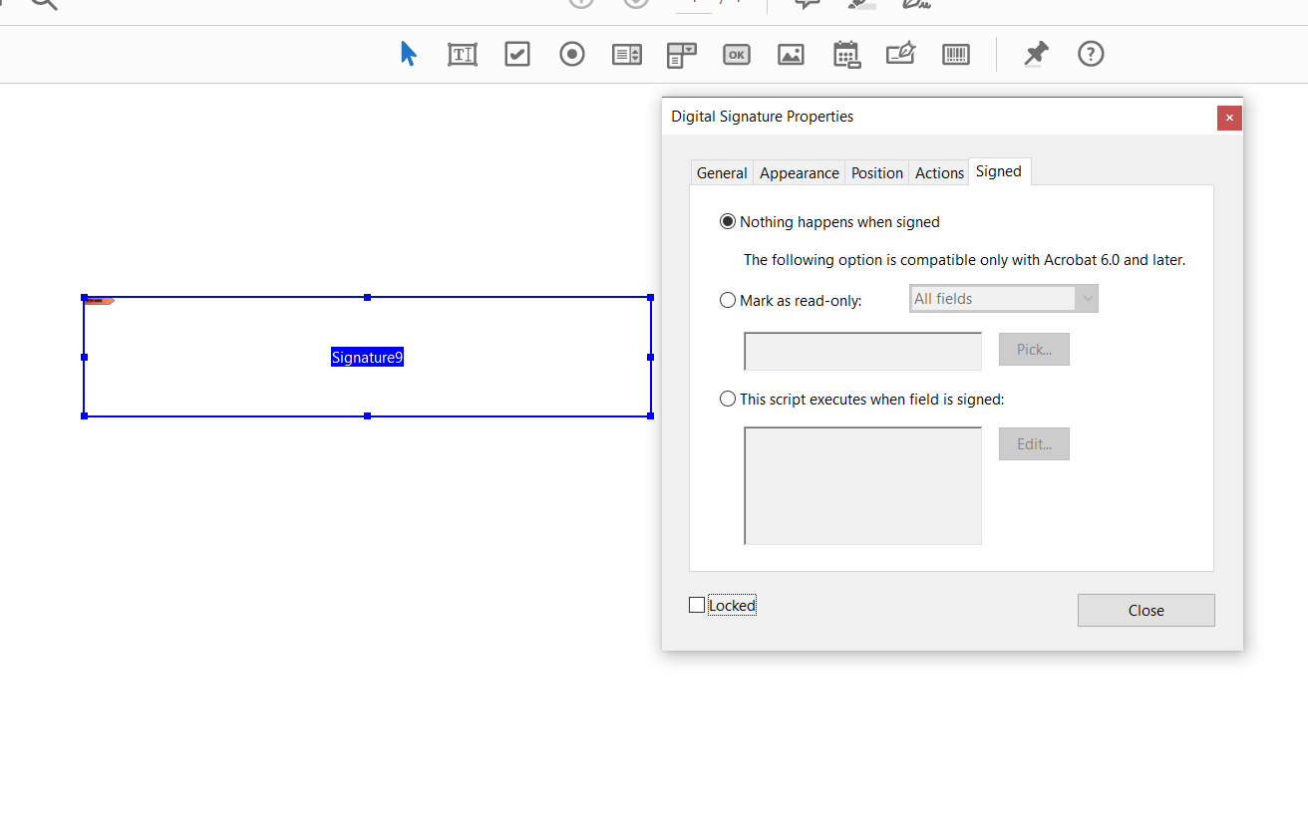
Other Form Fields: Signature

Slide 45
Other Form Fields: Image

Slide 46
Any Questions?

Slide 47
Ensure Reading Order
Often in order created
Reorder manually

Slide 48
Adding Form Fields to Tags
Can be time consuming
Ensure that your body text is tagged too

Slide 49
The Search Is On!

Slide 50
How to Nest:

Slide 51
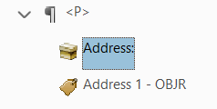
What Happened?
Can manually create form field if tag doesn’t have an identifier

Slide 52
Things to consider:
Make sure each item on a list is separate
Avoid chunks for check boxes and radio buttons
Can tag lines/styles as background
Nobody wants to hear outlines read
Font size and color

Slide 53
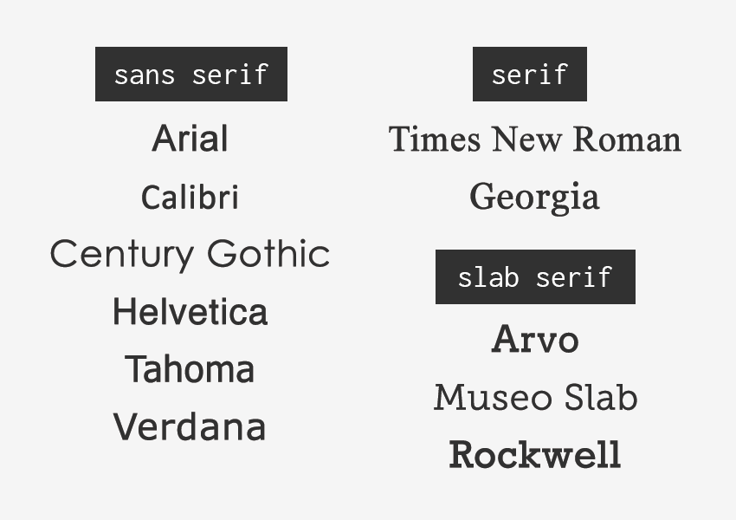
Font Choices

Slide 54
Color Choices

Slide 55
Validating your work
Use a screen reader
Adobe Read Aloud, Windows Narrator, NVDA
Use your keyboard
Can you access all form fields via tab?
Is the order correct?
Solicit feedback from an AT user

Slide 56
Wrapping Up
Forms used for many interactions and information sharing
More accessible for all!
Avoids printing and scanning
Productivity with digital versions
Focus should be keyboard accessibility and proper order with labeling
Always solicit feedback!

Slide 57
Contact Information
Sharon Rosenblatt: SRosenblatt@AccessibilityPartners.com
www.AccessibilityPartners.com 301-717-7177
www.facebook.com/AccessibilityPartners
@Access_Partners

Slide 58
Resources
University of Washington: Overview of Accessible Documents
Section 508 Resource from the Health Resources and Services Administration
Creating Accessible Forms from WebAIM
Karlen Communications: Accessible Documents Information
GSA: Section 508 Guide to Accessible Documents
PDF Techniques from the W3C

