Slide 1
Inclusive Hiring for Professionals in the Arts
2019 LEAD Conference August 7, 2019
Sharon Rosenblatt

Slide 3
Session Goals
Go beyond the feel-good factor
Learn how to market job listings accessibly
Have a greater understanding of the role of accessible and assistive technology in:
Hiring, training, management, and retention
Support employees with accommodations
Find innovative/out-of-the-box solutions to support your

Slide 4
A quick refresh or intro….

Slide 5
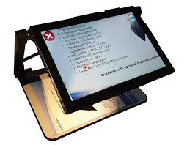
What is Assistive Technology?
Increase, maintain, or improve
Creates a diverse/inclusive workplace
Essential to support job functions
Communication and organization
Promotes independence

Slide 6
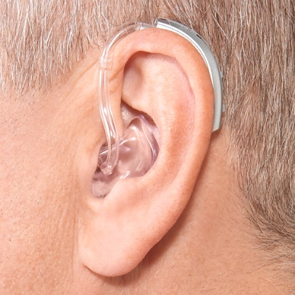
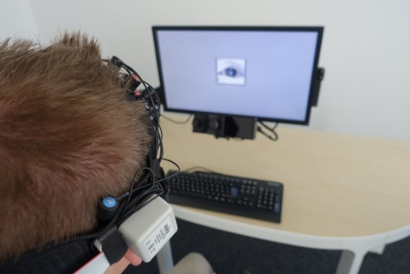
Types of Assistive Technology
Screen readers
Voice recognition
Hearing aids
Reading assistants
Closed captioning/subtitles
Motion or eye tracking
Refreshable Braille displays

Slide 7
What is Accessible Technology?
Technology designed to meet needs of users
Incorporates assistive technology
Customizable tools:
VoiceOver, Narrator, Magnifier
Browser support
Benefit people with disabilities, but universal design can benefit anyone!

Slide 8
The Danger of Inspiration

Slide 9
Reframing the Narrative

Slide 10
Why the Hesitation?
Disability stigma
Perceived liability/lawsuit
Fear of extra cost
Worries about safety

Slide 11
Need Some Reasons?
Market your culture of inclusion
Smithsonian Institute
Stronger relationships
Accessibility for All
Stay ahead of technology trends
AbilityNet Theatre
Diverse solutions=better products
Kennedy Center LEAD

Slide 12
“Businesses that embrace disability inclusion have found there is a positive correlation between their profitability, employee morale and engagement.
Shawna Berger, previous Director of Marketing and Communications at Disability:IN (formerly USBLN).

Slide 13
The Current Landscape of Hiring and Recruiting

Slide 14
What is ODEP?
Office of Disability Employment Policy
Non-regulatory federal agency
Promotes policies
Coordinates with employers
Increase workplace success via:
Employer Assistance and Resource Network on Disability Inclusion (EARN)
Job Accommodation Network (JAN)
Partnership on Employment and Accessible Technology (PEAT)

Slide 15
Current Statistics: June 2019

Slide 16
Unemployment Rate

Slide 18
Job Search Trends: Recent Hires
41% online job board
Women are more likely to find a job through an online job board (44%) than men (33%)
61% automatic job alerts
25% networking
Men and women are equally likely to find a job through networking

Slide 19
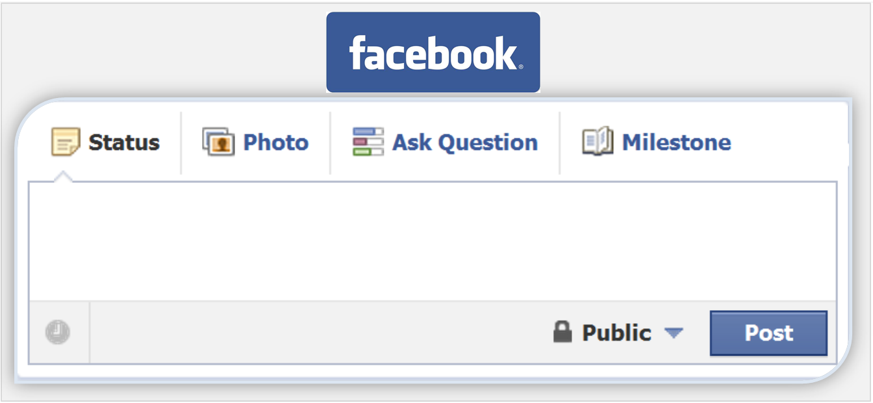
More than 1 in 10 recent hires (14%) found their current role through social media!

Slide 20
Job Search Trends for PWD
AAPD Career Center
abilityJOBS
disABLED Person
Disability:IN
Enable America.org
Getting Hired
Hire Disability Solutions
IMDiversity
LandAJob
One More Way
Think Beyond the Label
USAJobs

Slide 21
College Students
Workforce Recruitment Program
Career Opportunities for Students with Disabilities
Lime Connect
EARN Internships and Apprenticeships
Disability:IN NextGen Leaders

Slide 22
The Power of Apprenticeships
Classroom instruction with job training
Bridge skills gaps
Diverse talent in the workplace
Various industries
#ApprenticeshipWorks

Slide 23
The Details from DOL
Business involvement tailors training
Structured, hands-on training in a workplace
Overseen by an experienced mentor
Job-related instruction
Collaboration with education partners
Rewards for skill gains, with pay from day one
Increases as apprentices gain higher skill levels
A nationally recognized credential

Slide 24
I’m In! What’s Next?

Slide 25
Advertising Your Commitment
Work with state and local service providers
Rehab facilities, American Job Centers, Centers for Independent Living, community orgs.
Use the job boards and veterans recruitment

Slide 26
When Posting Online…
Consider the accessibility of the website
Does the host have an accessibility statement or commitment?
How inclusive is your language?
Consider job requirements
Ticketing scenario
Is what you’re asking of applicants necessary?

Slide 27
Quick Question/Answer
What are essential functions?
Employer requirements
What are reasonable accommodations?
What is considered reasonable?

Slide 28
Common Barriers: Recruiting
Nearly half of job seekers report online application process is: “difficult to impossible” for these reasons:
Cannot be navigated with screen readers
No keyboard navigation
Applications rely on color
Images without alternative text
Videos lack captions
Time assessments
No contact information

Slide 29
Don’t Panic!
Little steps at once
Work with an accessibility company
Feedback from people with disabilities
Good communication

Slide 30
The Job Interview
Advertise reasonable accommodations
Be transparent with expectations
Ask about skills, abilities, training, credentials

Slide 31
Focus on Your Hiring: Recruiting Applicants with Disabilities Online

Slide 32
TechCheck
Time to benchmark!
https://www.peatworks.org/techcheck

Slide 33
Your Access to Accessibility
Committing to an accessibility mindset
Who are your top leaders?
Find your applicable standards
Create your business case

Slide 34
Packing Your Business Case
Not all applicable—these are most cited:
Accessibility fuels productivity
Less expensive to do it right the first time
Mitigate legal risk
Improved and expanded recruitment
Boosts employee retention
Workplace diversity

Slide 35
Considerations for Your Staff…
Determine your employees and staff
Ability to customize for individual needs
Harder to retrofit: costly and inefficient
Consider universal design:
Widest possible user base

Slide 36
What Standard Applies to You?
Americans with Disabilities Act
Web Content Accessibility Guidelines (WCAG)
Section 508
Europe: EN 301 549
Japanese Industrial Standard (JIS) X 8341-3
21st Century CVAA

Slide 37
What about the ADA?
The American with Disabilities Act applies to technology:
Helped to ensure that people with disabilities can access Web sites, electronic book readers, online courses, and point-of-sale devices.
Title I: Employment
Title II: State and Local Governments
Title III: Business and Non-Profit Orgs

Slide 38
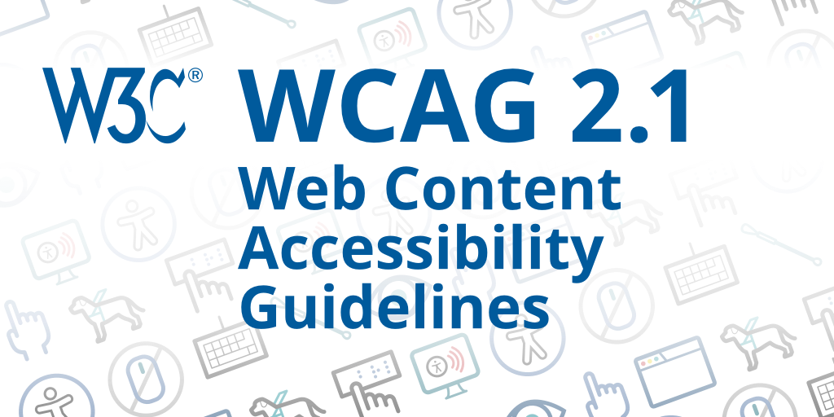
What is WCAG 2.0/2.1?
Web Content Accessibility Guidelines
Via the World Wide Web Consortium (W3C)
Cooperate of individuals and organizations
Single shared standard for web accessibility
Designed for:
Individuals
Organizations
Governments
An international best practice

Slide 39
What is Section 508?
Applies to Federal departments and agencies
Does not apply to private sector
Requirements:
Develop, procure, maintain, or use accessible tech
Unless it poses an undue burden
Comparable access to people without disabilities

Slide 40
What is EN 301 549?
Public procurement of products and services in Europe
Digital accessibility consistency
Published in 2014
EU members incorporate in 2018

Slide 41
Who Controls the Wallet?
Consider requirements and your needs
Identify your team of stakeholders
Define your scope:
Whether for 1 or 100 products
Do you solicit and evaluate?
Include more people! Leads to positive outcome

Slide 42
Bringing it All Together!
What to expect:
If applicable: Contracting/solicitation language
Do you have a formal accessibility process?
Are you looking at support documentation:
Market research
VPATs
Test results
Real-life feedback
How do you ensure? Testing?

Slide 43
Your Solicitation
RFI, RFP, or RFQ?
Specify your needs
Product demands/requirements
According to GSA’s Guidance on Creating 508 Compliant IT Solicitations:
“a well-written solicitation goes a long way toward ensuring agency compliance and accessible IT.”

Slide 44
Evaluating Responses
Assemble your experts
Accessibility is a key consideration
Understand your standards and requirements
Include people with disabilities
Look for support/proof:
Accessibility Conformance Report
https://www.section508.gov/buy/request-accessibility-information
VPAT 2.3

Slide 45
The VPAT
“Voluntary” Product Accessibility Template
Section 508, WCAG 2.0/2.1, and EN 301 549
Comprehensive analysis of key accessibility requirements
Outline level with explanation
Created by ITIC
Make equal assessments for buyers

Slide 46
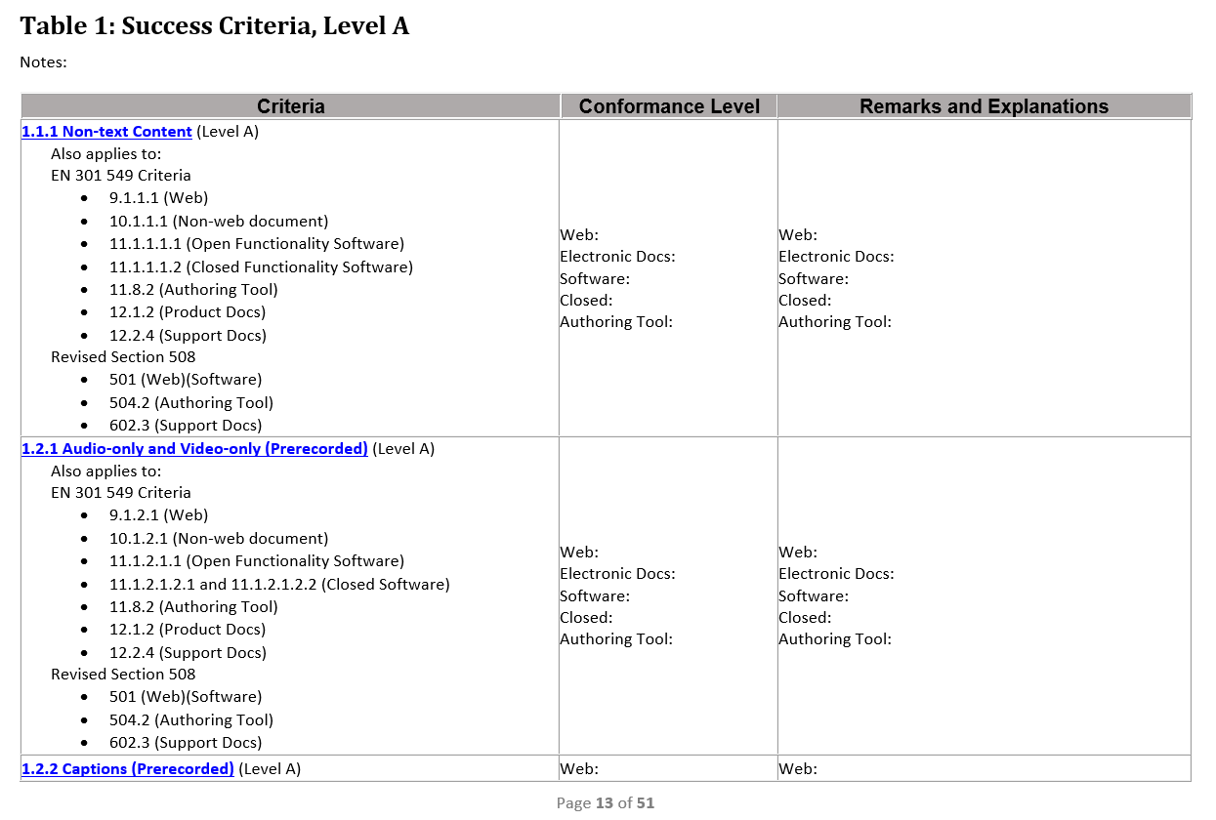
The VPAT

Slide 47
Is What We Bought Accessible?
See if you have options just in case
Some suggestions:
Comprehensive testing (automated)
Check compatibility with AT types (screen readers)
Product documentation
Share results with the vendor: apply pressure

Slide 48
Accessible Technology and Your Workplace

Slide 49
So, You Bought Accessible IT…
Mostly everyone wants to be inclusive, but how do you implement?
Focus on understanding:
Do you need more training?
Do we need professional development?
How is this playing out for our staff?
Attitudes and responses

Slide 50
Training Goals and Subjects
Disability basics
Typical barriers: simulations and solutions
Advantages for inclusion
Value of accessibility solutions
Commitment to preventing inaccessibility

Slide 51
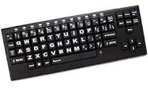
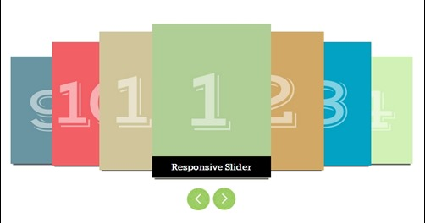
Becoming an Accessibility Expert
Assistive technology compatibility
Alternative text
Keyboard accessibility
Controls for moving content
Timed content

Slide 52
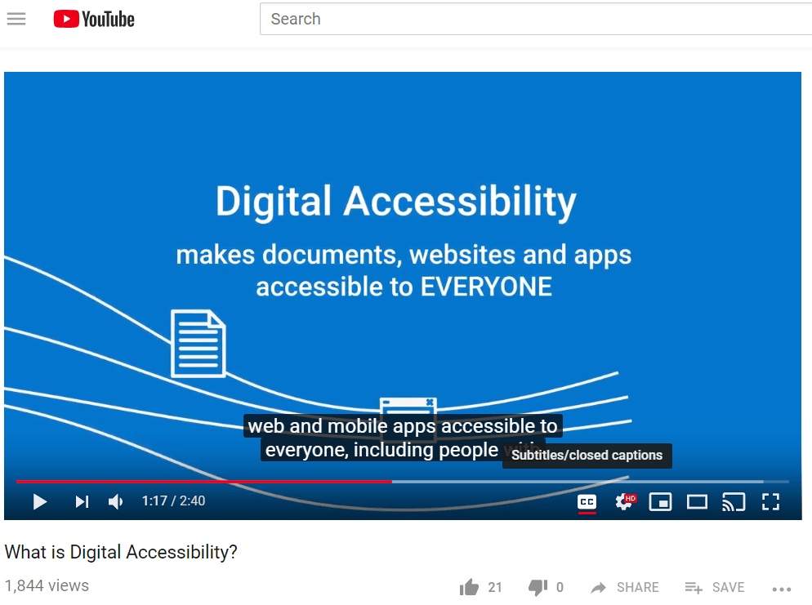
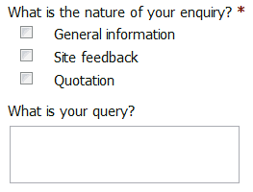
Becoming an Accessibility Expert
Labeled forms
Color contrast/usage
Downloadable files
Language
Captions

Slide 53
Staff Training and Development: eLearning
Vision Loss
Zoom, screen readers, keyboard accessibility
Hearing loss
Captions and transcripts
Cognitive/Learning Disabilities
Understand/comprehend content, recognize information, time restrictions
Color and fonts
Clear navigation

Slide 54
Accessible Training
Variety of formats: Braille, Large Print, captions, transcripts, ASL
Universal Design Language: UDL
Equal opportunities to succeed, no matter how your participants learn
Use inclusive images
Language/identification of attendees

Slide 55
Accessible Solutions: Productivity
Focus on digital content
E-mail
Documents (Word/Excel/PDFs)
Presentations (PowerPoint, Google)
Images
Social media (Tweets/Facebook)
Multimedia (YouTube)
Content management systems (web updates)

Slide 56
Performance Reviews
Written performance expectations
Apply standards uniformly
Recognize disclosure
See how accommodations are implemented
Document the process

Slide 57
Accommodation Types

Slide 58
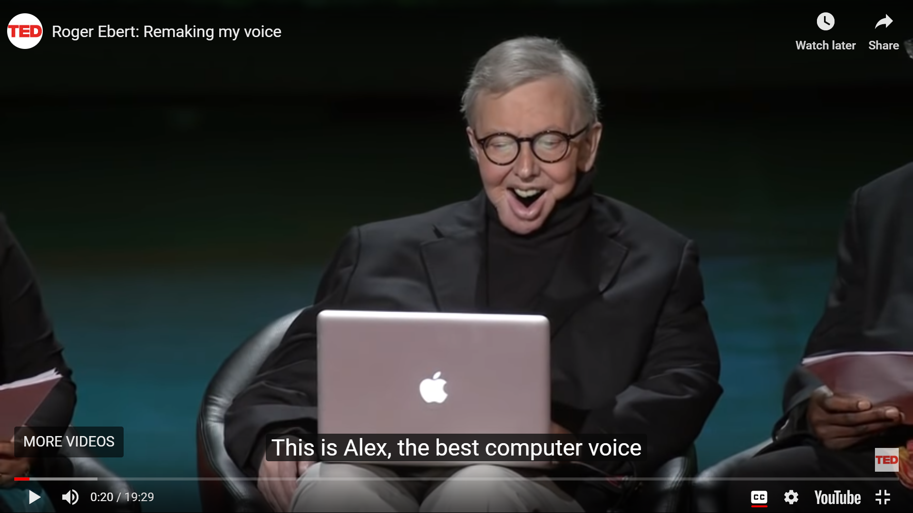
Workplace Trends in AT
Artificial Intelligence
Predictive text
Visual recognition
Speech-to-text transcription
Examples:
Seeing AI
Prologuo2Go app
IntelliGaze
AI for Accessibility

Slide 59
Example: Seeing AI

Slide 60
Rolling Chair: Promoting Dance

Slide 61
Trends in Assistive Technology
Intelligent Voice Assistants
Amazon Echo
Google Home
Connect workplace to make environment accessible
Simulate conversation and integration of apps
Make calls, schedule appointments
Adjust other devices

Slide 62
What’s Next? Events and Resources
Events:
AccessU (Austin, TX)
Accessing Higher Ground (Denver)
CSUN Assistive Technology Showcase (California)
mEnabling (Washington, DC)
Organizations:
Intl. Association of Accessibility Professionals
Society of Human Resources Management
TeachAccess
Disability:IN
G3ICT

Slide 63
How Can I Make This Happen?
Funding available: public and private
Tax incentives for hiring and retaining
States and university lending library
Try before you buy!
ATIA: Resources Funding Guide
Americans for the Arts Funding Resources
EARN: Employer Financial Incentives

Slide 64
Wrapping Up
Hiring people with disabilities works!
Positive experience
Accessibility for procurement and productivity
Always include people with disabilities
Stay ‘in the know’: new things always developed and talked about

Slide 65
Contact Information
Sharon Rosenblatt: SRosenblatt@AccessibilityPartners.com
www.AccessibilityPartners.com 301-717-7177
www.facebook.com/AccessibilityPartners
@Access_Partners

Slide 66
Resources
Getting Hired: Top Assistive Technology Trends in the Workplace in 2019
U.S. Access Board
Mandate 376: Accessible ICT Procurement Toolkit
W3C Introduction to WCAG
Huffington Post: Why Hire Disabled Workers? 4 Powerful (and Inclusive) Companies Answer
Clutch: How Do People Find Jobs?
SHRM: Can People with Disabilities Use Your Careers Website?
PDF: Pre-Employment Screening Considerations and the ADA from Cornell Unversity ILR School
ADA.gov Technical Assistance and Guidance
Section 508.gov Guidance on Solicitations
6 Tips For Designing Accessible eLearning
AskJAN: Performance Management and Employees with Disabilities
Training Employees With Disabilities: Creating an Inclusive Workplace
Roger Ebert: Remaking my voice

